Slide 1
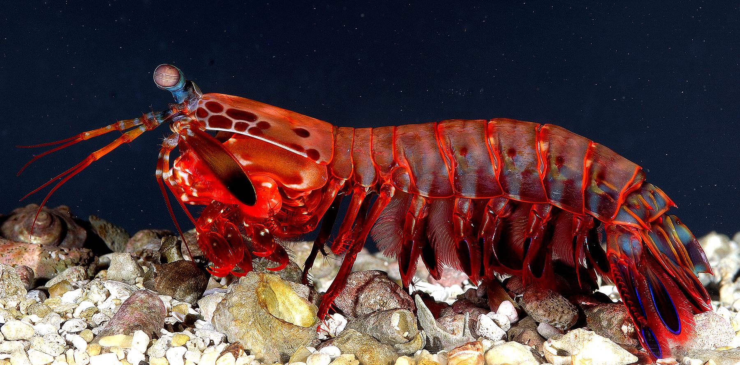
Crustacea
Subphylum of Arthropoda
Mostly Aquatic
Two pairs of antennae, mandibles, pair of appendages on each segment of their body.
Notes:
C

Slide 2
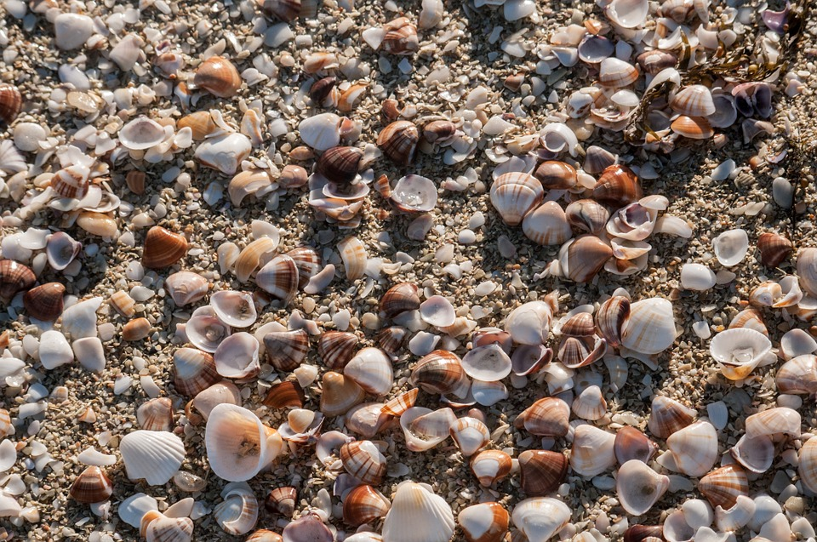
Mollusca
Gastropods - Snails (Single Shell)
Bivalves - Clams (2 Shells)
Cephalopods - Squid and Octopus (Internal Shell)
Bilateral Symmetry
Radula & Foot Structure
Sexual Reproduction
Notes:
M

Slide 3
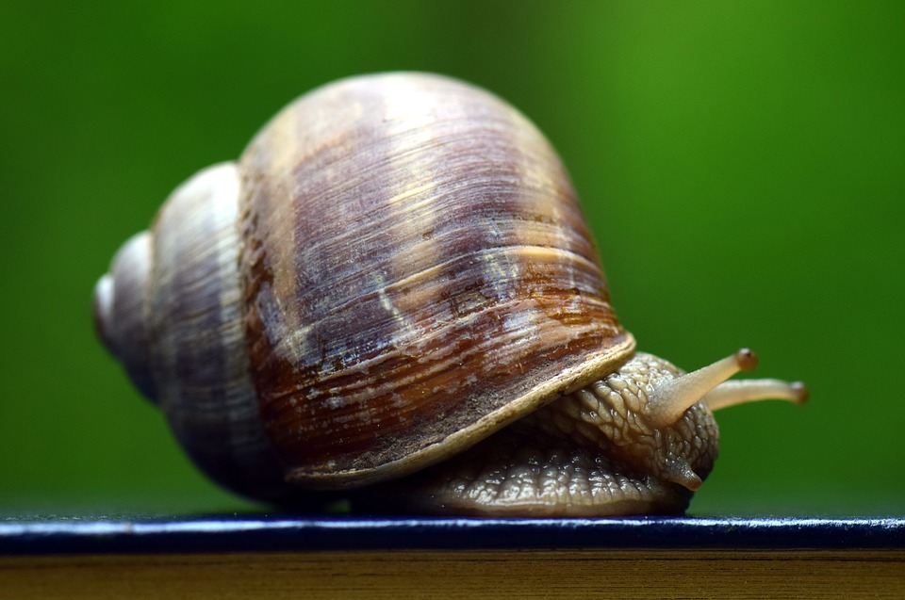
Gastropoda
Class of Mollusks
Single Shell
Radula for Feeding
Foot Structure for Motion
Sexual Reproduction
Notes:
P

Slide 4
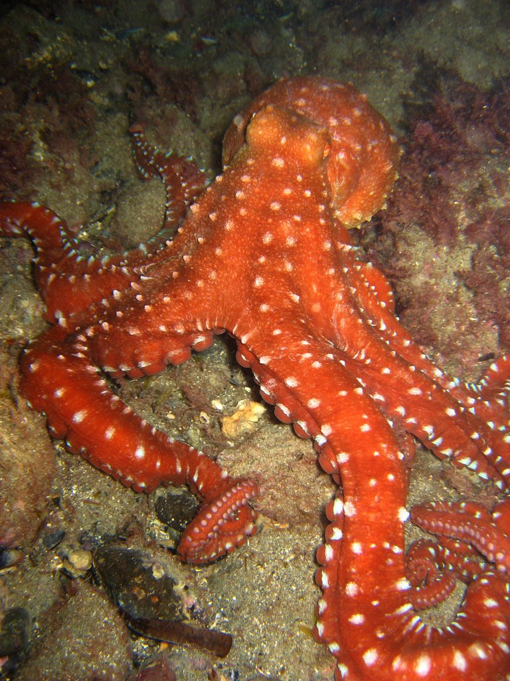
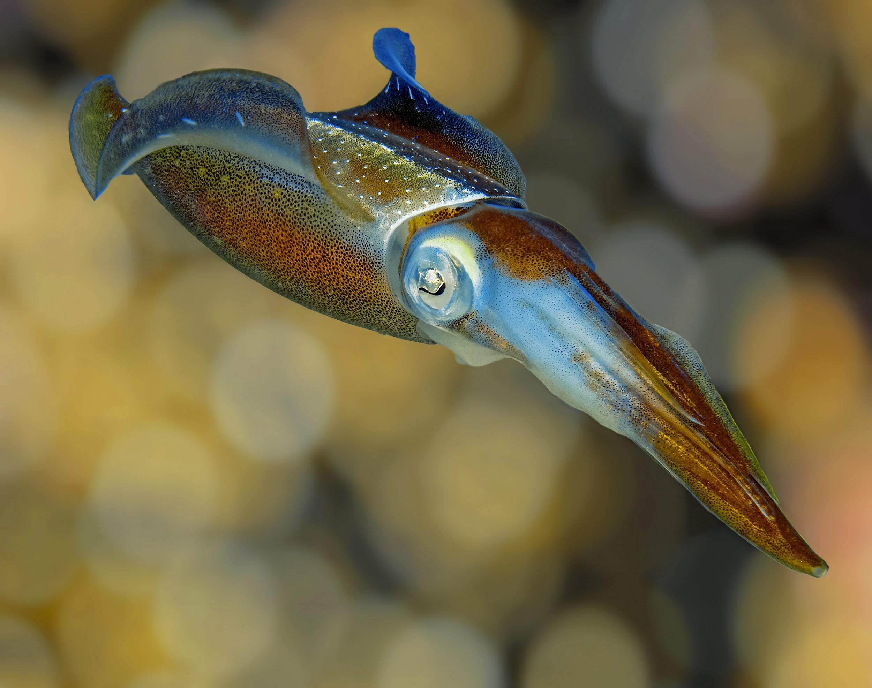
Cephlapods
Class of Mollusks
Well developed head region = cephalization
Use jet propulsion to move through the water
Notes:
H

Slide 5
Phylum Chordata
Subphylum Vertebrata
Vertebrates
These organisms have a dorsal nerve cord and vertebrae.
Bilateral Symmetry
Notes:
!

Slide 6
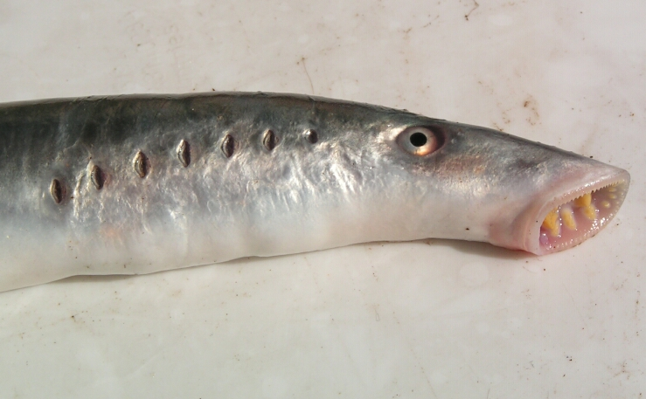
Agnatha
Lamprey and Hagfish
Vertebrate Made of Cartilage
Lack Scales
Ectothermic
External Fertilization
Have Slimy Skin
A.K.A. Jawless Fish
Notes:
T

Slide 7
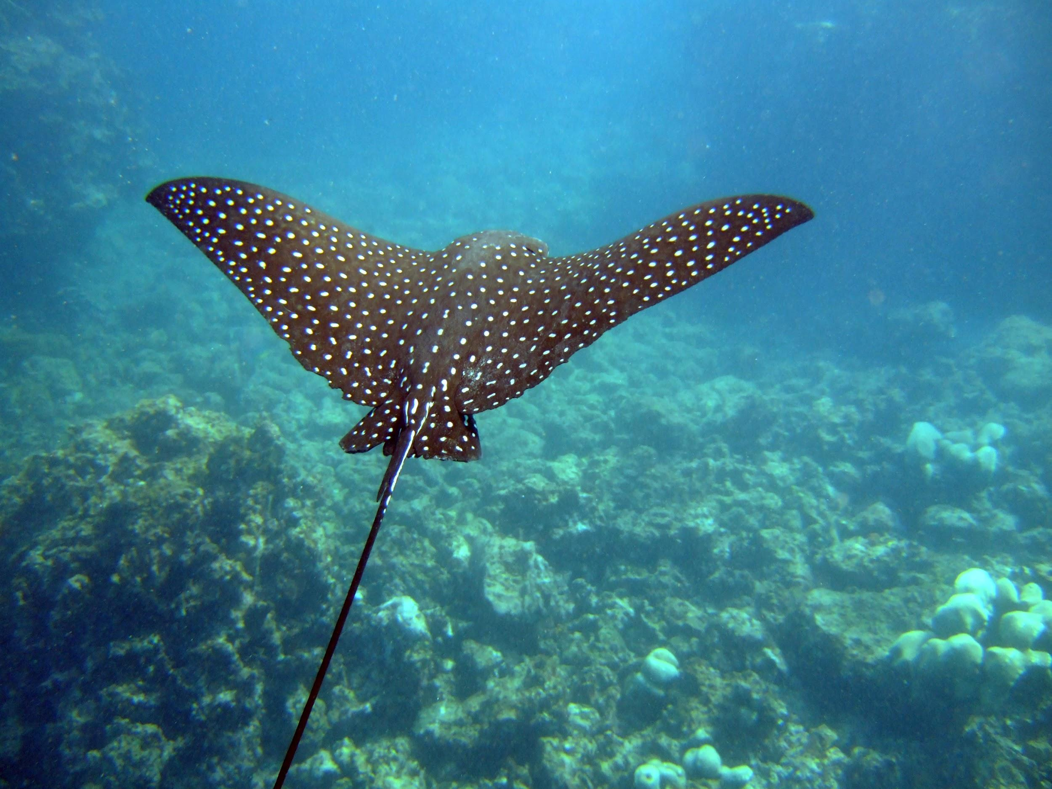
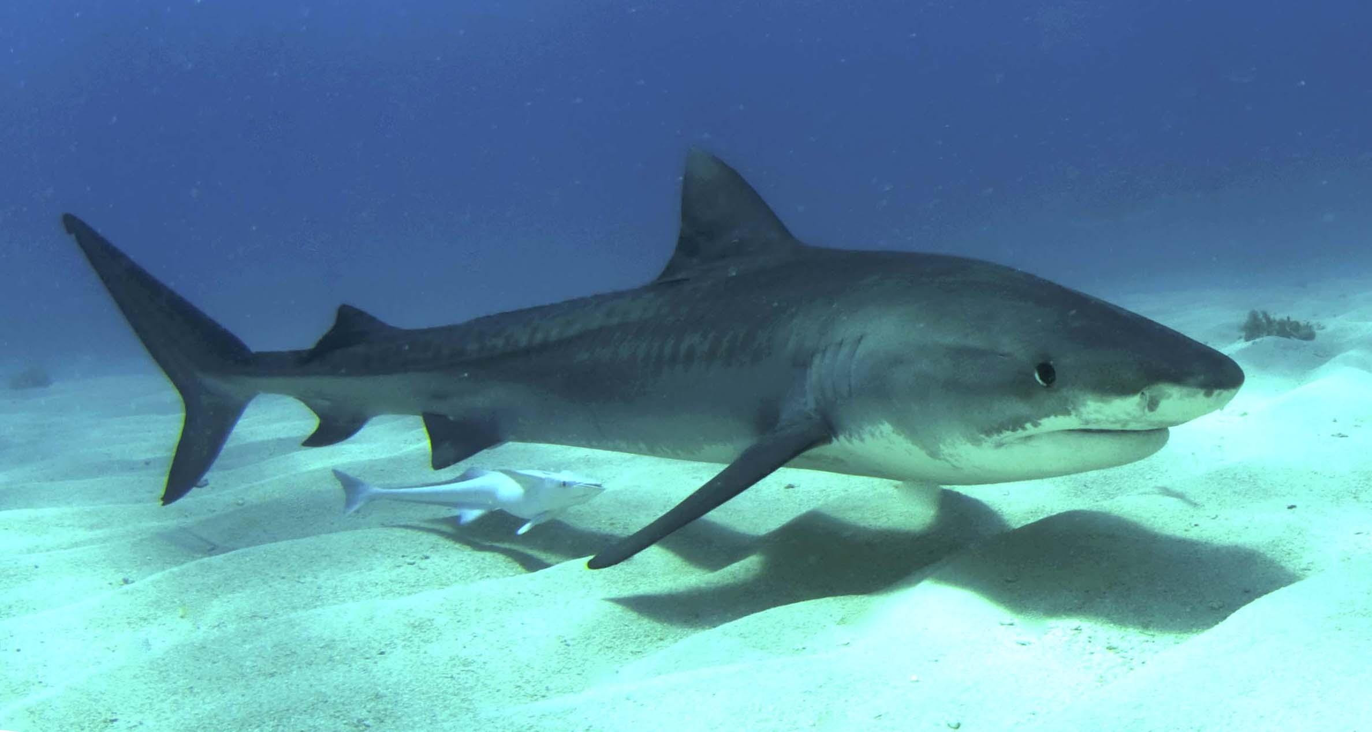
Chondrichthyes
Cartilagenous Fish (Bone is actually cartilage)
Sharks, Skates, and Rays
Scales
Ectothermic
2 Pairs of Fins
Internal Fertilization
Notes:
D

Slide 8
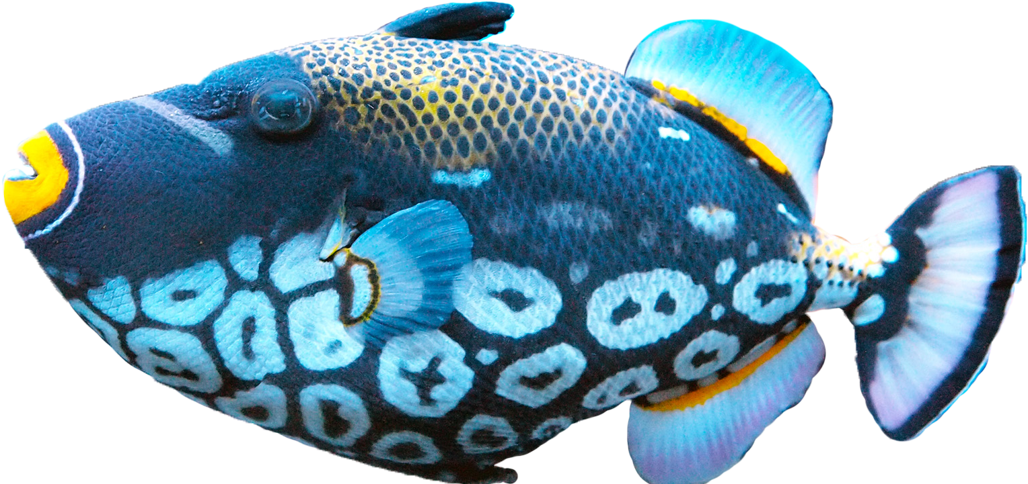
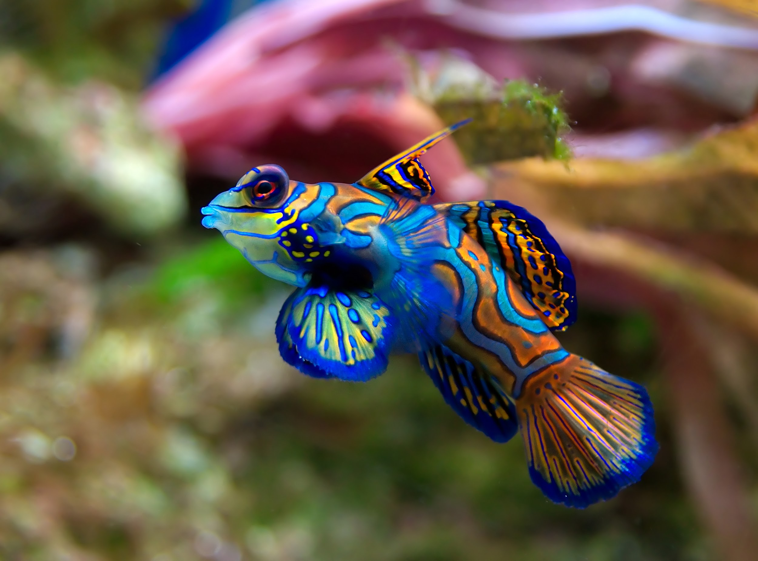
Osteichthyes
“Bony Fish” True Bone for a skeleton
Ectotherm
2 pairs of fins and Gills
External fertilization
Have a swim bladder to keep them buoyant
Trout, Bass, Flounder
Notes:
N

Slide 9
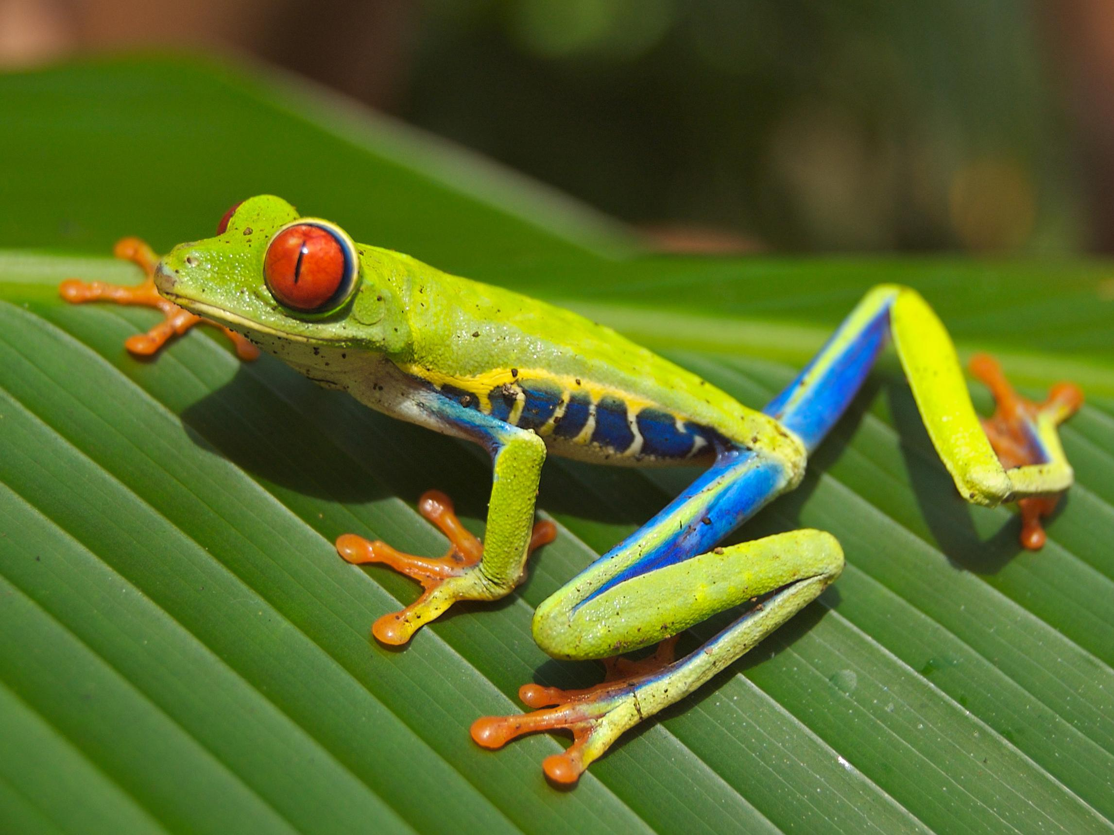
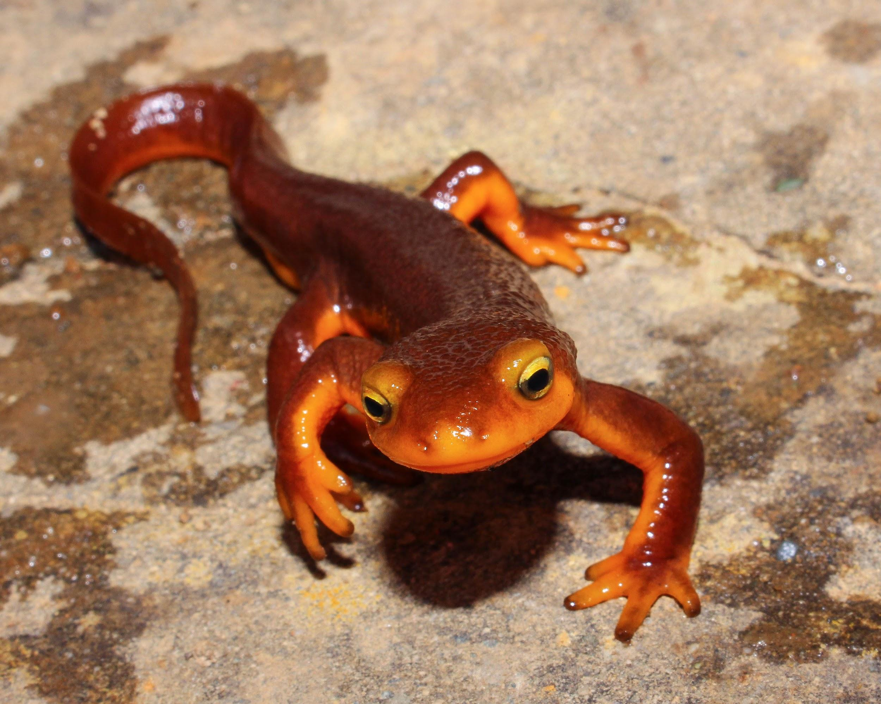
Amphibia
Can live on land but must return to water for reproduction.
Lay Eggs/External Fertilization
Slimy Skin, Scale-less
Gills as juveniles and lungs in adult mature forms.
Frogs, Toads, Salmanders
Notes:
Y

Slide 10
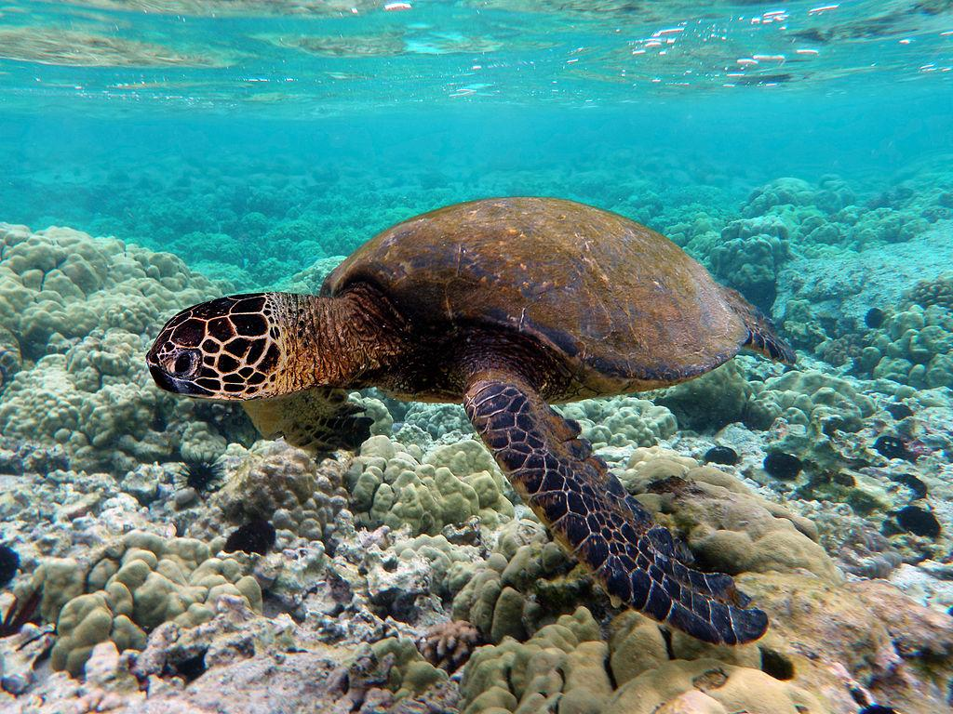
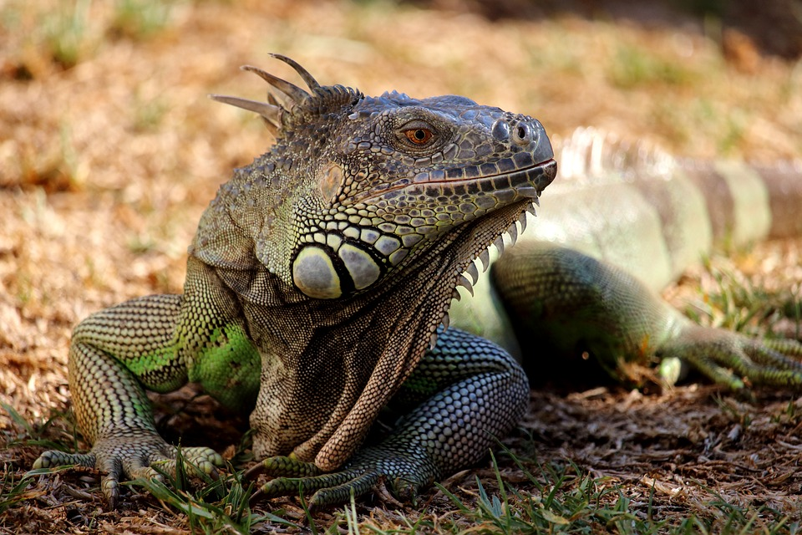
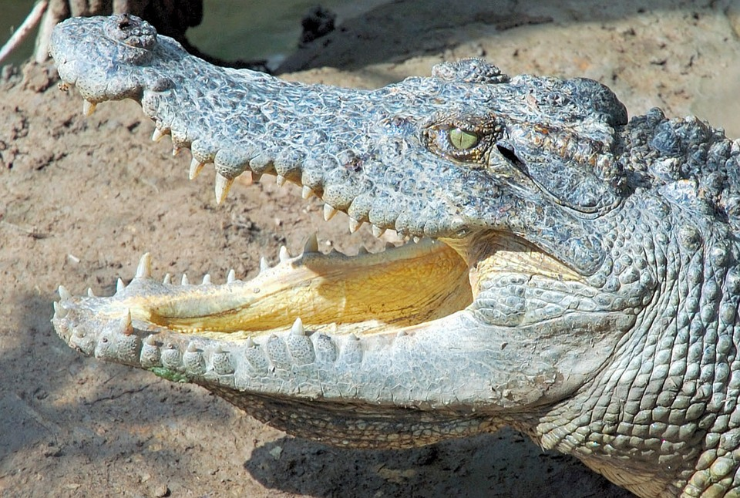
Reptilia
Dry, Scaly Skin
Ectothermic
2 Pairs of Legs
Lungs
Lay Eggs on Land
Internal Fertilization
Turtles
Crocodile
Alligator
Lizard
Snake
Notes:
I

Slide 11
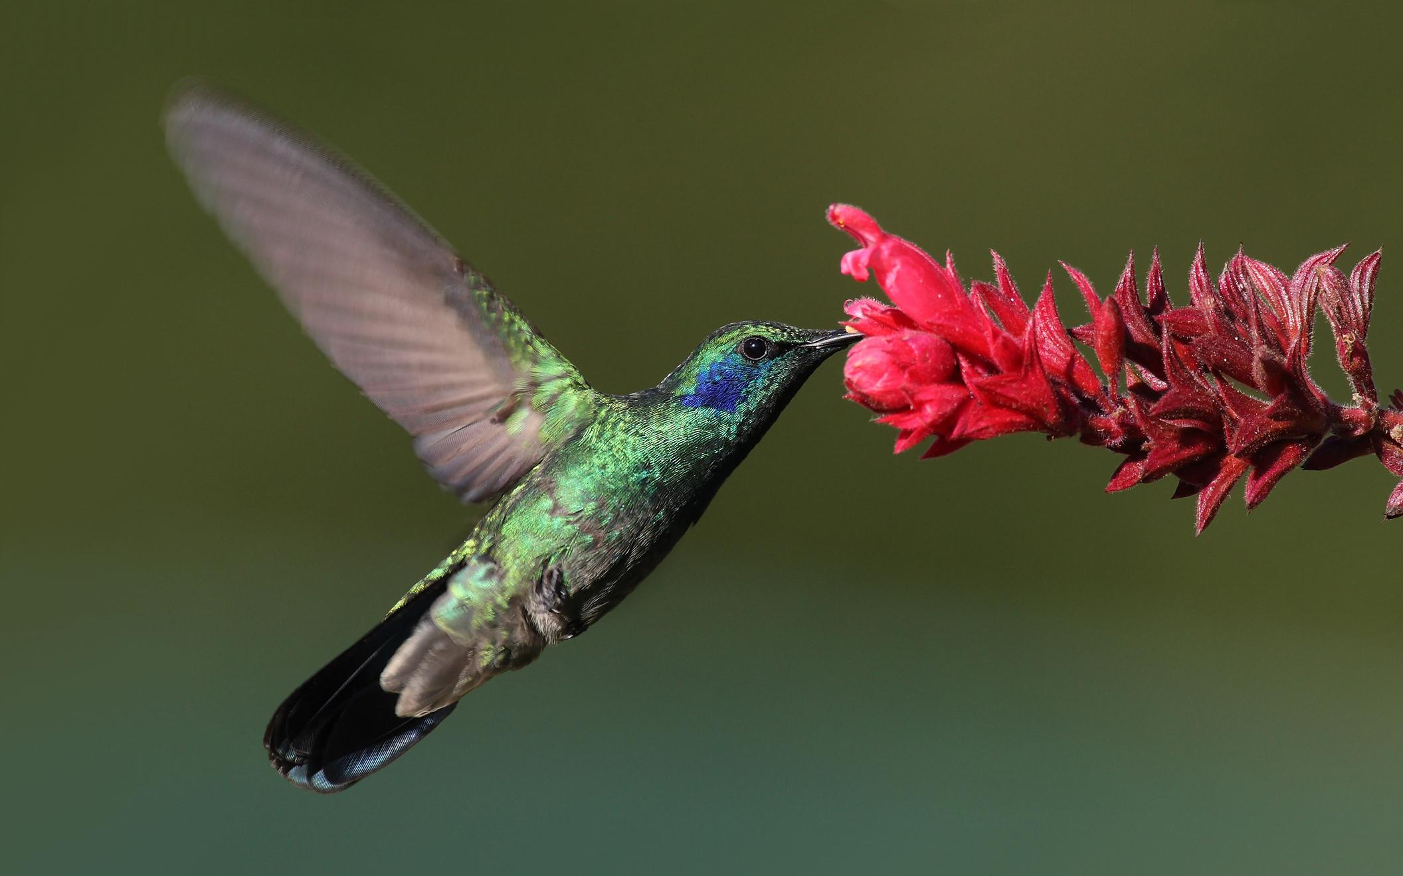
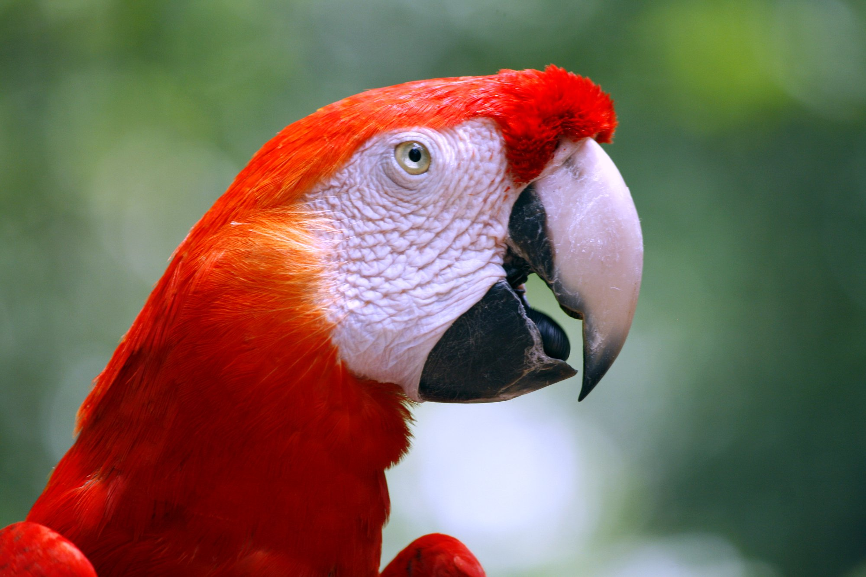
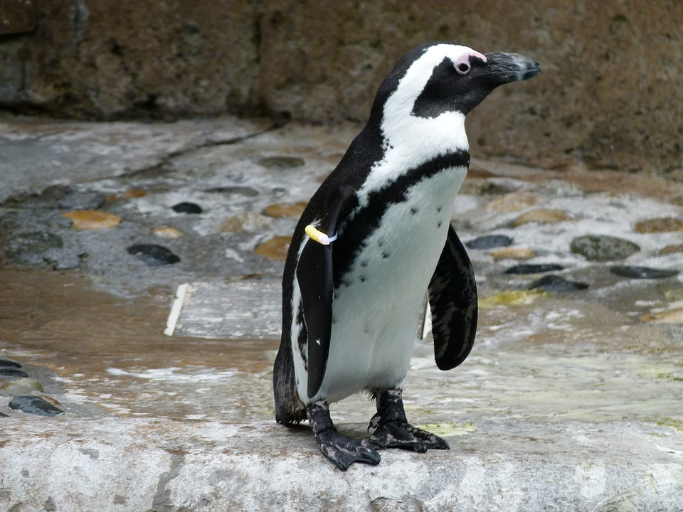
Aves
Penguin
Macaw
Turkey
Feathers (Modified Scales)
Scales on Legs
Endothermic (Homeostasis)
Internal Fertilization
Hollow Bones
Notes:
S

Slide 12
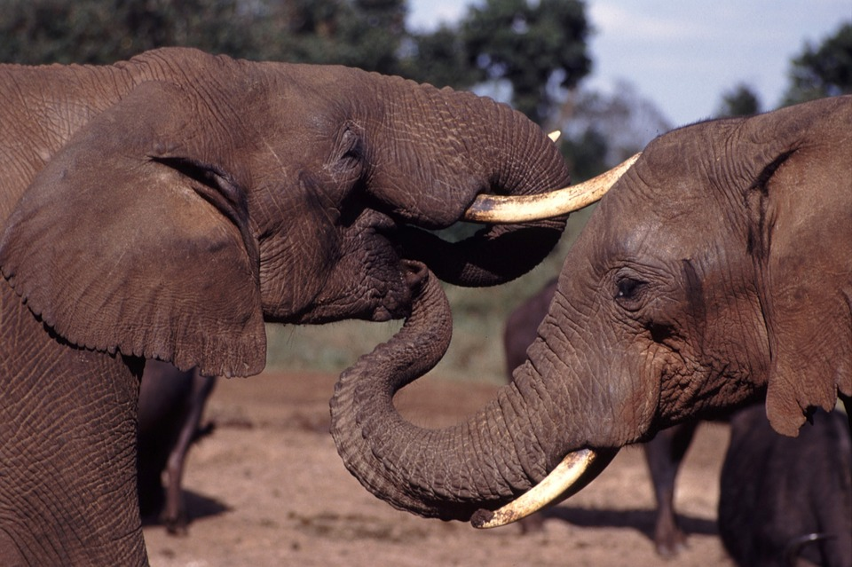
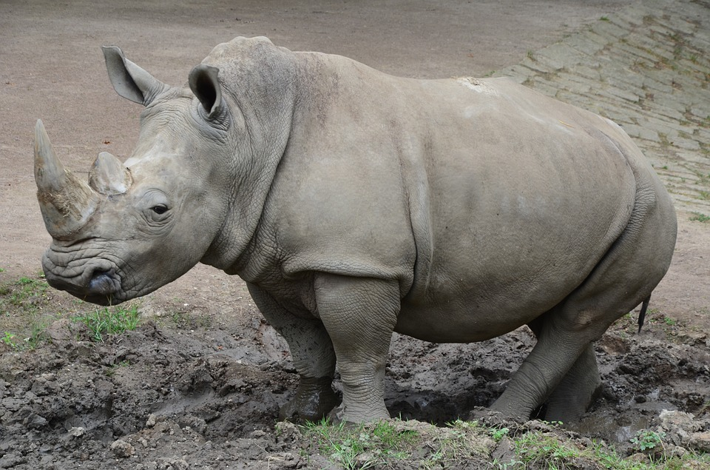
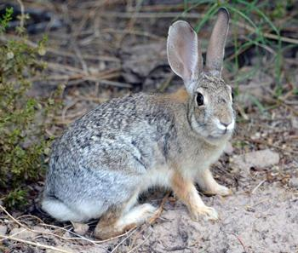
Mammalia
Elephants
Rhinoceros
Rabbits
Hair/Fur
Endothermic
Lungs
Internal Fertilization
Mammary Glands
Notes:
O

Slide 13
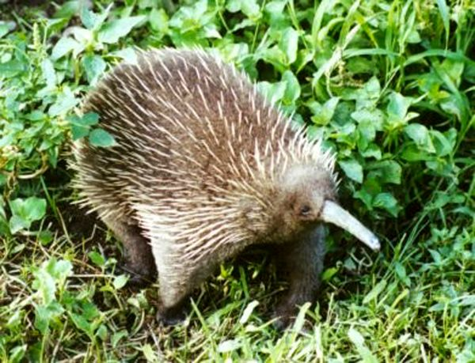
Monotremes
Subclass of Mammals
Mammals that Lay Eggs
Highly Modified Snout or Beak
Platypus
Notes:
E

Slide 14
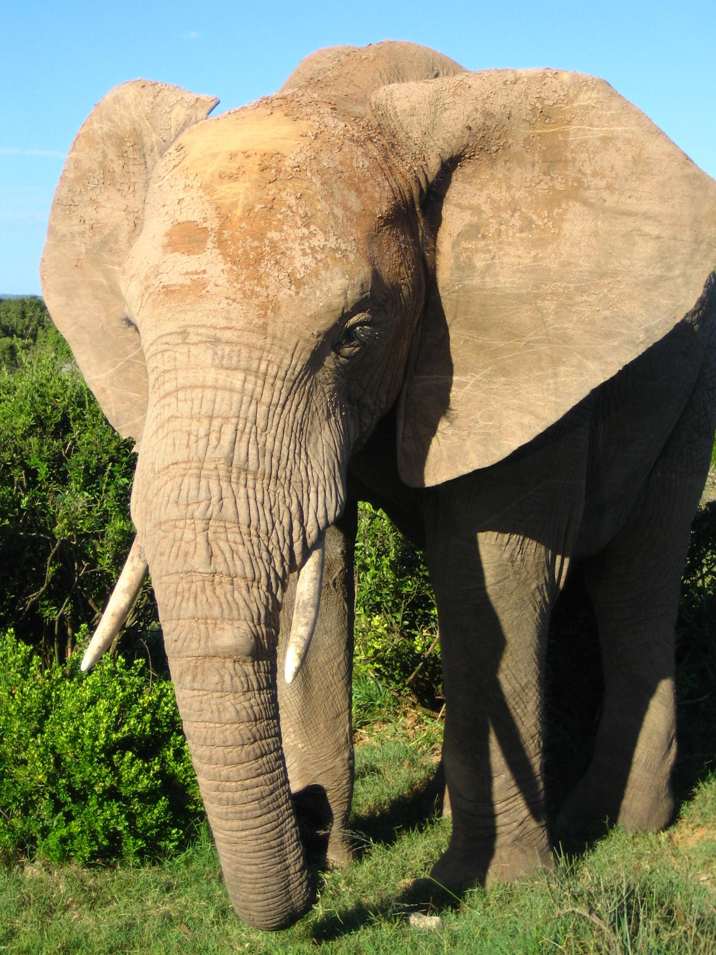
Placental
Subclass of Mammals
Mammals that bear live young.
Nourished before birth by the mother.
Elephant
Notes:
J

Slide 15
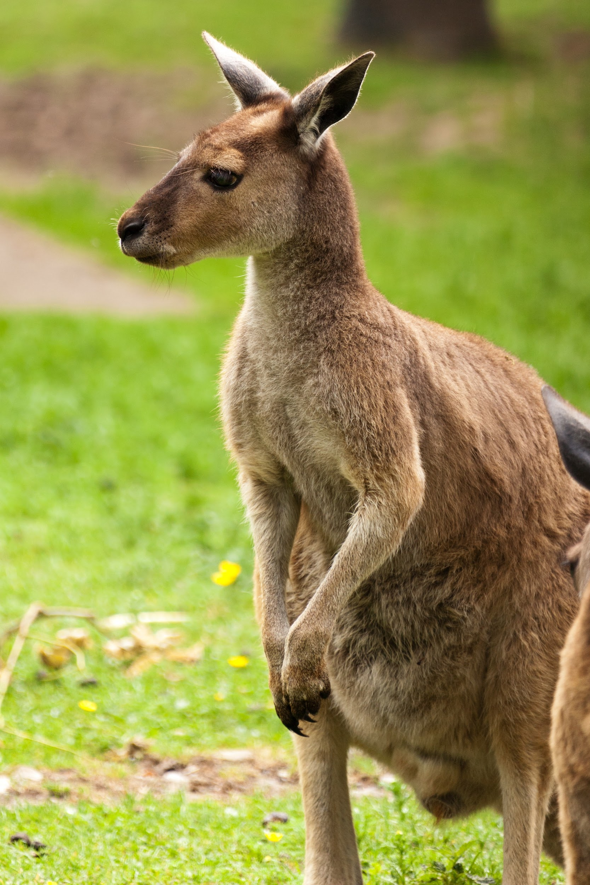
Marsupials
Subclass of Mammals
Mammals that give live birth and continue early development within a pouch
Kangaroo
Notes:
U

