Slide 1
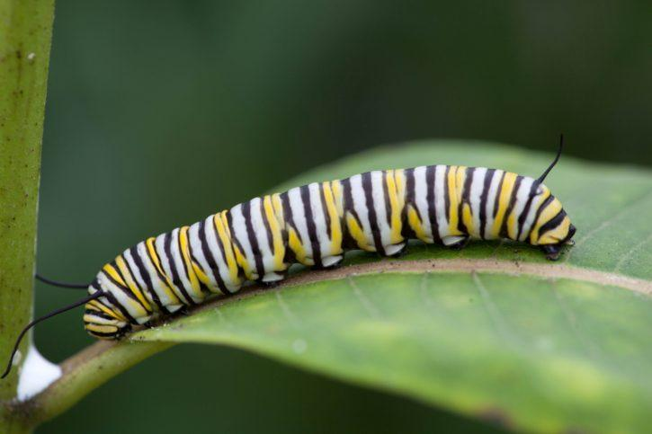
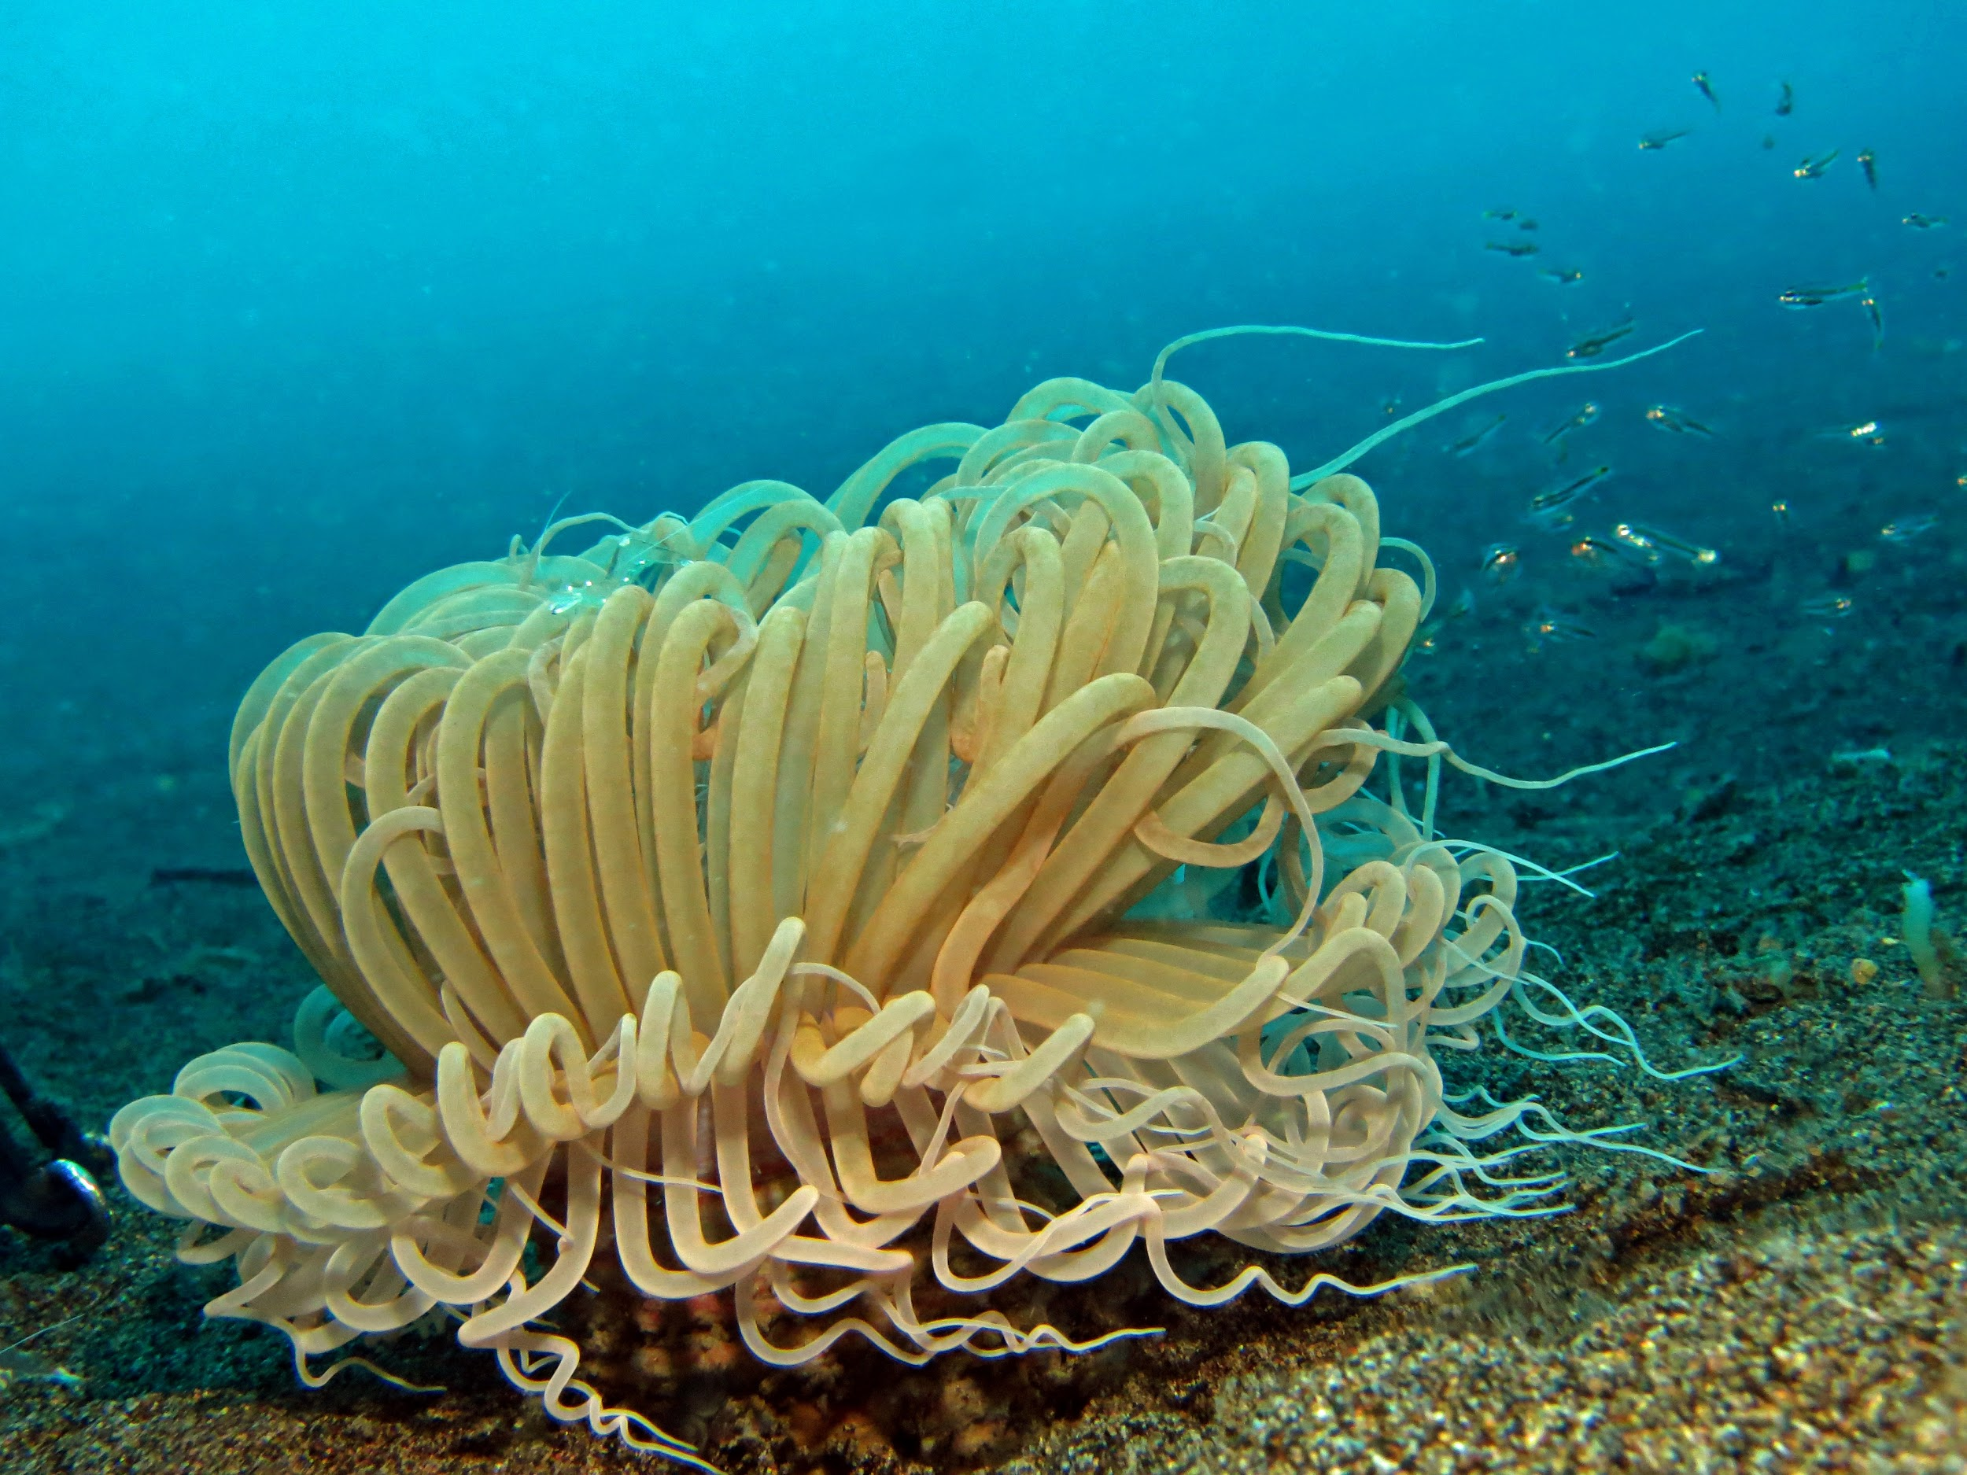
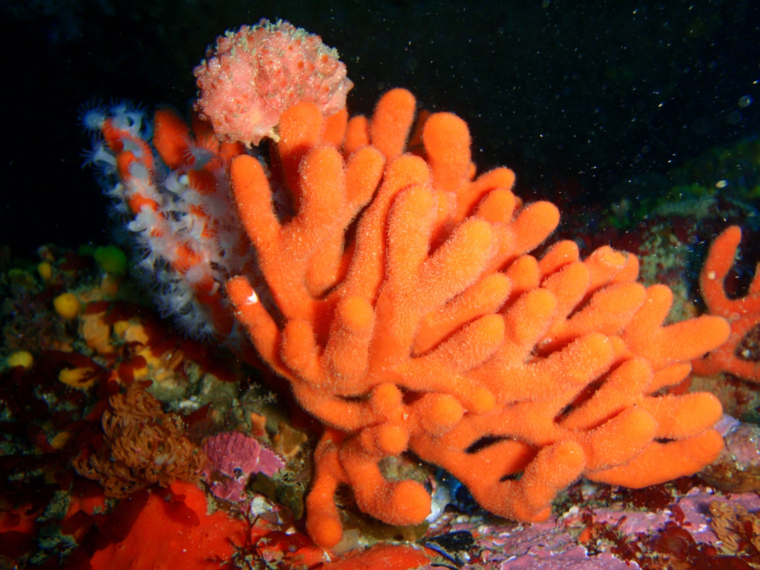
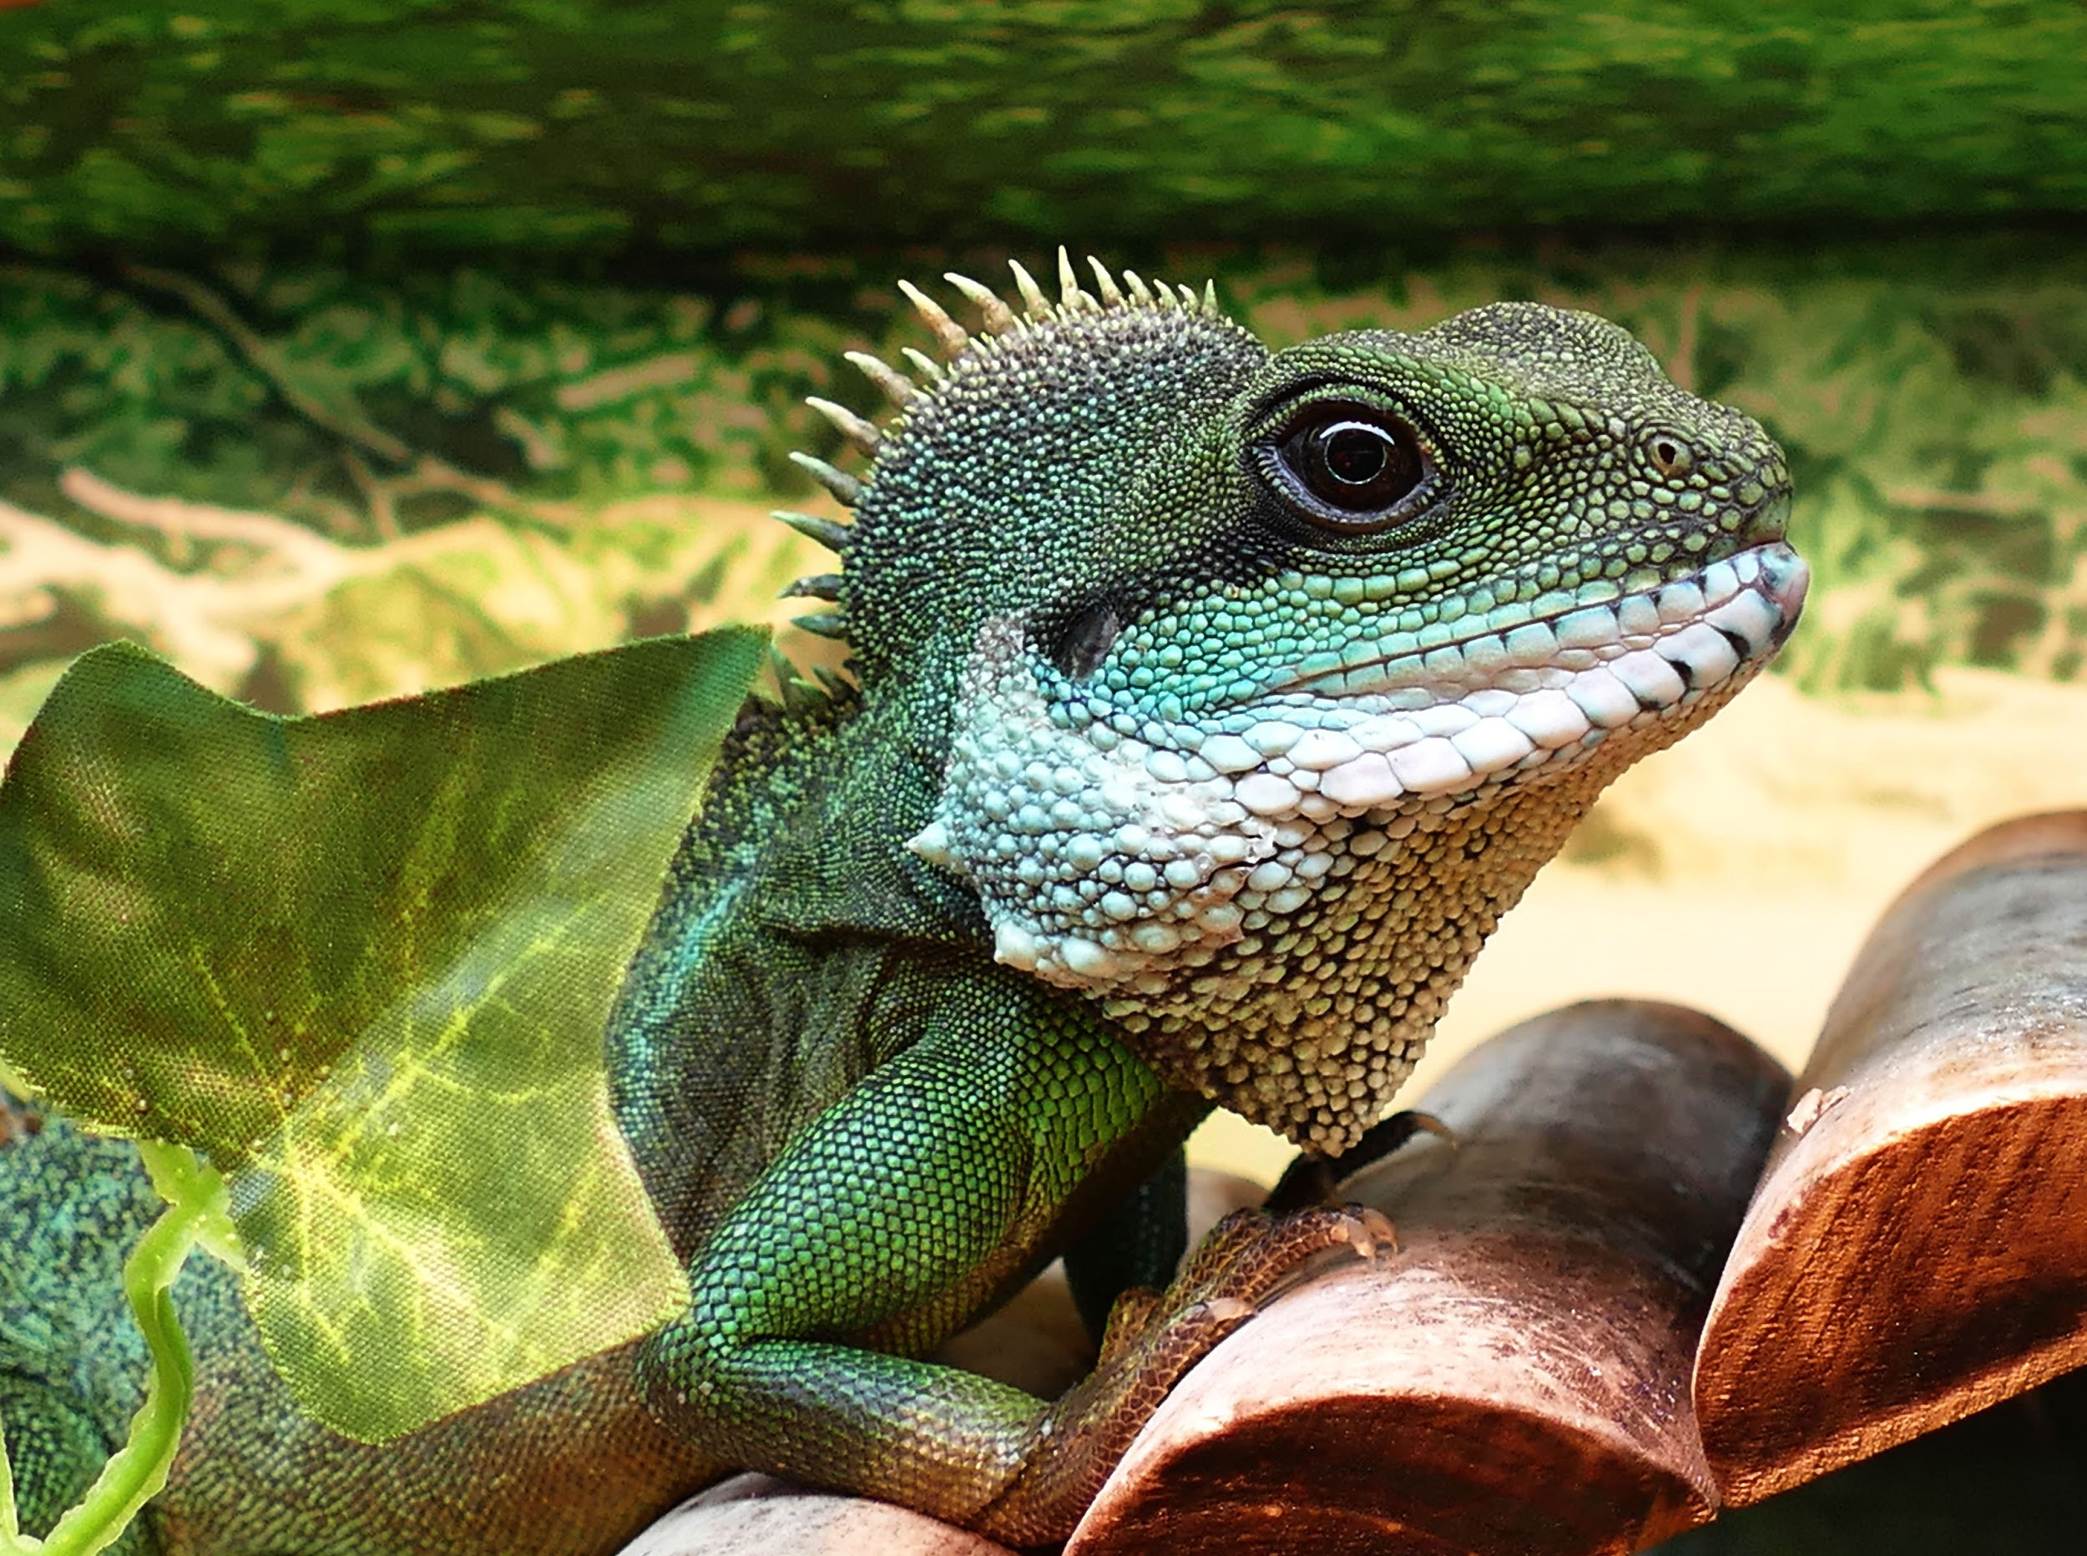
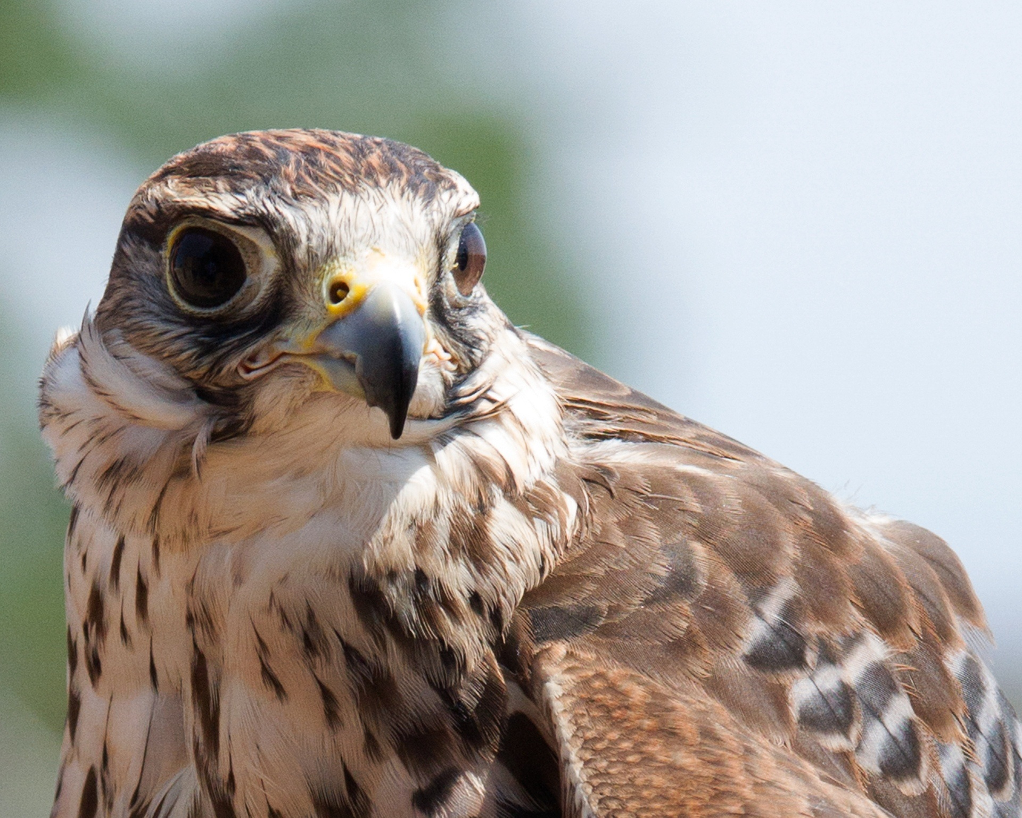
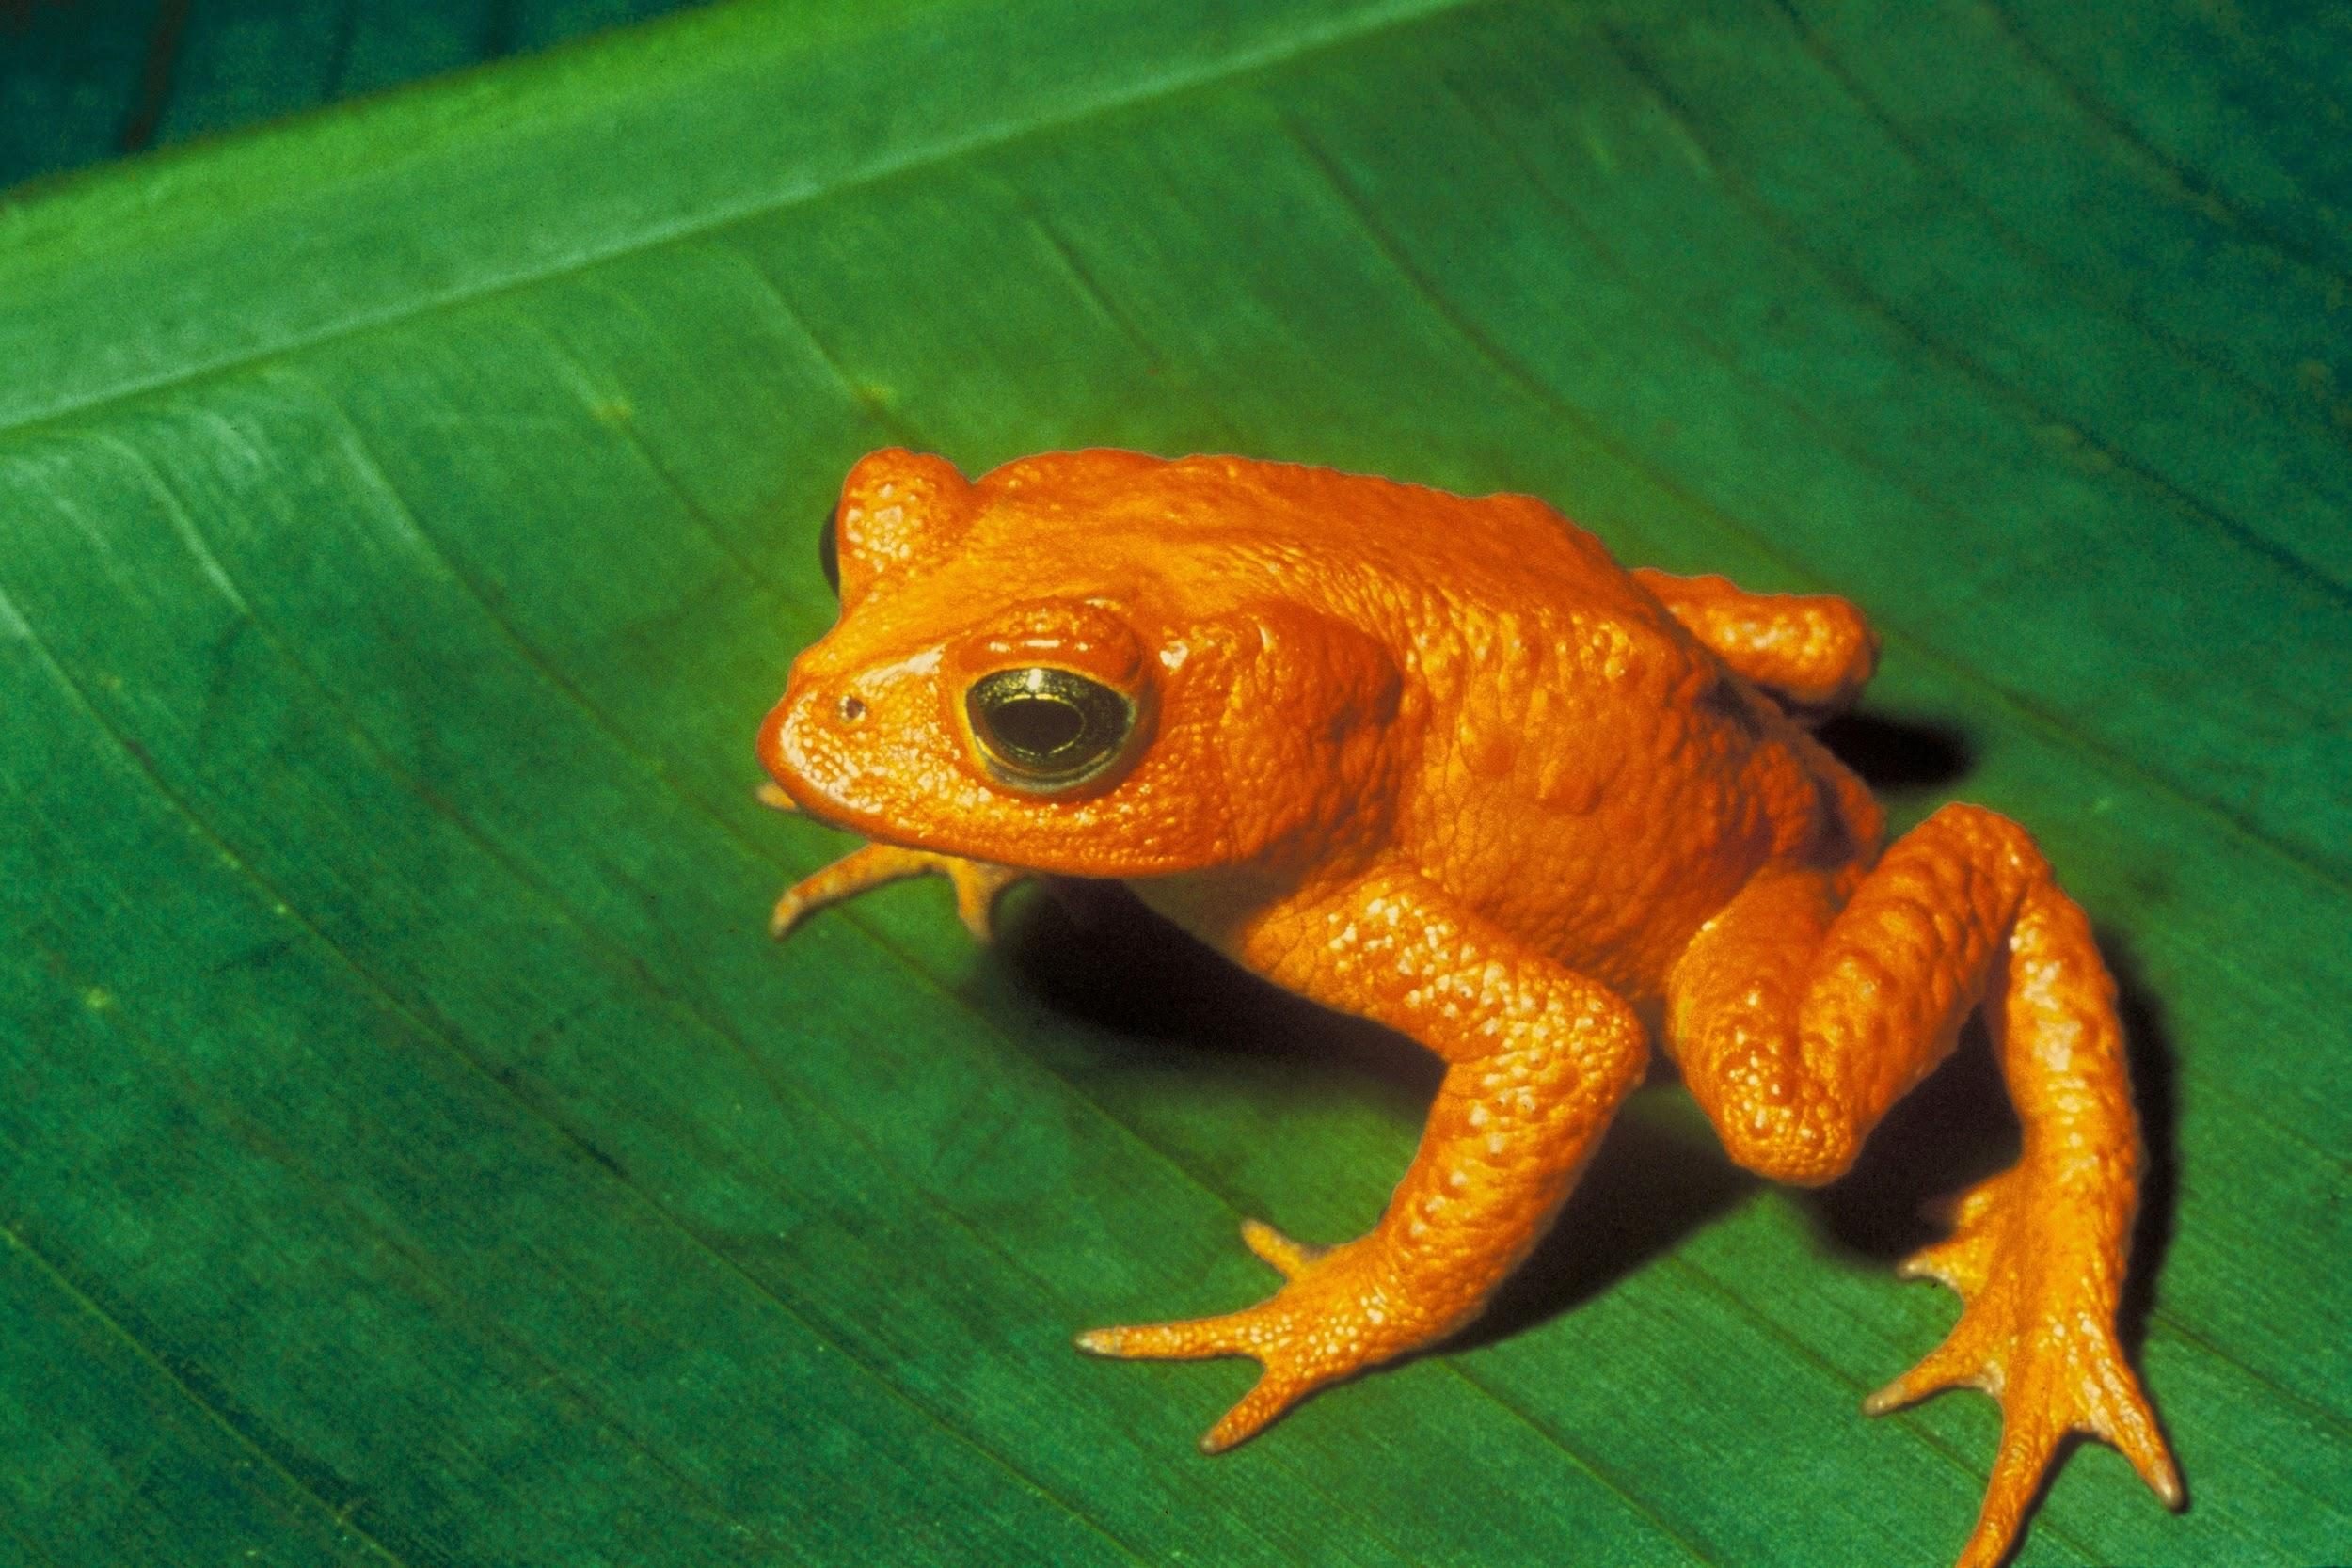
Animals Review

Slide 2
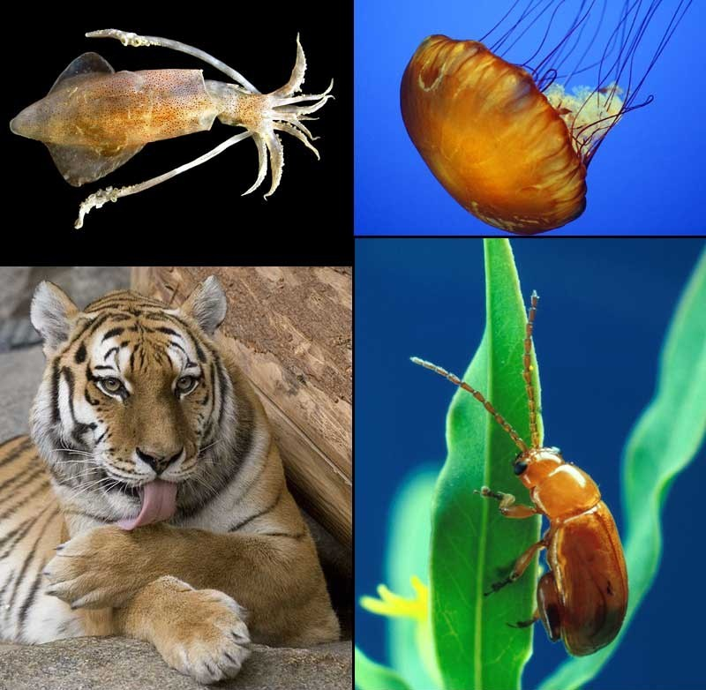
Kingdom Animalia
Eukaryotic
Multicellular
Heterotrophic
Lacks a Cell Wall
Diversity at its best!
Notes:
A

Slide 3
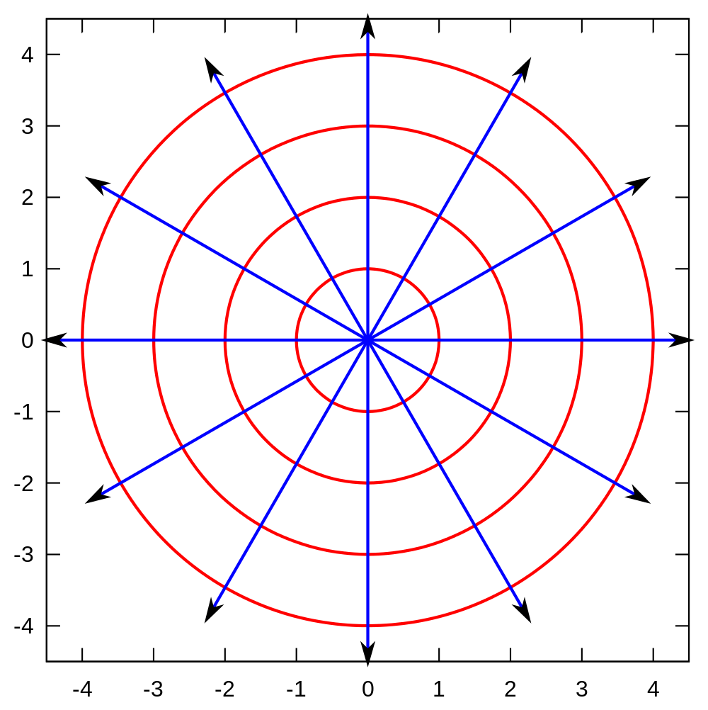
Symmetry
Radial
Object can be equally divided on multiple planes.
Notes:
K

Slide 4
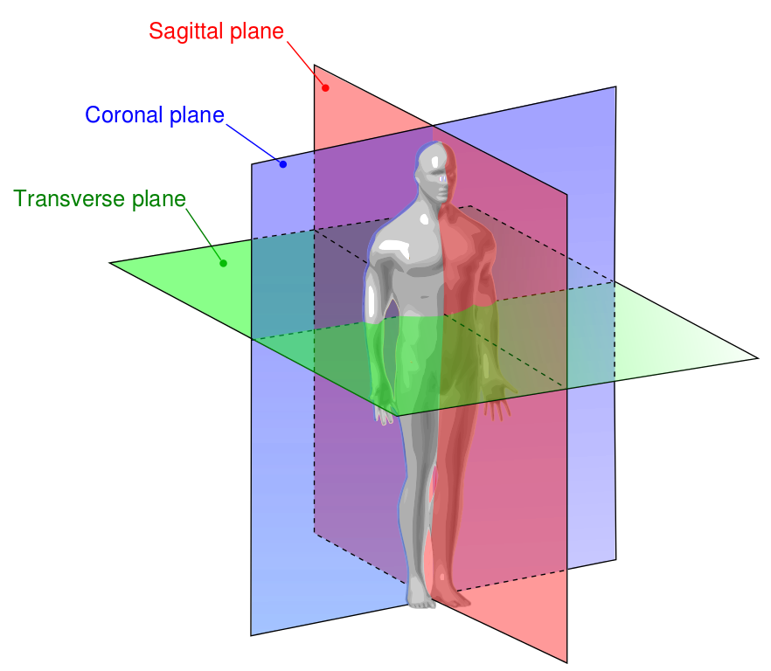
Symmetry
Bilateral
Object can be equally divided into two equal halves among a central axis.
Notes:
X

Slide 5
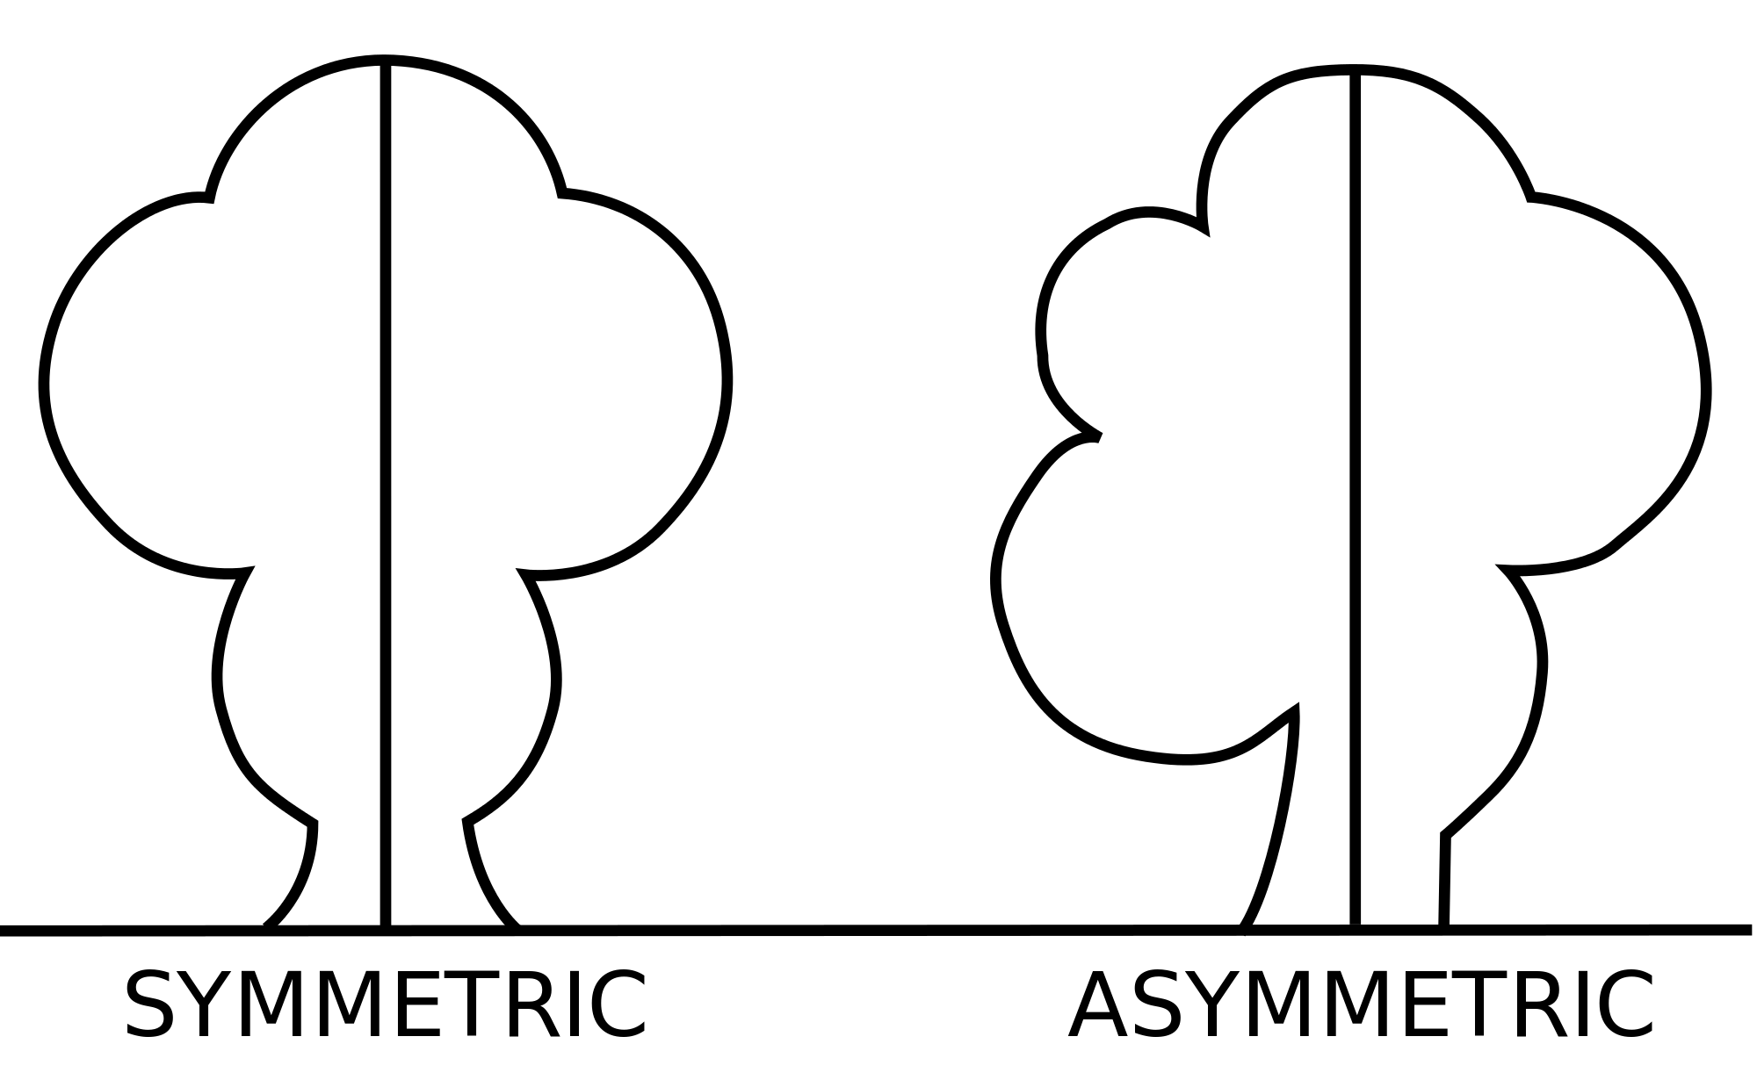
Symmetry
Asymmetrical
Object cannot be equally divided into two halves.
Notes:
F

Slide 6
Invertebrates
97% of all Animals
Lack a Backbone
Notes:
R

Slide 7
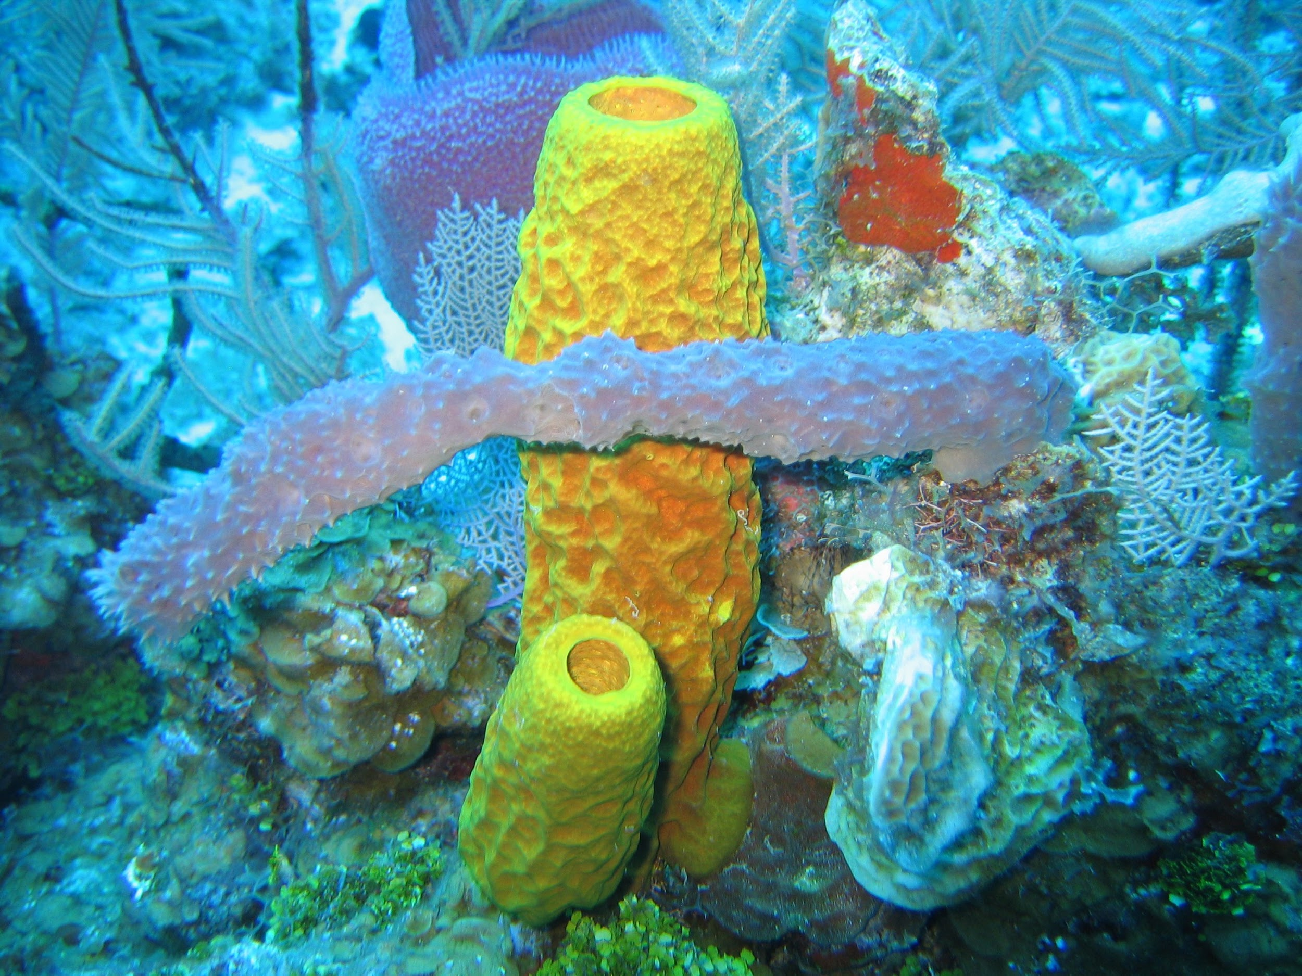
Porifera
Cells are considered colonial
Filter Feeder
Hermaphrodite
Asexual Reproduction
Sessile
A.K.A. Sponge
Notes:
Z

Slide 8
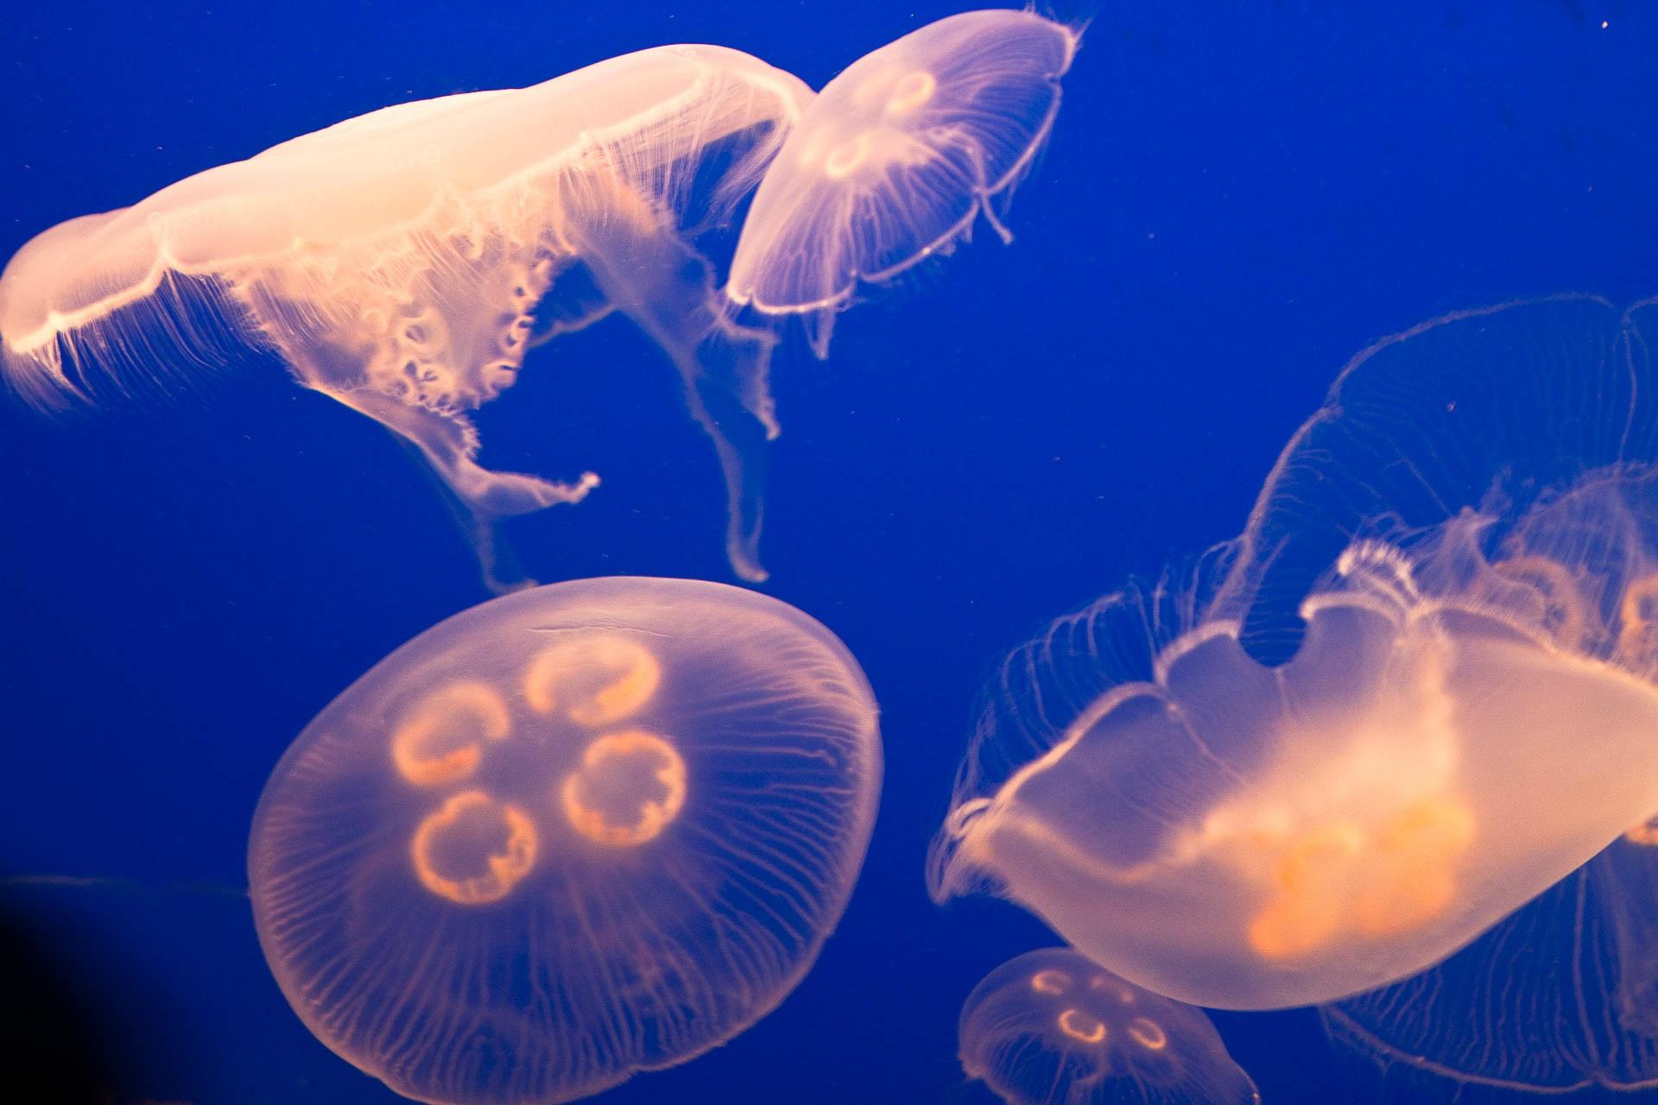
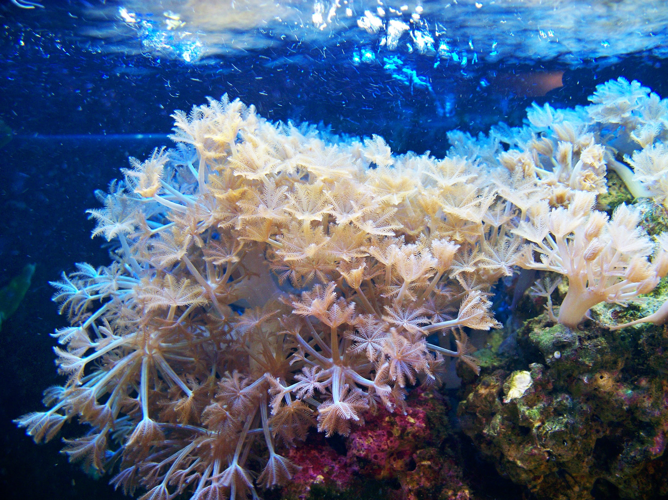
Cnidaria
Nematocysts - Stinging Cells
Jellyfish, Corals, and Hydra
Radial Symmetry
Hydrostatic Skeleton
Notes:
B

Slide 9
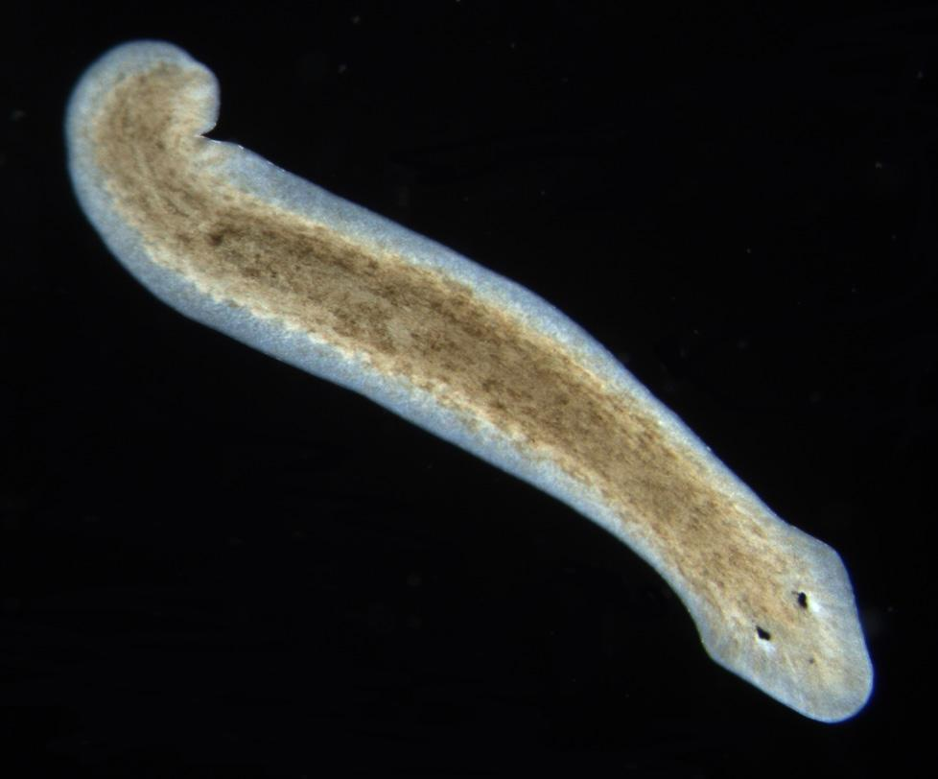
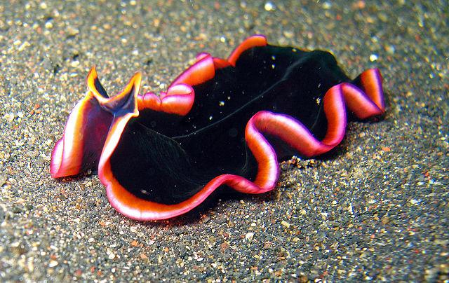
Platyhelminthes
Tapeworms, Flukes, and Planaria
Often Parasitic
3 Tissue Layers
Sexual and Asexual Reproduction
A.K.A. Flat Worms
Notes:
L

Slide 10
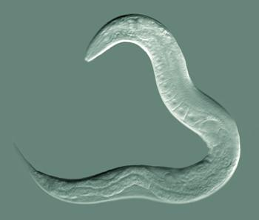
Nematoda
Hookworms, Pinworms, and Trichinae
Most numerous group of worms
2 body openings
Move using a thrashing motion
Sexual reproduction
A.K.A. Roundworms
Parasitic
Notes:
Q

Slide 11
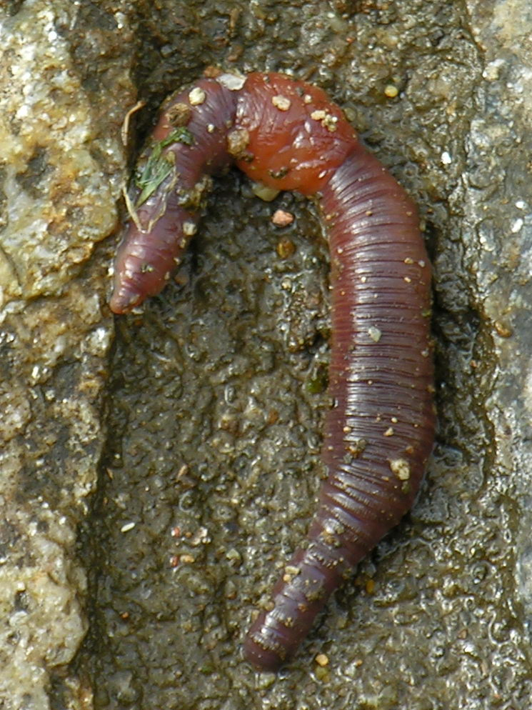
Annelida
Earthworms and Leeches
Coelomate: Complete lined digestion system
Moves using contractions of each segment.
Each segment functions on its own (regeneration)
Sexual reproduction
Segmented Worms
Notes:
G

Slide 12
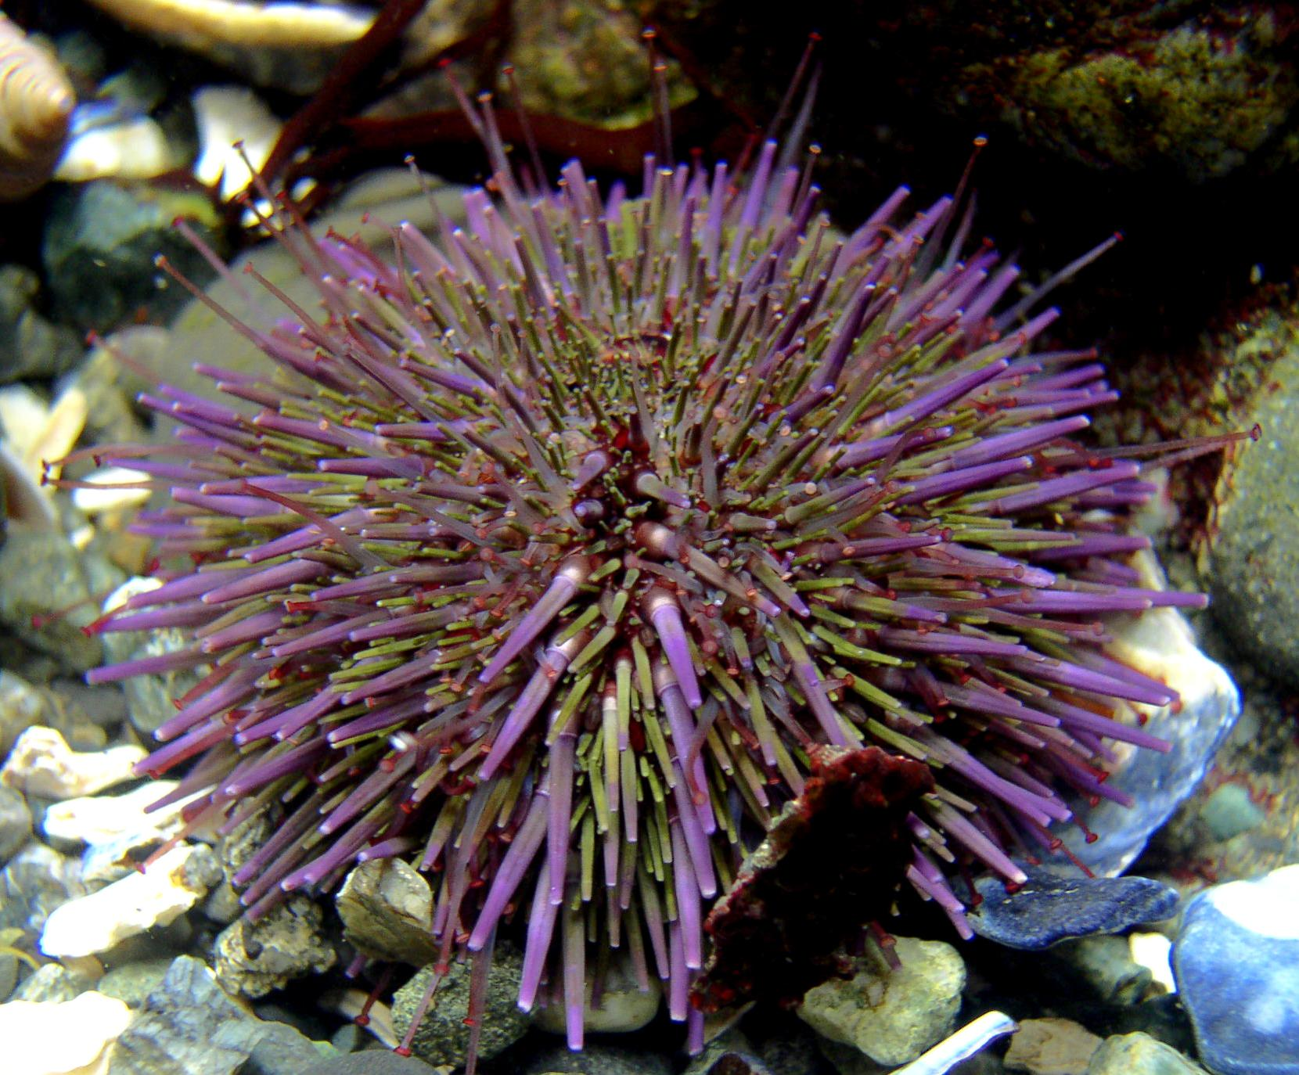
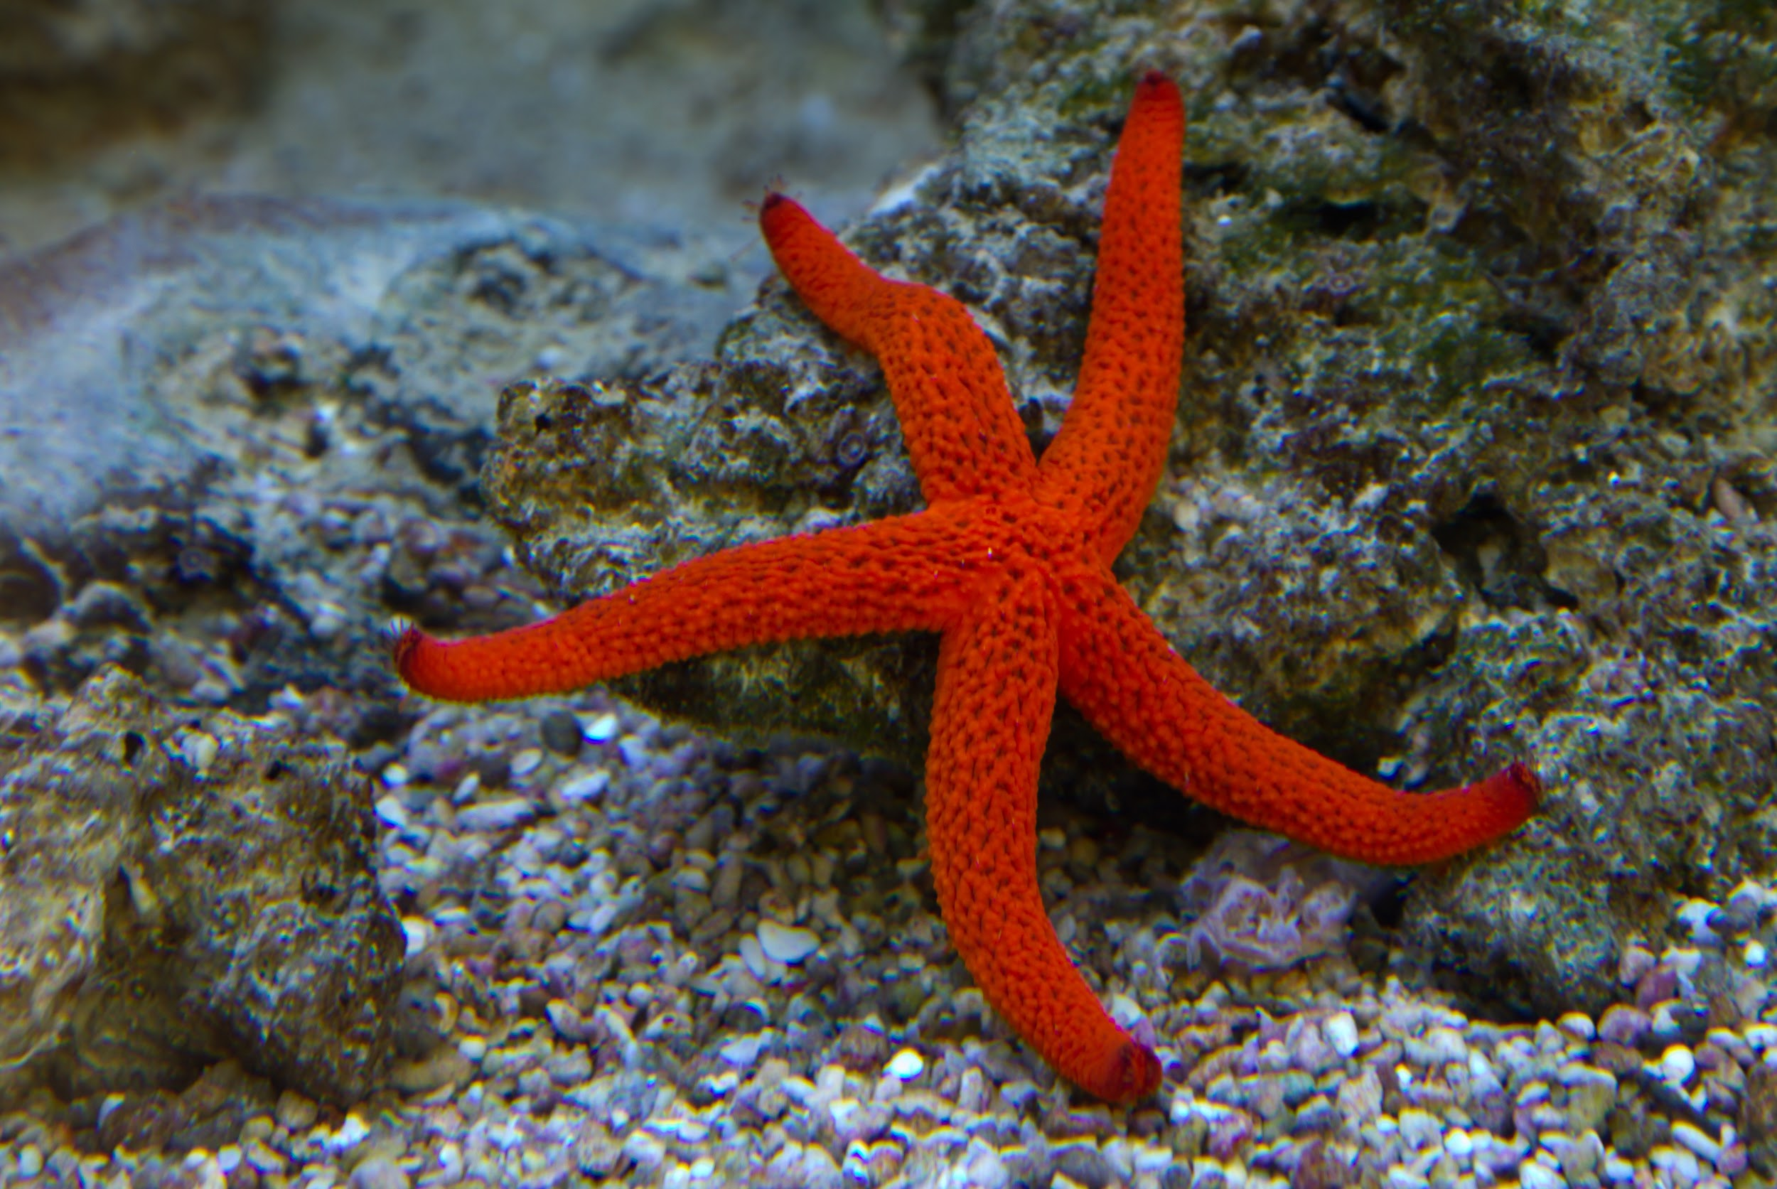
Echinodermata
“Spiny Skin”
Radial Symmetry
Endoskeleton (Water Vascular System with Tube Feet)
Ability to Regenerate
Starfish, Sand Dollar, Sea Cucumbers, Sea Urchins
Notes:
W

Slide 13
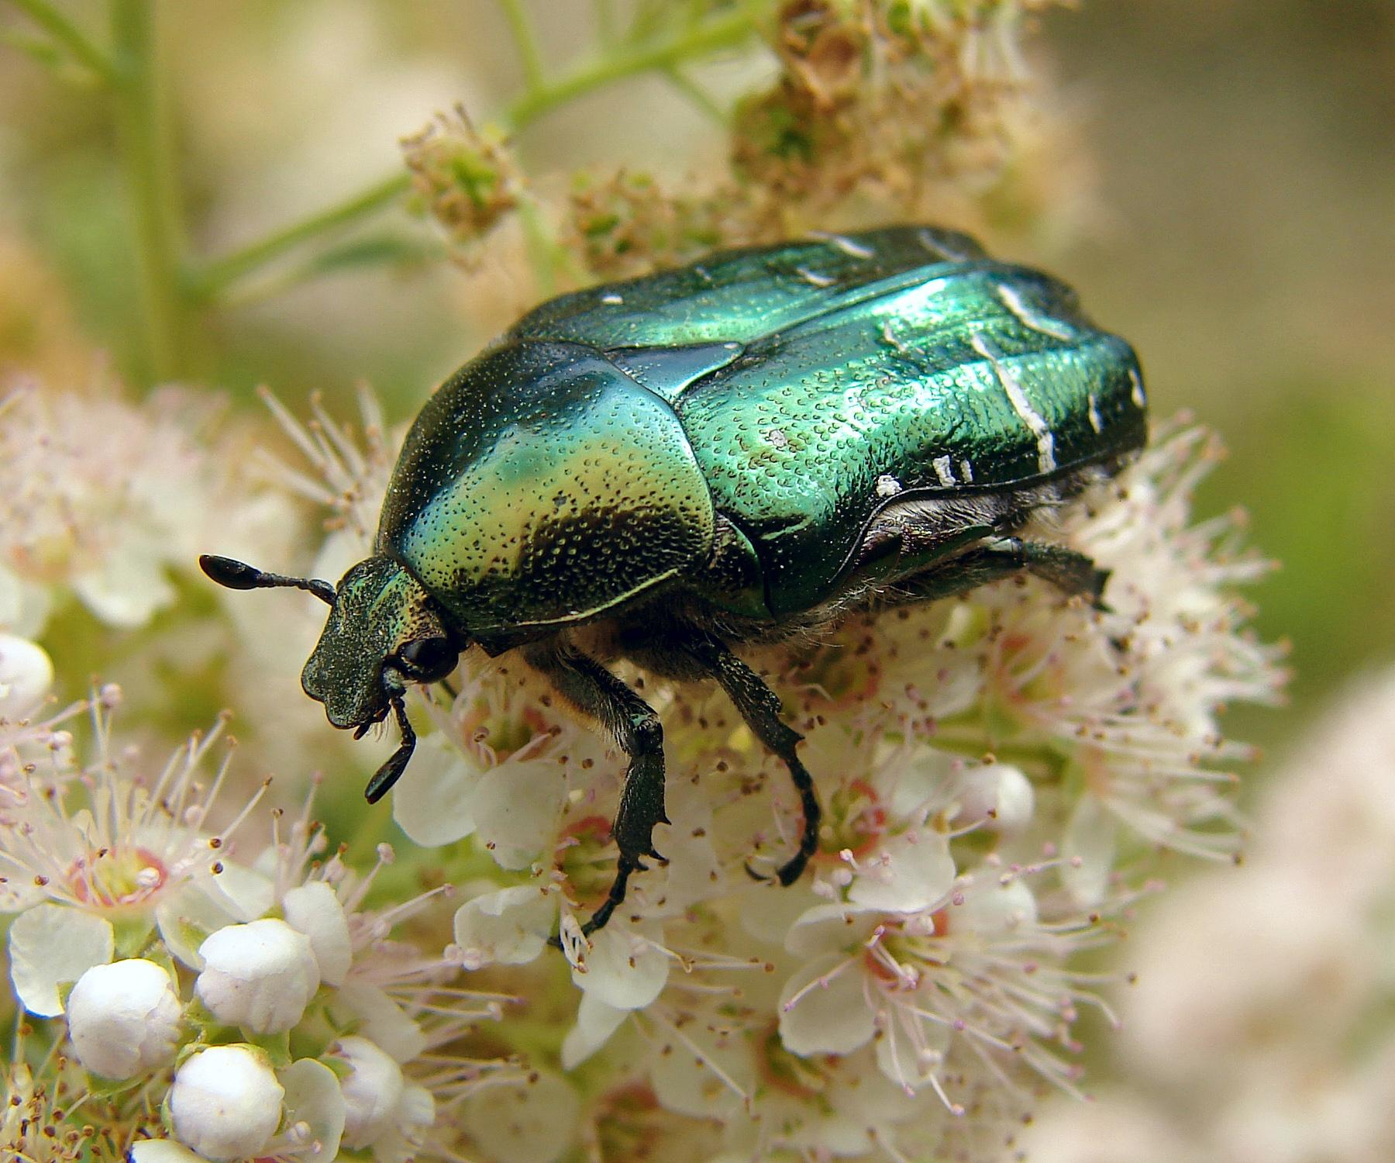
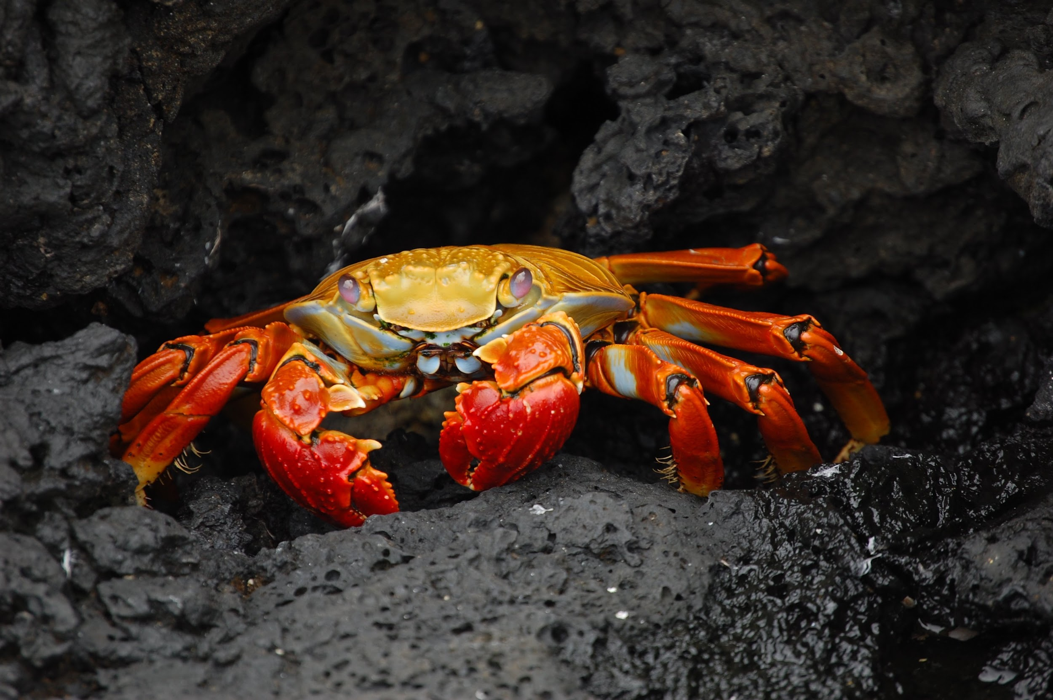
Arthropoda
“Jointed Appendages”
Exoskeleton - Must Molt to Grow
Head, Thorax, Abdomen - 3 Body Segments
Internal Fertilization
Spiders, Insects, Crabs, Lobsters, Crayfish
Notes:
V

Slide 14
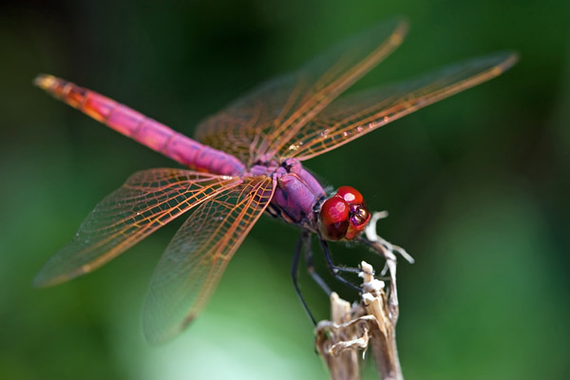
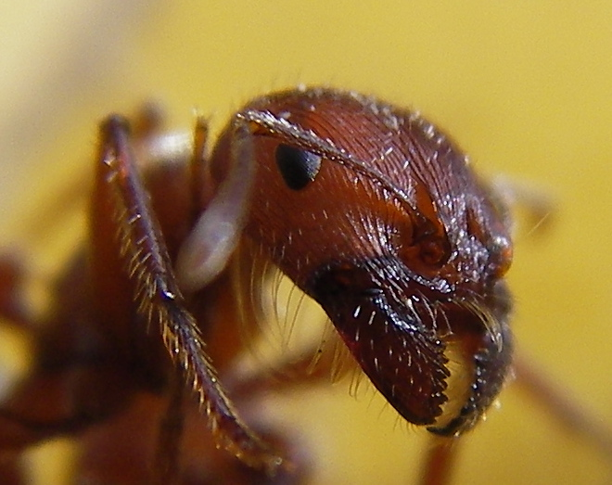
Insecta
Class of Arthropods
Most numerous invertebrate on earth.
Three distinct body parts.
Three pairs of legs.
Exoskeleton
Notes:
?

