Slide 2
Domain: Eukarya
Eukaryotic Cell (Has a nucleus)
Unicellular and Multicellular
Autotrophic and Heterotrophic
May or May Not Have A Cell Wall (Made of Cellulose)
Organized into three different groups: 1 – Fungus Like
2 – Animal Like
3 – Plant Like

Slide 3
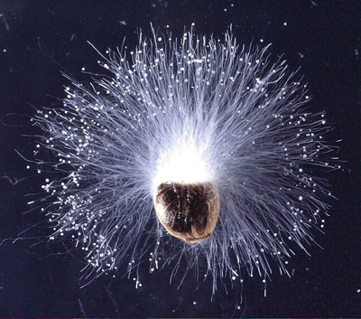
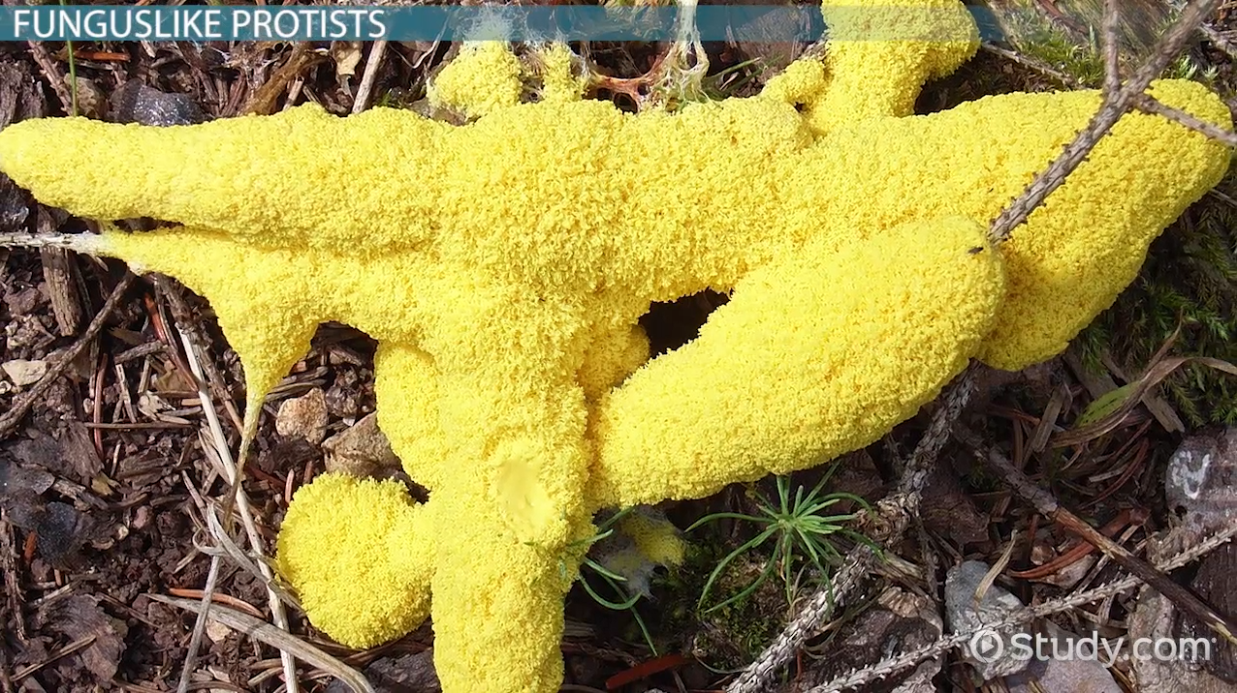
Fungus Like Protists- heterotrophs
Heterotrophic Decomposers (External Digestion)
Found in Damp Moist Environments (Commonly called Molds)
Reproduce by Spores (Asexual) or Alternation of Generations (Sexual)
Phylums: Acrasiomycota, Myxomycota, Oomycota
Caused the Great Potato Famine
Oomycota

Slide 4
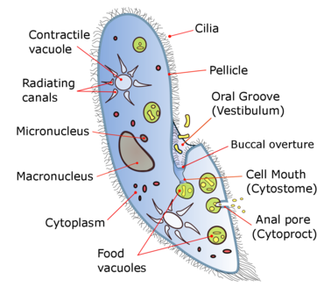
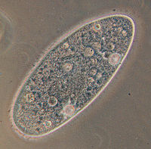
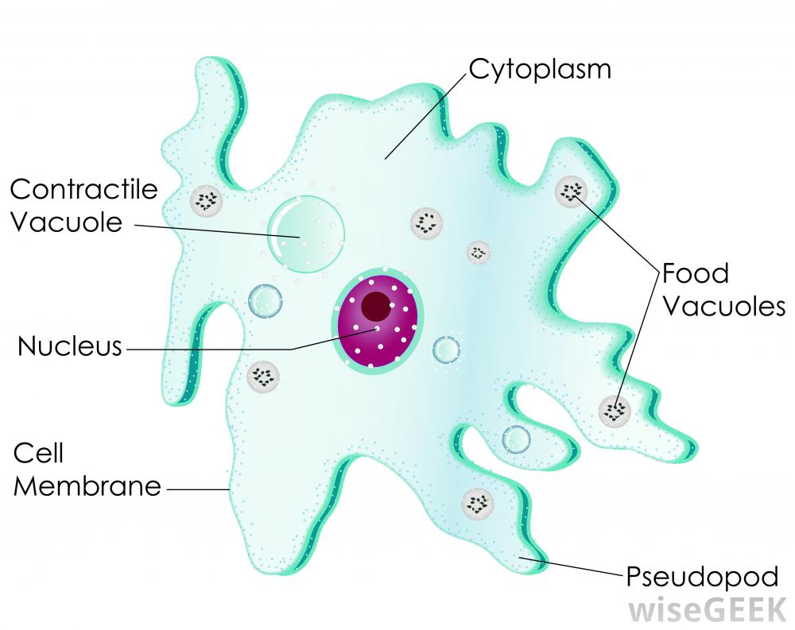
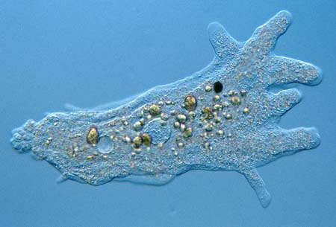
Animal Like Protists- heterotrophs
1. Sarcodina - Ex) Amoeba (Ameba)
Uses pseudopods/psuedopodia (false foot) to move and gain energy
2. Ciliophora (Ciliates)- Ex) Paramecium and Stentor
Uses small hair like projections called cilia to move
and obtain energy
Paramecium
Amoeba
Amoeba
Paramecium

Slide 7
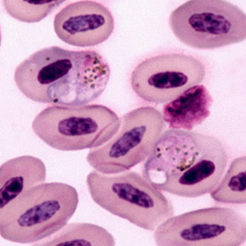
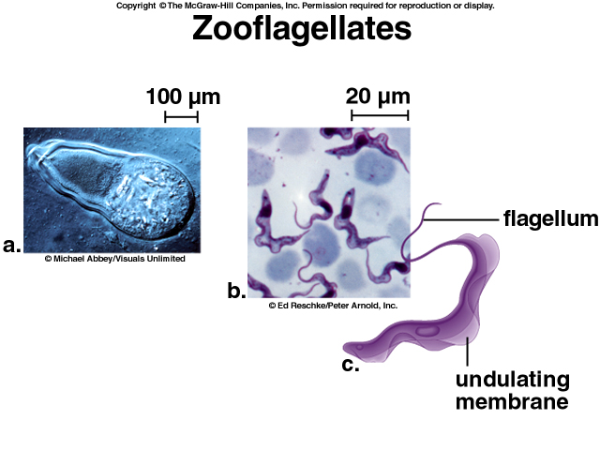
Animal Like Protists- heterotrophs
3. Sporozoans – Ex) Plasmodium (Causes Malaria)
Do not move on their own
Mostly Parasitic
4. Zooflagellates – Ex) Trypanosoma (African Sleeping Sickness)
Trichonympha (Symbiotic Relationship with Termites)
Giardia (Causes giardiasis)
Uses Flagella to Move
Plasmodium

Slide 8
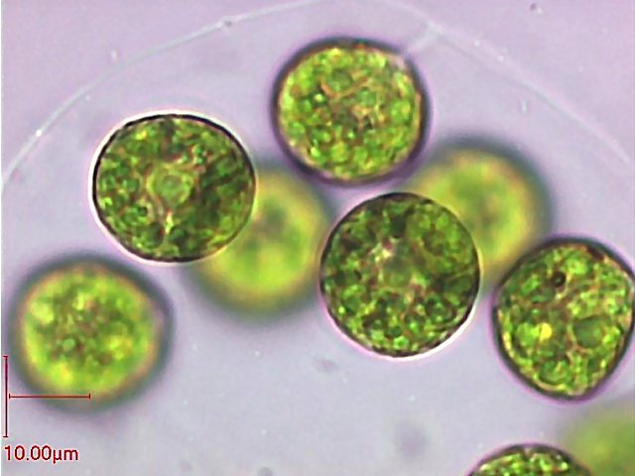
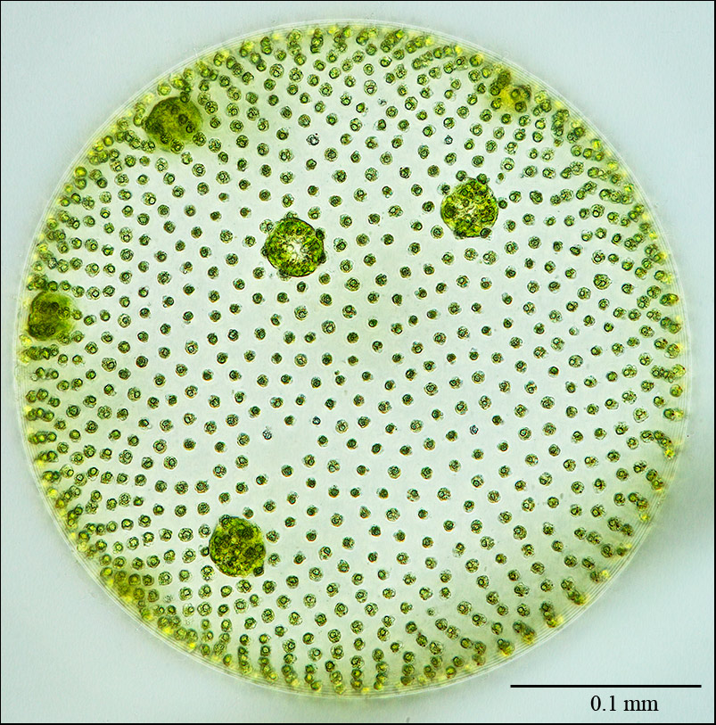
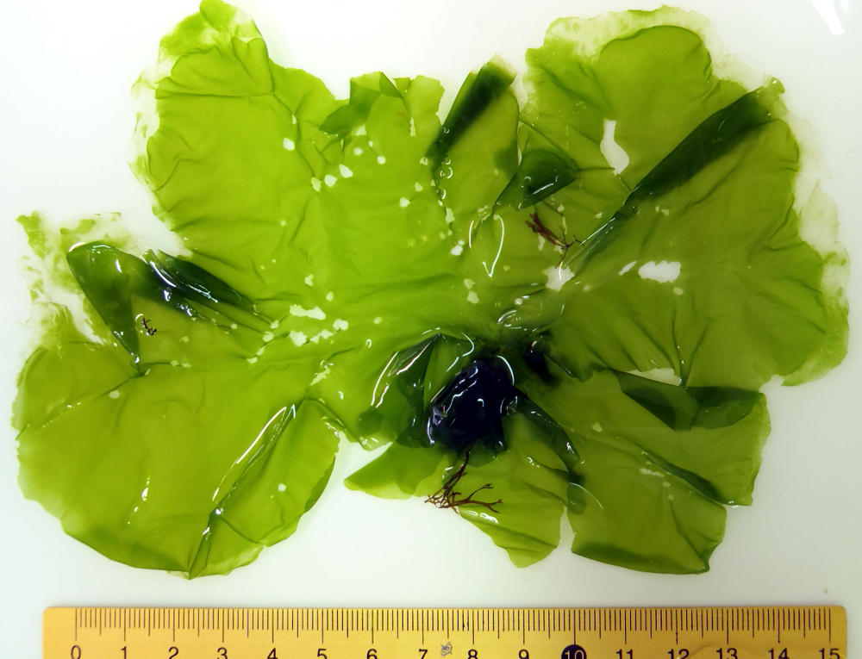
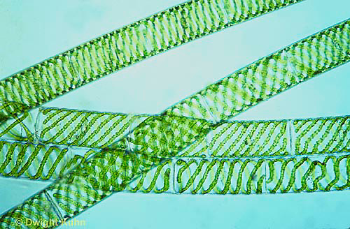
Plant Like Protists- autotrophs
Classified Based on Chlorophyll (Coloration)
Chlorophyta (Green Algae) – Ex) Volvox, Spirogyra, Ulva
Ancestor to Modern Plants
Chlorophyll A and B
Used in cosmetics and paints and food
May be unicellular or multicellular
Volvox
Spirogyra

Slide 9
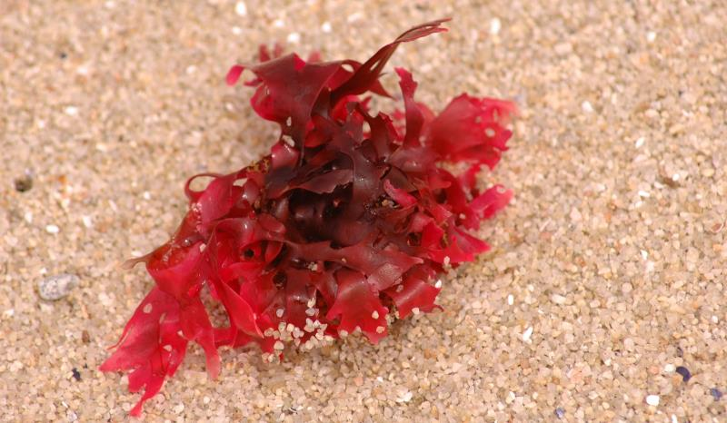
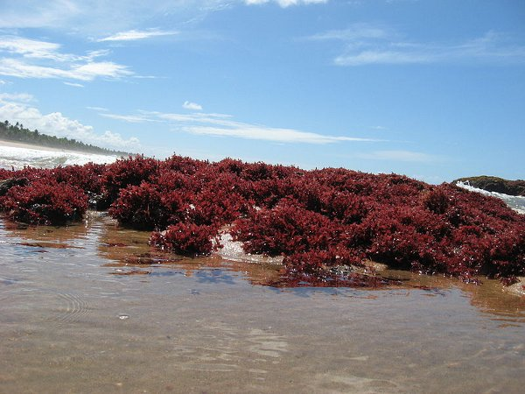
Plant Like Protists- autotrophs
Rhodophyta (Red Algae) - Mostly multicellular
Lives at Great Depths (Absorbs Blue Light)
Used in ice cream and pudding
Important to coral formation

Slide 10
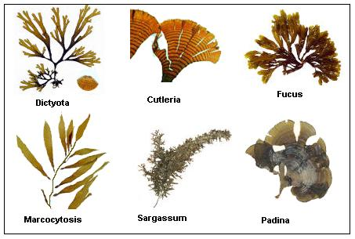
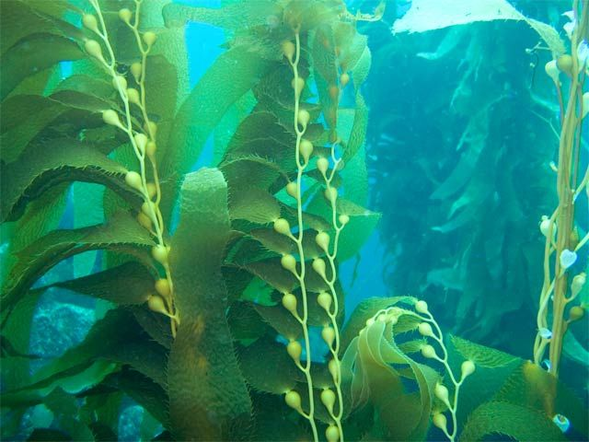
Plant Like Protists- autotrophs
Phaeophyta (Brown Algae) – Ex) Kelp
Multicellular
Largest Algae (Up to 60 meters long)
Uses a swim bladder to stay upright

Slide 11
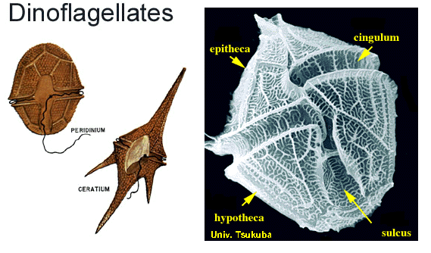
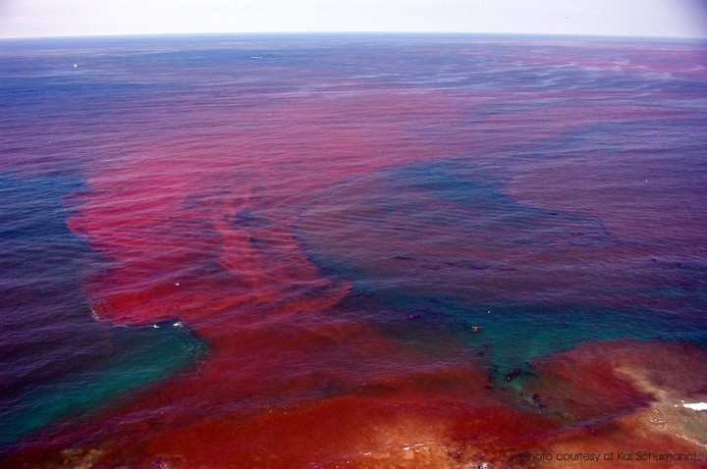
Plant Like Protists- autotrophs
Pyrrophyta (Fire Plants) – Ex) Dinoflagellate
Autotrophic or Heterotrophic
Has a flagella
Can be luminescent
Algal bloom (Red Tide – produces toxin)

Slide 12
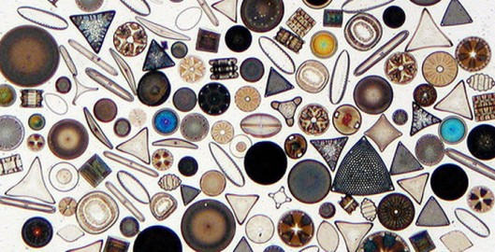
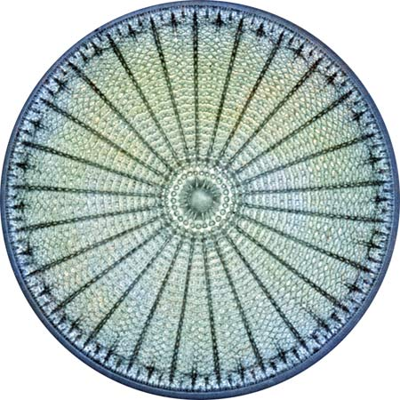
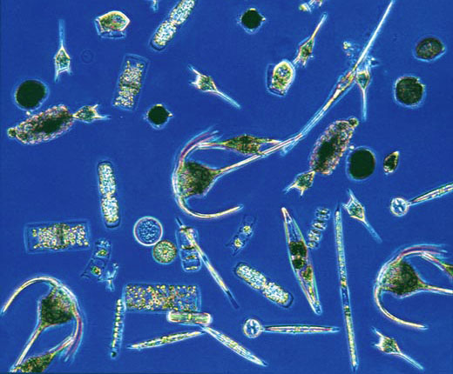
Plant Like Protists- autotrophs
Bacillariophyta (Diatoms) – Unicellular
Cell Wall of Silicon not Cellulose
Most Abundant Organisms on Earth
Commonly Called Phytoplankton

Slide 13
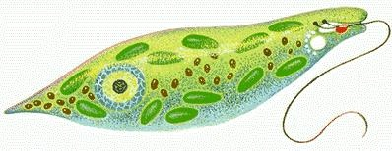
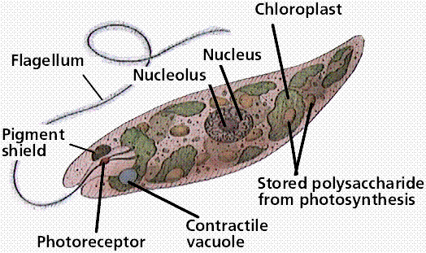
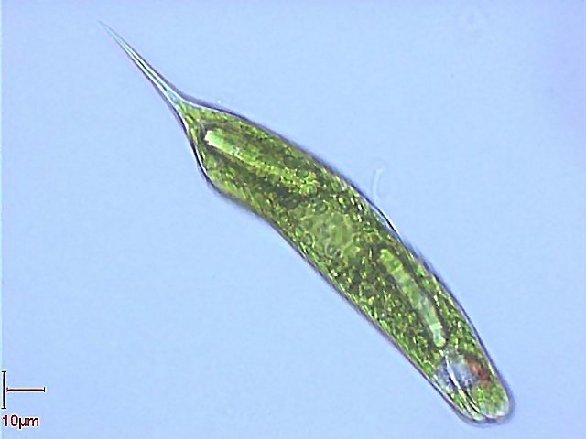
Plant Like Protists- autotrophs
Euglenophyta (Euglena) – Unicellular
No Cell Wall
Autotrophic & Heterotrophic
Uses a flagella to move
around to find food and light

Slide 14
