Slide 1
Plant & Animal Game

Slide 2
What is believed to be the ancient ancestor of plants? a. Moss b. Grass c. Green Algae d. Bacteria

Slide 3
c. Green Algae

Slide 4
Which of the following animals have asymmetrical body plan? A. jelly fish B. coral c. sponge d. none of the above

Slide 5
c. sponge

Slide 6
What is NOT true about plants? a. are prokaryotes b. carry out photosynthesis c. have cell walls made of cellulose d. are multicellular

Slide 7
a. are prokaryotes

Slide 8
The body of an annelid has ________________. A. a backbone b. an external shell c. segments d. stinging tentacles

Slide 9
c. segments

Slide 10
What makes up the cell wall of plants? a. chitin c. peptidolycan b. cellulose d. cholorplast

Slide 11
b. cellulose

Slide 12
Porifera:sponge::Cnideria:__________ A. jellyfish b. starfish c. mollusca d. earthworm

Slide 13
A. jellyfish

Slide 14
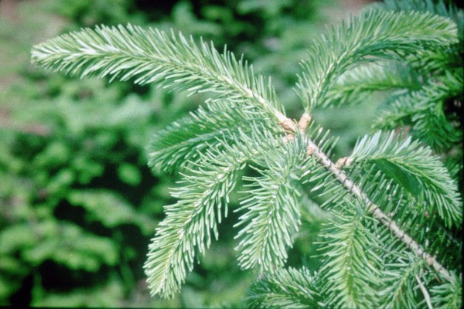
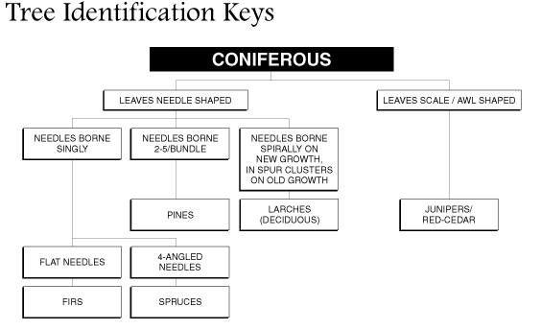
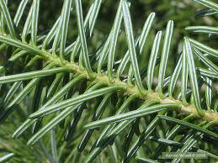
Name the tree in the picture using the identification key a. pine c. spruce b. firs d. juniper

Slide 15
b. firs

Slide 16
Which of the following includes liver flukes, and tapeworms? A. Mollusca B. Annelida C. nematoda D. platyhelminthes

Slide 17
D. platyhelminthes

Slide 18
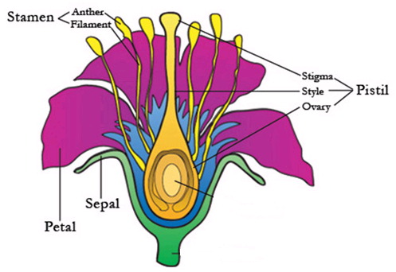
Use the picture below to answer the question. The male part of the flower is ___________, and the female part of the flower is _______. a. stamen, pistil c. petal, sepal b. pistil, stamen d. sepal, petal

Slide 19
a. stamen, pistil

Slide 20
All of the following are mollusks EXCEPT A. snails B. clams C. tapeworms D. octopus

Slide 21
C. tapeworms

