Slide 1
When it all goes wrong? Mutations (Chapter 12 Section 4)

Slide 2
Mutation - A Change in Genetic Information Causes can be:
1) Genetic (DNA proofreader does not catch mistakes) in Replication or Protein Synthesis
2) Environmental (Sun exposure or exposure to certain chemicals) – Mutagens or Carcinogens

Slide 3
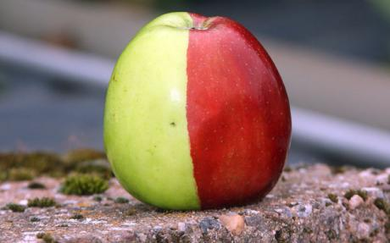
Mutations in a reproductive cell vs. a somatic cell: Mutations in reproductive cells will be passed on to offspring, in somatic cells they only impact that organism.
For example: Some somatic mutations convert a normal cell into a cell that can become cancerous – skin cancer.
The golden color on half of this Red Delicious apple was caused by a somatic mutation. Its seeds will not carry the mutation.

Slide 4
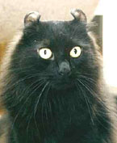
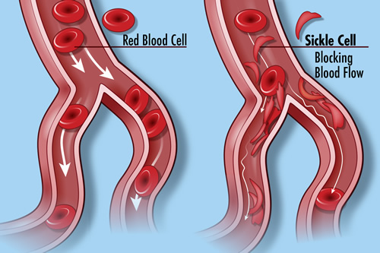
A single mutation caused this cat's ears to curl backwards slightly. This mutation occurred in the gamete cells and will be passed on to future generations.
Sickle-cell Anemia is caused by a single point mutation in the hemoglobin gene that converts a GAG codon into GUG, which codes for the amino acid valine rather than glutamic acid. This single mutation will be passed on to future generations.

Slide 5
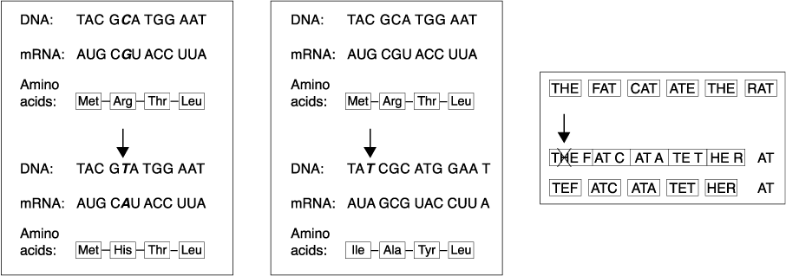
Gene Mutations: A change in one or a few DNA nucleotides (a single gene) Also called Point Mutations.
Missense – Change in Amino Acid Sequence
Nonsense – This change causes an early stop codon, shortening the amino acid chain.

Slide 6
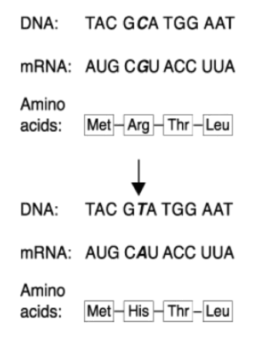
NORMAL
Substitution - One base pair replaces another. Only that DNA is impacted. Only changes one amino acid.
May be a Silent Mutation meaning that the DNA changes but it does not impact the amino acid (Amino Acid stays the same).
MUTATED
SUBSTITUTION

Slide 7
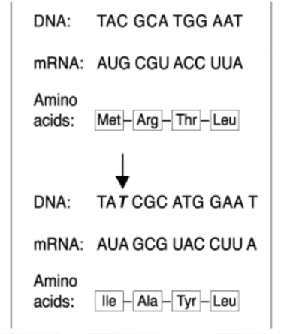
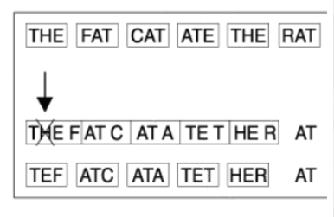
Frameshift mutations → Point mutations that change the DNA code from the point of the mutation to the end of the strand. Either shifts the sequence to the left or to the right. Has the potential to change MANY amino acids
Insertion -
A nucleotide is added into the DNA strand.
Deletion -
A nucleotide is omitted from the DNA strand.
NORMAL
MUTATED

Slide 9
In 1963, Hawking was diagnosed with amyotrophic lateral sclerosis "ALS" or (Lou Gehrig's disease) that gradually paralyzed him over the decades.
Even after the loss of his speech, he was still able to communicate through a speech-generating device, initially through use of a hand-held switch, and eventually by using a single cheek muscle.
He died on 14 March 2018 at the age of 76, after battling the disease for more than 50 years.

Slide 10
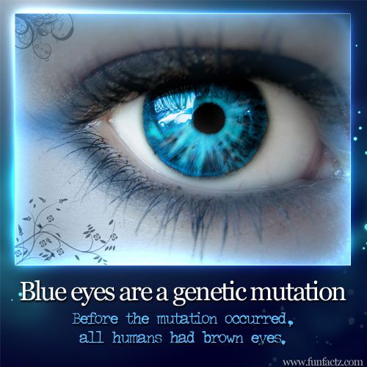
In 2008, researchers discovered a genetic mutation that took place 6,000-10,000 years ago and is thought to be the original genetic source of all blue-eyed humans alive on the planet today. The mutation is also in a gene responsible for the pigment melanin, this time in the iris of the eyes.

Slide 11
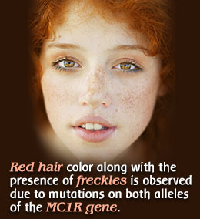
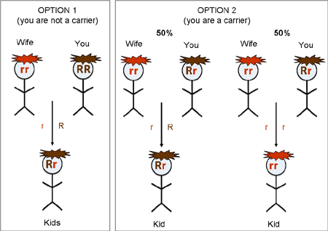
Redheads have genes to thank for their tresses. Research shows red hair usually results from a mutation in a gene called MC1R, which codes for the melanocortin-1 receptor. The pigment found in red hair that makes it red is called pheomelanin.

Slide 12
Chromosomal Mutations: Changes in the number or structure of chromosomes (Can be entire chromosome or large portions).
a) Entire Chromosome Mistakes
What is nondisjunction? Error in meiosis when homologous chromosomes fail to separate.
Monosomy – 1 Chromosome (TURNER SYNDROME XO)
Trisomy – 3 Chromosomes (DOWN SYNDROME/TRISOMY 21)
Polyploidy – Many copies of a particular chromosome (Great for plants, dangerous for animals).

Slide 13
Colchicine is a toxic chemical that is often used to induce polyploidy in plants. Basically, Colchicine prevents the microtubule formation during cell division, thus the chromosomes do not pull apart like they normally do.... Orchid growers will often sell polyploidy plants that are larger or have larger flowers.

Slide 14
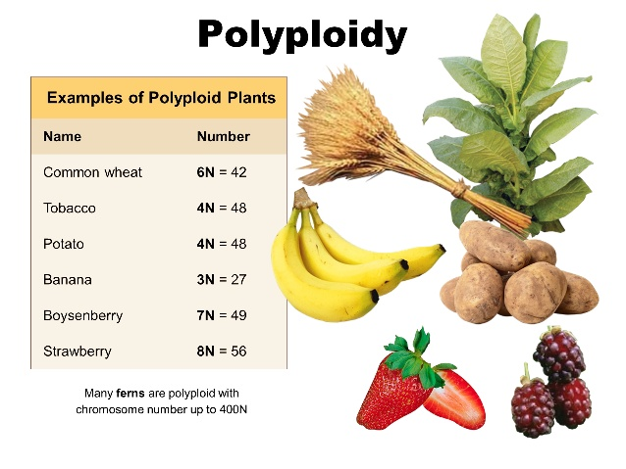
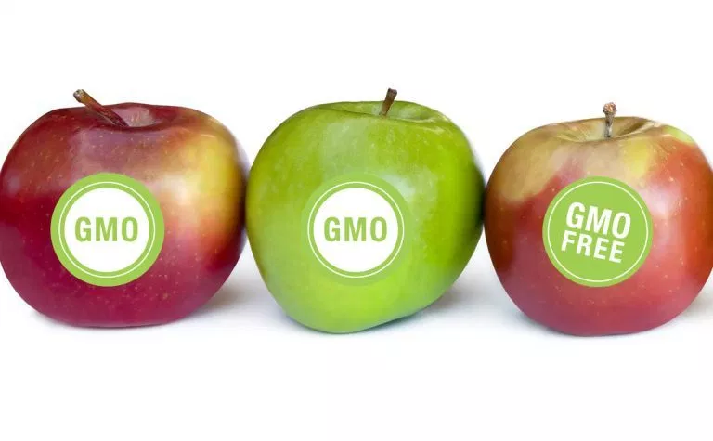

Slide 15
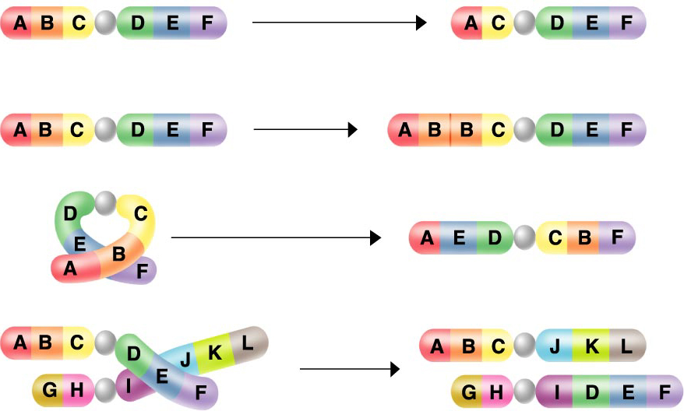
b) Mistakes with a Portion of a Chromosome
Deletion – A portion of the chromosome is missing
Insertion/Duplication – A portion of a chromosome is added (two of the same pieces)
Inversion – Portions of the chromosomes are inverted and connected to the wrong side of the chromosome.
Translocation – Involves an incorrect exchange between TWO chromosomes (A piece breaks off and attaches to another chromosome)

Slide 16
When do chromosomal mutations happen? During Meiosis
Now answer questions 1-4 on page 308 in the dragonfly book (Section Assessment)
1.
2.
3.
4.

