Slide 2
GENETICS
Georgia Performance Standards (GPS)
SB2. Students will analyze how biological traits are passed on to successive generations.
Distinguish between DNA and RNA
Explain the role of DNA in storing and transmitting cellular information.
Using Mendel’s laws, explain the role of meiosis in reproductive variability.
Describe the relationships between changes in DNA and potential appearance of new traits including
Alterations during replication.
Insertions
Deletions
Substitutions
Mutagenic factors that can alter DNA.
High energy radiation (x-rays and ultraviolet)
Chemical
Compare the advantages of sexual reproduction and asexual reproduction in different situations.
Examine the use of DNA technology in forensics, medicine, and agriculture

Slide 3
DNA vs. RNA
Deoxyribonucleic acid
Double helix
Original, complete instructions stay in nucleus
Made up of Nucleotides
Nucleotides made up of
Deoxyribose sugar
Phosphates
Nitrogen bases
Cytosine
Guanine
Adenine
Thymine
Ribonucleic acid
Single strand
Copy of instructions that can leave nucleus
Made up of Nucleotides
Nucleotides made up of
Ribose sugar
Phosphates
Nitrogen bases
Cytosine
Guanine
Adenine
Uracil
RNA uses uracil when it copies DNA. This uracil molecule signifies that it is RNA trying to leave the nucleus and not DNA so RNA can leave the nucleus. Otherwise the nucleus would think the DNA was trying to leave which may be “dangerous”.

Slide 4
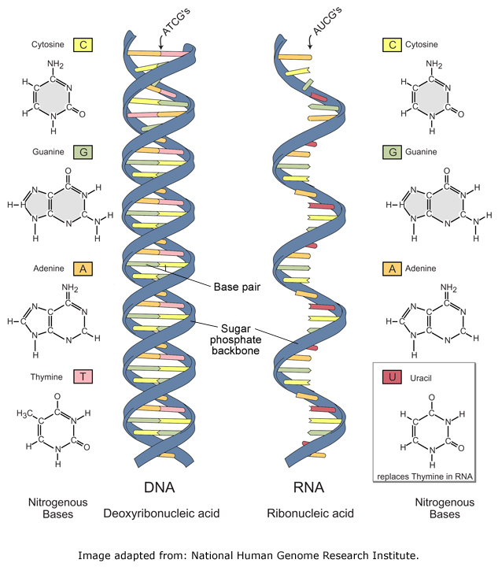

Slide 5
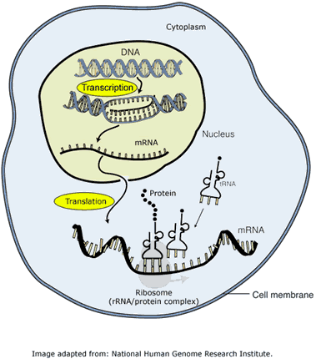
Protein synthesis
Transcription
mRNA makes a copy of segment of DNA
mRNA leaves nucleus and attaches to ribosome in endoplasmic reticulum.
Translation
Ribosome reads mRNA code and calls for matching amino acids
Amino acids link together to form polypeptide chain
Protein Synthesis Animation/Tutorial

Slide 6
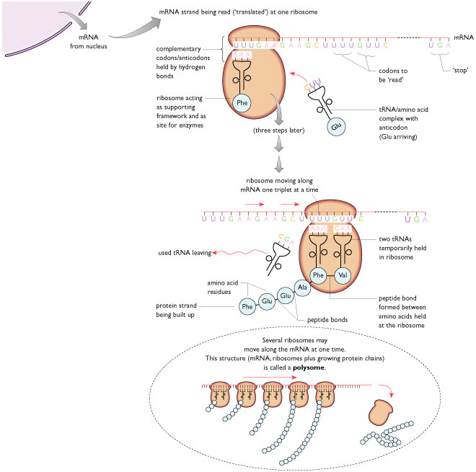
PROTEIN SYNTHESIS

Slide 7
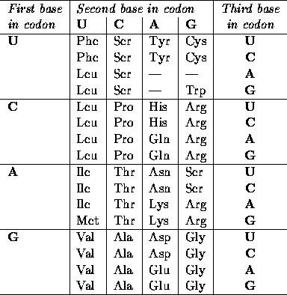
How does the cell know which amino acids to bring in?
mRNA is written with letters (like a secret code) which are set up in groups of 3’s called codons.
Ribosome reads the codons and brings in the matching amino acids
Decipher this codon:
DNA= AGG CCC TAG
RNA= UCC GGG AUC
A.A.= Ser Gly Ile

Slide 8
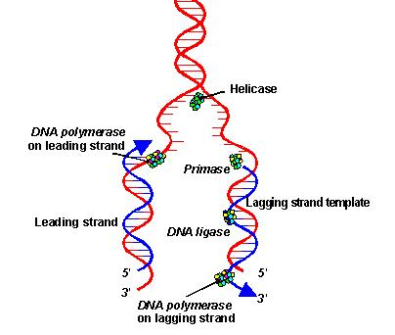
DNA Replication
DNA needs to copy itself or replicate when the cell gets ready to divide.
This is necessary so each new cell gets a copy of the DNA which are the instructions for how the cell functions.
DNA helicase enzyme unzips the DNA and DNA polymerase enzyme attaches new nucleotides to create new strands

Slide 9
Heredity Vocabulary
Gene- a segment of DNA that codes for a certain trait (seed color)
Allele- a variation of a gene (green allele, yellow allele)
Phenotype- the physical description of a gene (green seed)
Genotype- two alleles you inherit for a gene; represented by letters (GG, Gg, gg)
You always get two alleles for a gene- one comes from your mom, one comes from your dad
You can pass these alleles onto your future children
Whether the kids express the allele or not depends on if they inherit dominant or recessive alleles.
Dominant Allele- masks a recessive allele (EX: G)
Recessive Allele- is overpowered by dominant allele (EX: g)
Heterozygous- one dominant one recessive allele (Gg)
Also called carrier or hybrid
Homozygous dominant- two dominant alleles (GG)
Also called purebred
Homozygous recessive- two recessive alleles (gg)
Also called purebred

Slide 10
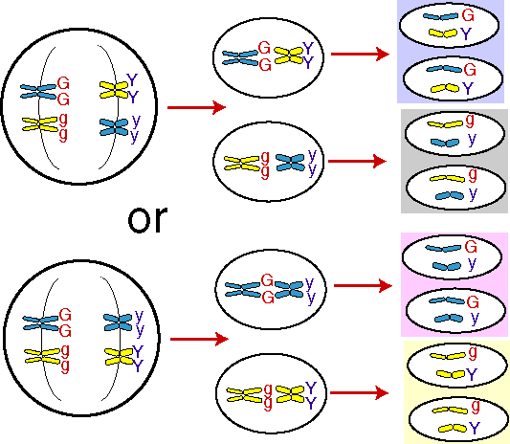
Mendelian Genetics
Gregor Mendel- father of genetics came up with 3 laws when researching heredity:
Rule of dominance- always a dominant allele that can mask a recessive one
Law of Segregation- when gametes are made the allele pairs are separated and divided up amongst your new sperm or egg
Law of Independent Assortment- genes are inherited independently of each other; explains how alleles can skip a generation.
Law of Independent Assortment

Slide 11
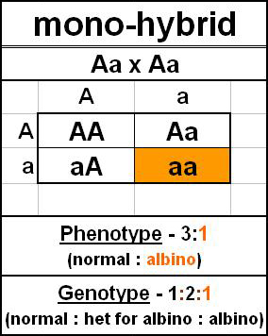
Punnett Squares
Be able to complete simple Punnett Squares
Be able to determine phenotype percentages and ratios
Be able to determine genotype percentages and ratios

Slide 12
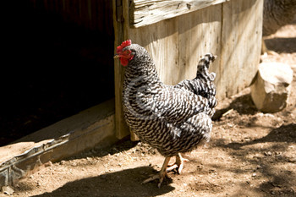
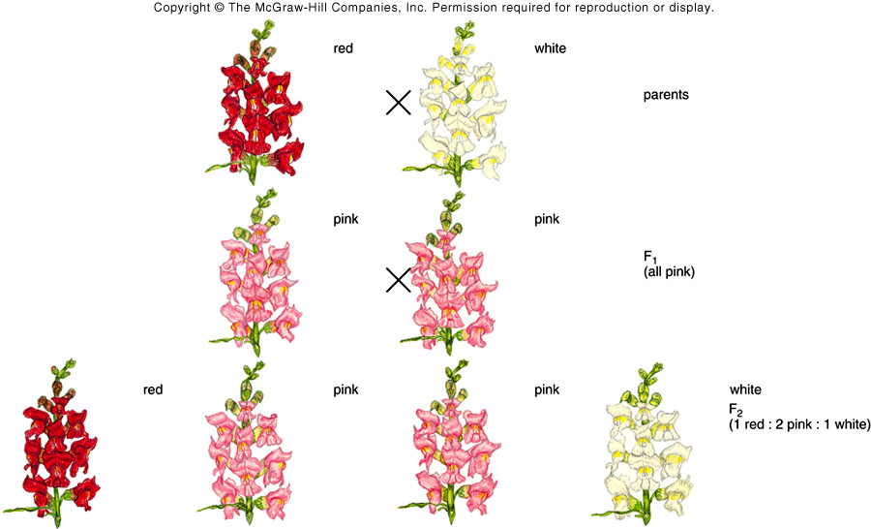
Non-Mendelian Genetics
Codominance- both alleles are dominant so both show
Ex: white chicken (WW) crossed with black chicken (BW) gives black and white checkered chicken (BW)
Occurs with blood cells: sickle cell anemia (SS), sickle cell trait (RS), normal cells (RR)
Incomplete Dominance- neither is completely dominant so they blend to produce new phenotype
EX: red flower (RR) crossed with a white flower (R’R’) produces a pink flower (RR’)

Slide 13
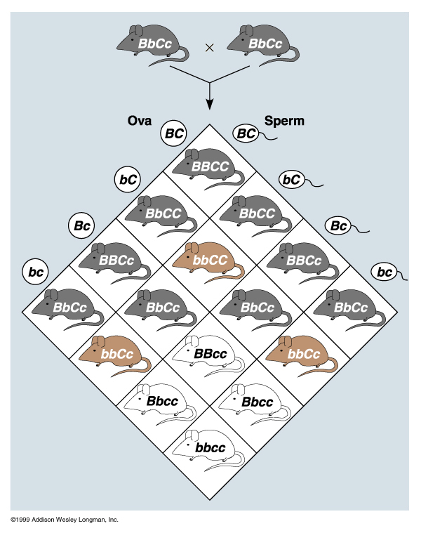
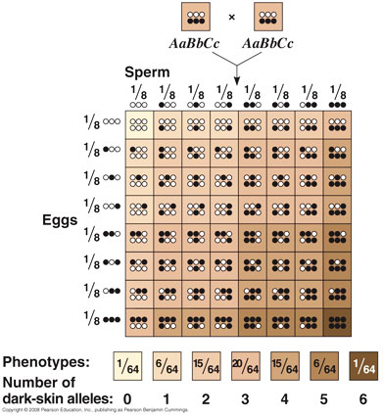
Non-Mendelian Genetics
Multiple Alleles- more than two alleles for a gene
EX: Blood types can be A, B, or O
Type A= AA or AO
Type B= BB or BO
Type AB = AB
Type O= OO
Polygenic Traits- controlled by more than one gene on a chromosome
EX: skin color, eye color, hair color

Slide 14
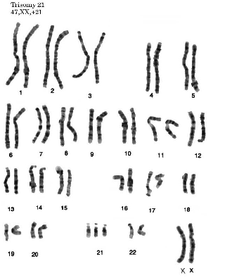
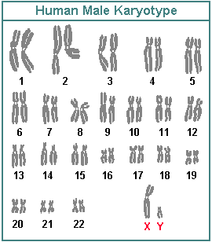
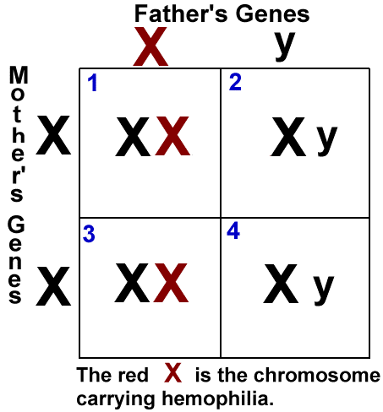
Sex Chromosomes
Autosomes- first 22 pairs of chromosomes
Sex Chromosomes- last pair of chromosomes
If last pair are XX= girl
If last pair are Xy= boy
Females can only donate X’s to their kids
Males can donate X or y to kids so he determines gender of baby

Slide 15
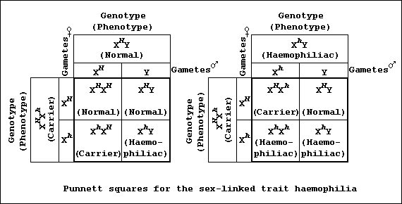
Non-Mendelian Genetics
X-Linked Traits (Sex-Linked Traits)
“X’s” carry some traits, “y’s” can’t b/c they are stumpy
X-linked traits are passed on the X chromosome that is always donated by mom to her kids
Boys have the trait more than girls b/c “y” chromosome cannot carry a dominant trait to mask a recessive one (remember it is too stumpy)
Girls are usually carriers
Boys can NEVER be carriers b/c they only get one allele- either the dominant or the recessive.

Slide 16
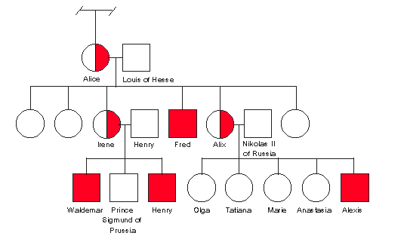
Pedigrees
Show inheritance patterns of traits
Sex-linked pedigree of royal family afflicted with hemophilia

Slide 17
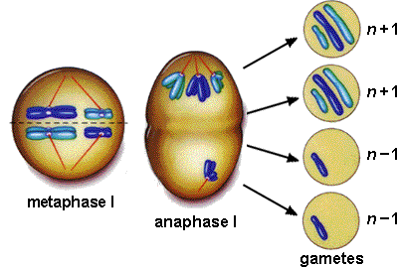
Chromosomal Disorders
Nondisjunction- chromosomes didn’t separate correctly during meiosis. Gamete gets too many or not enough chromosomes
Down syndrome (Trisomy 21)- too many chromosome #21.
Deletion, Duplication, Inversion, and Translocation

Slide 18
Gene Mutations
DNA mutations
Frameshift mutations- Insertions and deletions that shift the entire reading frame & cause major mutations
Point mutations- substitutions of one letter that may not have an affect on phenotype

Slide 19
Genetic Disorders
Most of these can be detected with an amniocentesis followed by a karyotyping of the person’s chromosomes.
Sex-Linked Disorders- present on sex chromosomes of mom and/or dad.
Colorblindness
Hemophilia- blood clotting disorder
Dominant Allele Disorders- if the allele for this disease is present, the person will have the disease/disorder
Achondroplasia (dwarfism)
Huntington’s disease- degenerative nerve/muscle disorder shows up later in life
Recessive Allele Disorders- must have two copies of the disease allele to have the disease/disorder.
Albinism- lack pigment in skin, eyes, hair, etc.
Tay Sach’s disease- develops in toddler’s, progressive degenerative nerve/muscle disorder
Phenylketonuria (PKU)- can’t drink milk or other items that contain phenylalanine
Cystic fibrosis- develop thick mucus in lungs & stomach

Slide 20
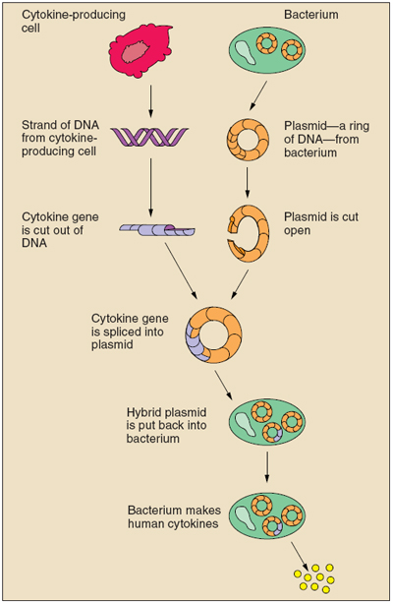
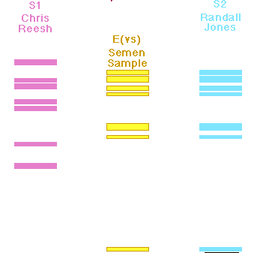
Technology
DNA Fingerprints
Gel electrophoresis- push DNA thru gel using electricity
Determine suspect at scene of crime, paternity, missing persons
Who left the semen sample- Chris or Randall?
Genetic Engineering
Cut human DNA to remove desired trait, splice into bacterial or host DNA (plasmid), reinsert into bacteria or host, which will produce desired trait
Also called
recombinant
DNA, gene
splicing
Make insulin,
GM foods,
cure some
diseases

