Slide 1
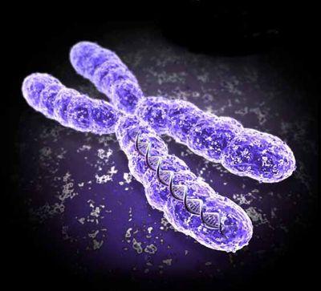
MEIOSIS
Reduction-Division
Genetic Recombination

Slide 2
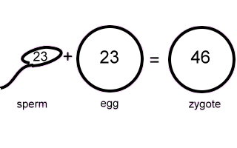
Meiosis
Cell division by which ONE DIPLOID somatic cell produces FOUR HAPLOID cells called gametes.
Chromosomes replicate ONCE but divide TWICE.
DIPLOID (2n) → HAPLOID (n)
Meiosis is SEXUAL reproduction.
TWO divisions (MEIOSIS I and MEIOSIS II).

Slide 3
Meiosis
Sex cells divide to produce GAMETES (sperm or egg).
Gametes have HALF the # of chromosomes.
Occurs only in GONADS (testes or ovaries).
Male: SPERMATOGENESIS -sperm
Female: OOGENESIS - egg or ova

Slide 4
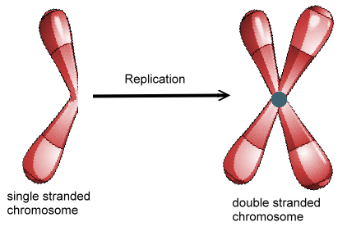
Interphase I
Similar to mitosis interphase.
CHROMOSOMES (DNA) replicate in the S phase
Each duplicated chromosome consist of two identical SISTER CHROMATIDS attached at their CENTROMERES.
CENTRIOLE pairs also replicate.

Slide 5
Interphase I
Nucleus and nucleolus visible.
Nucleus
chromatin
cell membrane
nucleolus

Slide 6
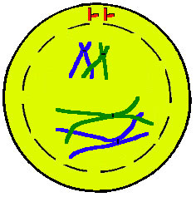
Meiosis I (four phases)
Cell division that reduces the chromosome number by one-half.
Four phases:
a. Prophase I
b. Metaphase I
c. Anaphase I
d. Telophase I
Prophase I

Slide 7
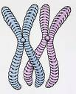
Prophase I
Longest and most complex phase (90%).
Chromosomes condense.
Crossing Over (Synapsis) occurs - Homologous chromosomes come together to form a tetrad.
Tetrad is two chromosomes or four chromatids (sister and non-sister chromatids).

Slide 8
Non-Sister Chromatids-HOMOLOGS
Homologs contain DNA that codes for the same genes , but different versions of those genes
Genes occur at the same loci

Slide 9
Prophase I - Synapsis
Homologous chromosomes
sister chromatids
sister chromatids
Tetrad

Slide 10
Homologous Chromosomes
Pair of chromosomes (maternal and paternal) that are similar in shape and size.
Homologous pairs (tetrads) carry GENES controlling the SAME inherited traits.
Each locus (position of a gene) is in the same position on homologues.
Humans have 23 pairs of homologous chromosomes:
a. First 22 pairs of autosomes
b. Last pair of sex chromosomes
LOCI

Slide 11
Homologous Chromosomes
eye color
locus
eye color
locus
hair color
locus
hair color
locus
Paternal
Maternal

Slide 12
Crossing Over
Crossing over may occur between non-sister chromatids at sites called chiasmata.
Crossing over: segments of nonsister chromatids break and reattach to the other chromatid.
Chiasmata (chiasma) are where chromosomes touch each other and exchange genes (crossing over.)
Causes Genetic Recombination

Slide 13
Genetic Recombination
nonsister chromatids
Tetrad
chiasmata: site of crossing over
variation

Slide 14
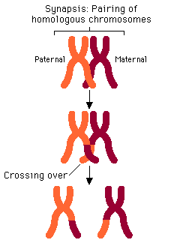

Slide 15
Sex Chromosomes
XX chromosome - female
XY chromosome - male

Slide 16
Prophase I
Nucleus & Nucleolus disappear
Spindle forms
Chromosomes coil & Synapsis (pairing) occurs
Tetrads form & Crossing over Occurs
spindle fiber
centrioles
aster
fibers
TETRAD

Slide 17
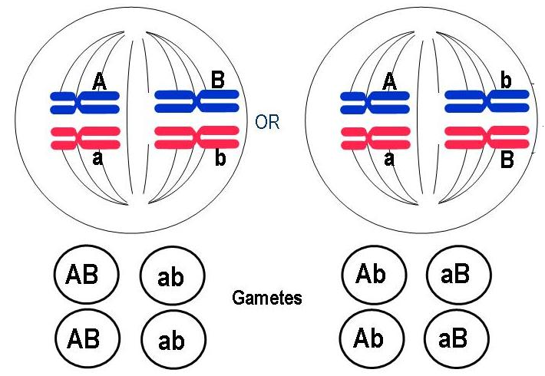
Metaphase I
Shortest phase
Tetrads align on the equator.
Independent assortment occurs – chromosomes separate randomly causing GENETIC RECOMBINATION

Slide 18
Metaphase I
OR
Homologs line up at equator or metaphase plate

Slide 19
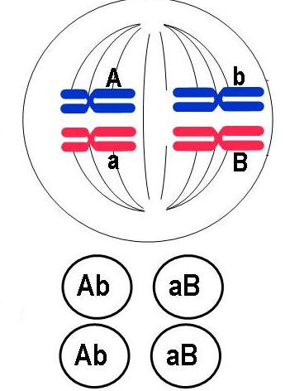
Formula: 2^{n}
Example: 2n = 4
then 1n = 2
thus 2² = 4 combinations

Slide 20
Question:
In terms of Independent Assortment -how many different combinations of sperm could a human male produce?

Slide 21
Answer
Formula: 2^{n}
Human chromosomes: 2n = 46
n = 23
2²³ = ~8 million combinations

Slide 22
Anaphase I
Homologous chromosomes separate and move towards the poles.
Sister chromatids remain attached at their centromeres.

Slide 23
Anaphase I
Homologs separate

Slide 24
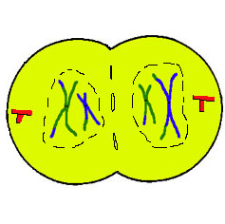
Telophase I
Each pole now has haploid (1n) set of chromosomes.
Cytokinesis occurs and two haploid daughter cells are formed.

Slide 25
Telophase I
cytokinesis

Slide 26
MEIOSIS II
Sister Chromatids Separate
Meiosis II

Slide 27
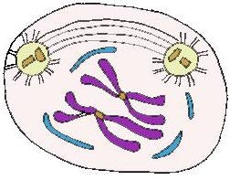
Meiosis II
No Interphase II
No DNA Replication
Remember: Meiosis II is similar to mitosis

Slide 28
Prophase II
Same as Prophase in mitosis
Nucleus & nucleolus disappear
Chromosomes condense
Spindle forms

Slide 29
Metaphase II
Same as Metaphase in mitosis
Chromosomes (not homologs) line up at equator

Slide 30
Anaphase II
Same as Anaphase in mitosis
SISTER CHROMATIDS separate

Slide 31
Telophase II
Same as Telophase in mitosis.
Nuclei and Nucleoli reform, spindle disappears
CYTOKINESIS occurs.
Remember: FOUR HAPLOID DAUGHTER cells are produced.
Called GAMETES (eggs and sperm)
1n Sperm cell fertilizes 1n egg to form 2n zygote

Slide 32
Telophase II

Slide 33
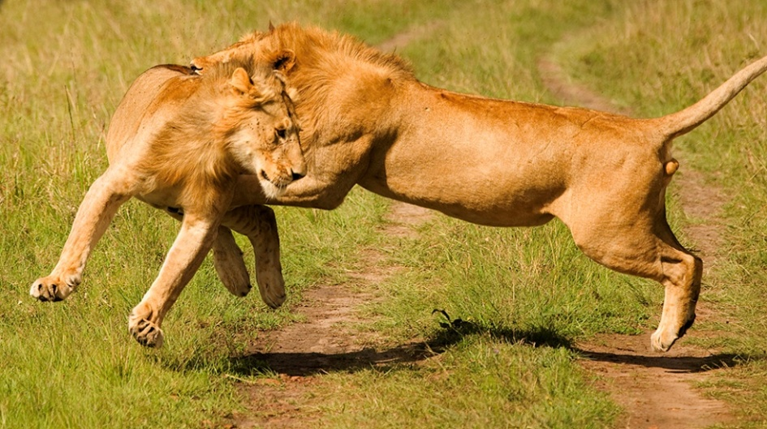
Variation
Also known as GENETIC RECOMBINATION
Important to population as the raw material for NATURAL SELECTION.
All organisms are NOT alike
Strongest “most fit” survive to reproduce & pass on traits

Slide 34
Question:
What are the 3 sources of genetic recombination or variation?

Slide 35
Answer:
CROSSING OVER (prophase I)
INDEPENDENT ASSORTMENT (metaphase I)
RANDOM FERTILIZATION

Slide 36
Question:
A cell containing 20 chromosomes (diploid) at the beginning of meiosis would, at its completion, produce cells containing how many chromosomes?

Slide 37
Answer:
10 chromosomes (haploid or 1n)

Slide 38
Spermatogenesis
n=23
human
sex cell
sperm
n=23
n=23
2n=46
n=23
n=23
diploid (2n)
haploid (n)
n=23
Meiosis I
Meiosis II

Slide 39
Oogenesis
Haploid (1n)
n=23
human
sex cell
egg
n=23
2n=46
Polar Bodies (die)
n=23
diploid (2n)
Meiosis I
Meiosis II

Slide 40
Fertilization
The fusion of a sperm and egg to form a zygote.
A zygote is a FERTILIZED EGG
sperm
n=23
n=23
egg
2n=46
zygote

Slide 41
Non-disjunction
Non-disjunction is one of the Two major occurrences of Meiosis
(The other is Crossing Over)
Non-disjunction is the failure of homologous chromosomes, or sister chromatids, to separate during meiosis.
Non-disjunction results with the production of zygotes with abnormal chromosome numbers…… remember…. An abnormal chromosome number (abnormal amount of DNA) is damaging to the offspring.

Slide 42
Non-disjunctions usually occur in one of two fashions.
The first is called Monosomy, the second is called Trisomy. If an organism has Trisomy 18 it has three chromosomes in the 18th set, Trisomy 21…. Three chromosomes in the 21st set. If an organism has Monosomy 23 it has only one chromosome in the 23rd set.

Slide 43
Common Non-disjunction Disorders
Down’s Syndrome – Trisomy 21
Turner’s Syndrome – Monosomy 23 (X)
Kleinfelter’s Syndrome – Trisomy 23 (XXY)
Edward’s Syndrome – Trisomy 18

Slide 44
Amniocentesis
An Amniocentesis is a procedure a pregnant woman can have in order to detect some genetics disorders…..such as non-disjunction.

Slide 45
Amniocentesis
Amniotic fluid withdrawn

Slide 46
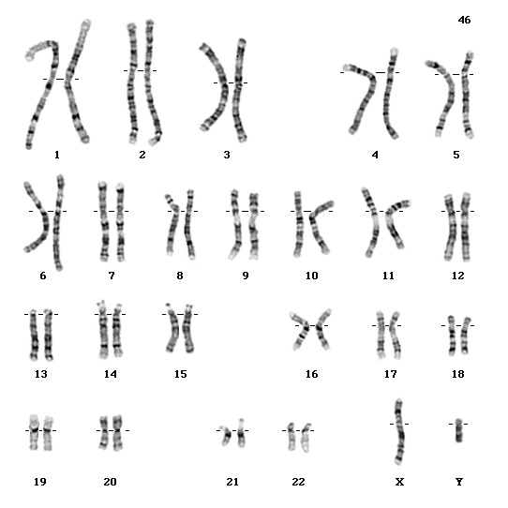
Karyotype
An organized picture of the chromosomes of a human arranged in pairs by size from largest to smallest.
Pairs 1-22 called AUTOSOMES
Last pair are SEX CHROMOSOMES
Male - XY

Slide 47
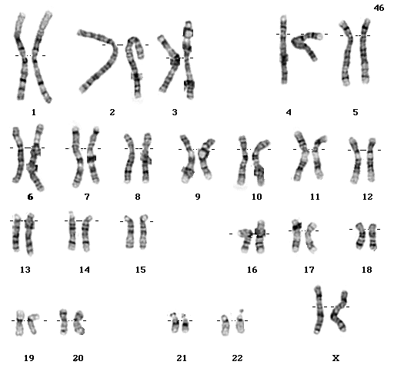
Karyotype
Female - XX

Slide 48
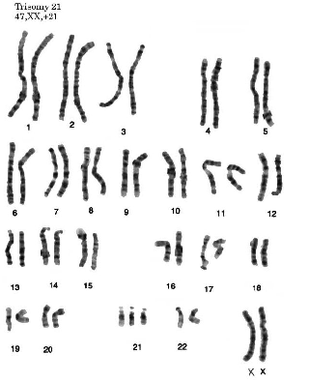
Karyotype
Down Syndrome – Trisomy 21
Female - XX

Slide 49
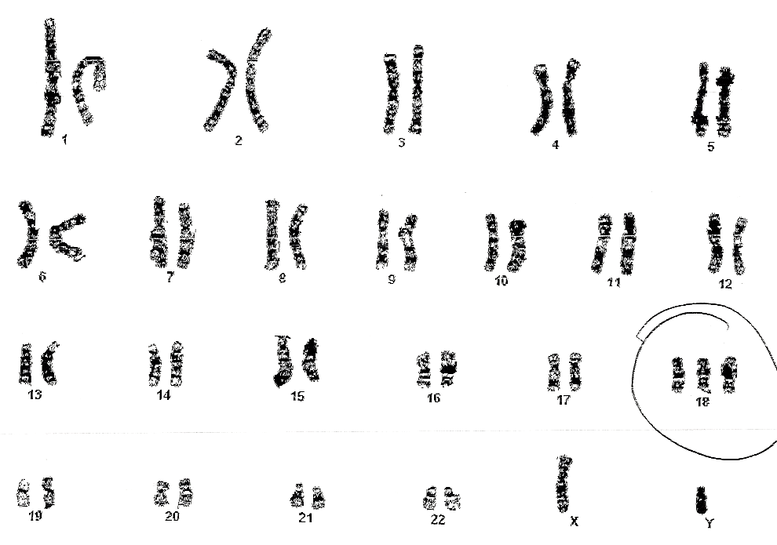
Karyotype
Observe the following karyotype and see if you can determine if there is an unusual chromosome number

Slide 50
Karyotype
Observe the following karyotype and see if you can determine if there is an unusual chromosome number

Slide 51
Karyotype
Specimen Type: Amniotic Fluid
Tests Performed: Chromosome Analysis
Banding Technique: G-Banding
Band Resolution: 450
Results: 47, XY, +18
Interpretation: An extra chromosome 18 is found in all metaphases examined. The findings are consistent with a diagnosis of 18 trisomy in a fetus with male sex chromosomes. Trisomy 18 is associated with spontaneous fetal loss. Term infants with this (Edward’s) syndrome also have multiple and severe congenital defects.

