Slide 1
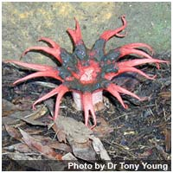
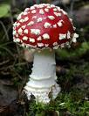
Chapter 21 : Kingdom Fungi
Page: 527

Slide 2
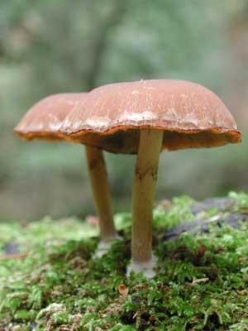
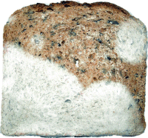
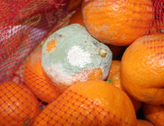
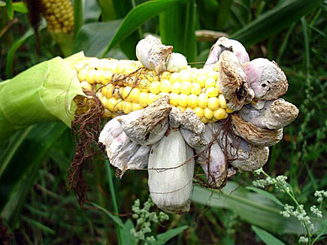
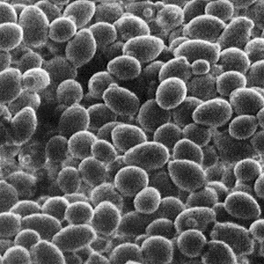
What types of Fungi do you know?
Bread Molds
Mushrooms
Molds on oranges
Yeasts
Mildews
Rusts & Smuts

Slide 3
What are Fungi?
Plant-like characteristics:
Stationary
Grow upward
Have cell walls, but contain CHITIN not Cellulose
The big difference is they lack Chlorophyll
Animal-like Characteristics:
Heterotrophic (Parasitic or Saprohytes)

Slide 4
Parasite v. Saprophyte
Parasite
Feed on living material
Internal digestion
Saprophyte
Feeds on dead and decaying material
Extracellular digestion
– Excretes enzymes to break down materials, then absorbs what it needs.

Slide 5
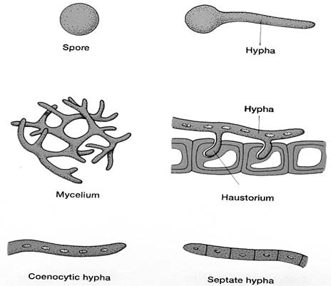
How are Fungi Classified?
Fungi are classified according to the way they produce spores during Sexual reproduction.
Zygomycota- Zygospore
Basidiomycota- Basidium
Ascomycota- Ascus
Deuteromycota - None

Slide 6
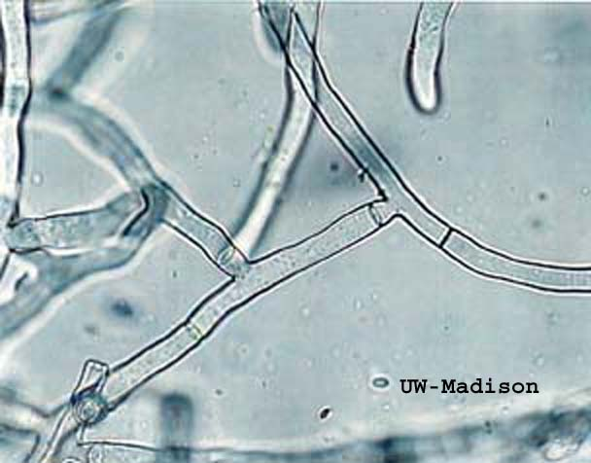
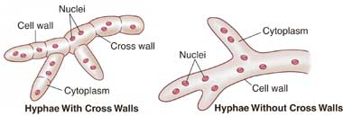
Structure and function
Multicellular
Tiny filaments called Hyphae. These may or may not have crosswalls.

Slide 7
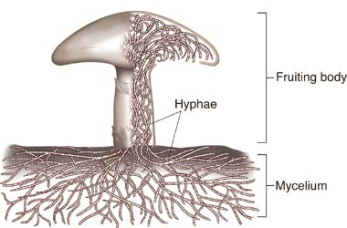
The bodies of multicellular fungi are composed of many hyphae tangled together in a mass called a Mycelium.
Mycellium is well suited to absorb food because it provides a large surface area.

Slide 8
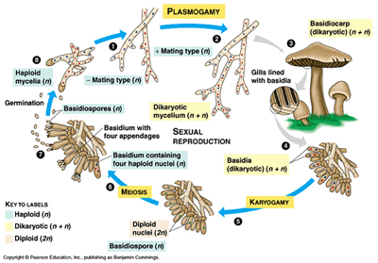
Reproduction
Most use both sexual and asexual reproduction. (Exception to the rule is Deuteromycota)

Slide 9
Phylum Zygomycota
“The Common Molds” pg. 530
Ex. Bread Mold (Rhizopus stolonifer )
Structures:
Zygospore-> resting spore that contains zygotes
Rhizoids.->(roots)Anchor fungus to bread
Stolons->Stems that run along the surface
Life cycle: contains zygospores
Sexual & asexual
Alternation of generations

Slide 10
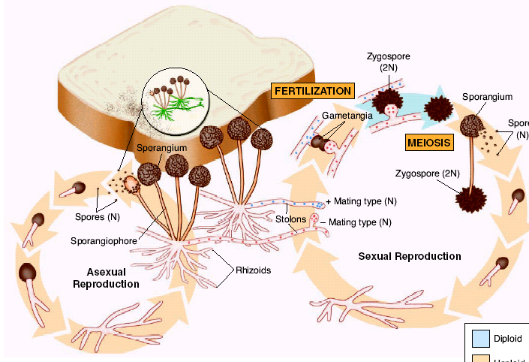
Bread Mold

Slide 11
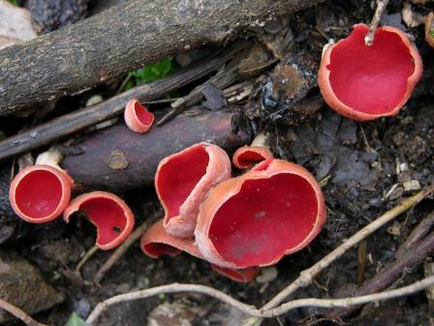
Phylum Ascomycota
“The sac Fungi” pg. 532
Ex. Yeast, Mildew, Cup Fungi.
Largest phylum in the kingdom Fungi.
Structures:
-Ascus (Asci) ->The Ascus is a cup like structure where sexual spores are produced.
Life Cycle: Asexual & Sexual
Alternation of generations

Slide 12
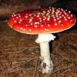
Phylum Basidiomycota
“The club fungi”pg. 534.
Ex. Mushrooms and Shelf Fungi. Rusts and smuts that damage crops.
Structure: Basidium-> Named after the club shape of their reproductive structure
Life Cycle: One of the most elaborate life cycles.
Sexual & Asexual
Alternation of generations

Slide 13
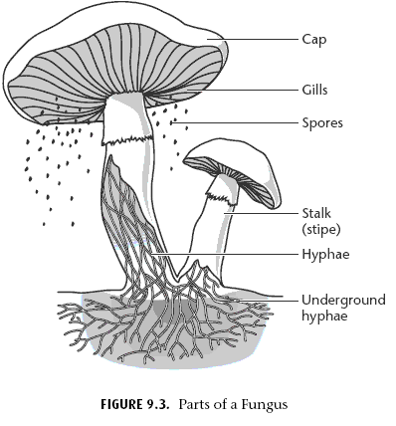

Slide 14
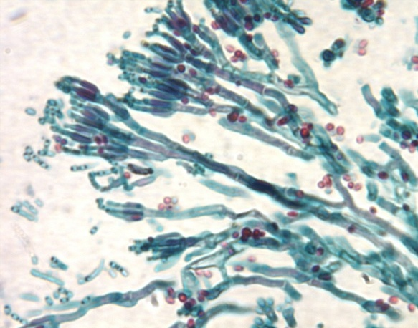
Phylum Deuteromycota
“The Imperfect Fungi” pg. 536
Ex. Penicillium notatum
Structure: No sexual reproductive structures found
Life cycle: Only asexual

Slide 15
Fungi Relationships
Lichen are a symbiotic relationship between a fungus and a photosynthetic algae/cyanobacteria.
The relationship helps them to survive in harsh conditions
Lichens are often a pioneer organism in barren environments, and a good indicator of air quality.
Fungus provides protection, algae provides energy.

Slide 16
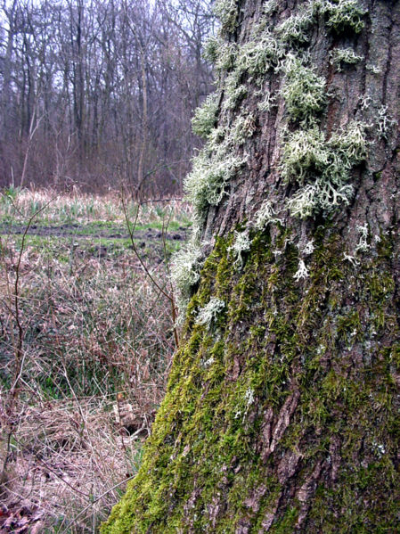
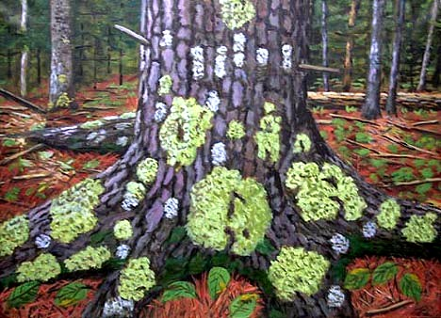

Slide 17
Fungi Relationships
Mycorrhizae is a mutualistic relationship between a plant and a fungus
Fungus in the root of the plants helps to break down nutrients for absorption.
Plant provides sugars for the fungus.

Slide 18
