Slide 1
Cell Growth and Division
Cell Size
Cell Cycle
Mitosis

Slide 2
Why do Cells Divide?
Cellular Reasons
1. The DNA is placed under too much stress
2. Movement of water and nutrients is not efficient in larger cells
Organism Reasons
Replace Dead or Damaged Cells
Growth of a multicellular organism
Reproduction of a Unicellular Organism

Slide 3
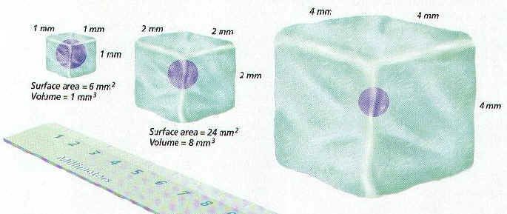
Cell Size

Slide 4
Factors that determine cell size
Surface Area- the amount of cell membrane
Volume- the space the inside of the cell takes up
Healthy cells have a high surface area: volume ratio

Slide 5
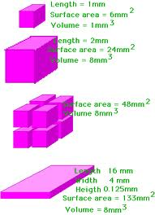
Surface Area : Volume Ratio
Calculate the surface area : volume ratio for each example
Determine which ratio is the best of a cell? Explain your answer
The largest cell is an ostrich egg (the size of a grapefruit) How does it survive?

Slide 6
What next?
If a cell grows too big what happens?
  IT DIVIDES, HOW IS CELL DIVISION HELPFUL?
  IT allows for a better surface area : volume ratio

Slide 7
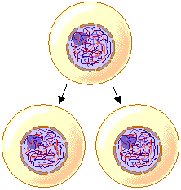
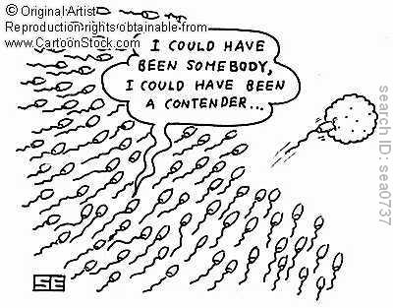
Cell Division
Asexual Reproduction- production of offspring that are identical to the parent
Sexual Reproduction- production of offspring that are different from the parent cells.

Slide 8
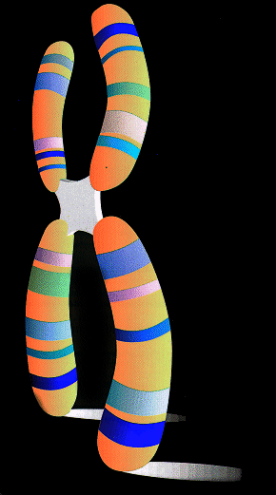
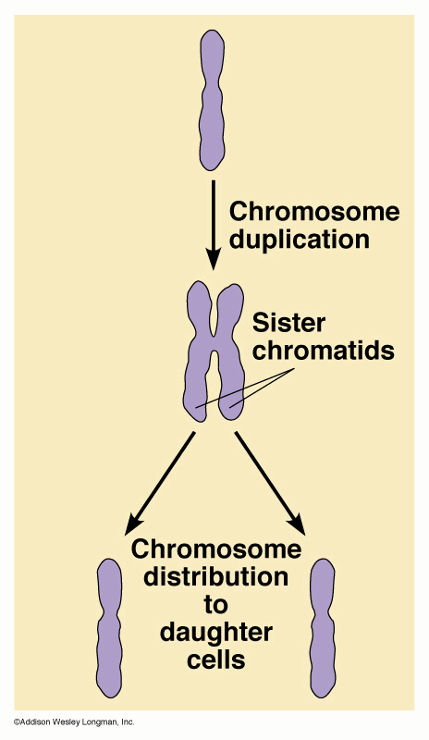
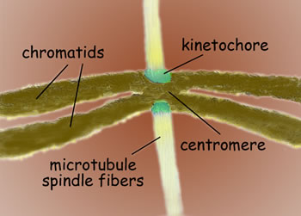
Terms of Cell Division
Chromosome
  Chromatid
  Centromere
  Kinetochore
Daughter cell/Sister cells
Parent cell

Slide 9
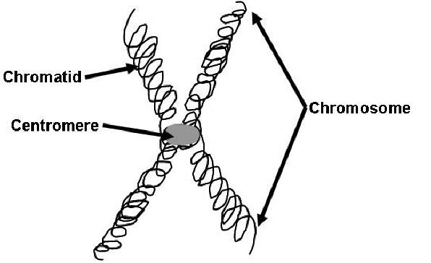
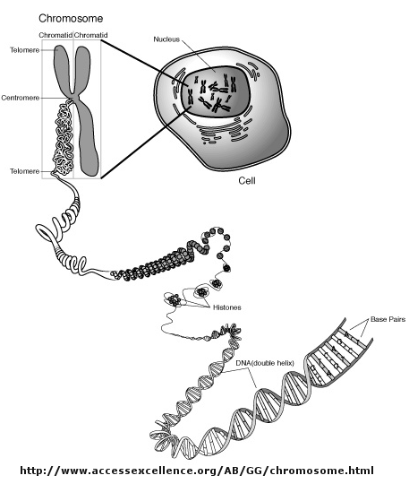
Chromosomes
When cells are ready to divide they need to pack their DNA
Unpacked DNA is call chromatin
Packed DNA is call a chromosome

Slide 10
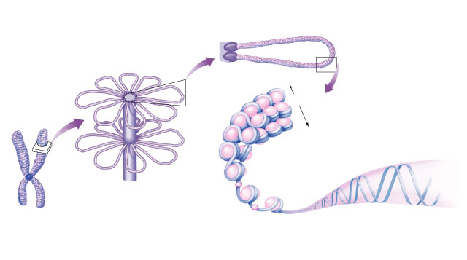
Chromosome structure
scaffold
protein
chromatin loop
30 nm
DNA
nucleosome
histone
rosettes of
chromatin loops
chromosome
DNA double helix

Slide 11
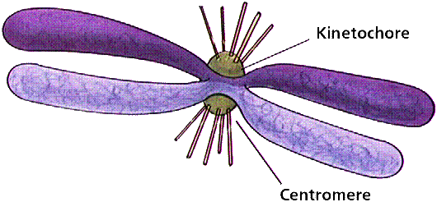
Kinetochore
Each chromatid
has own kinetochore proteins
  microtubules
  attach to kinetochore proteins

Slide 12
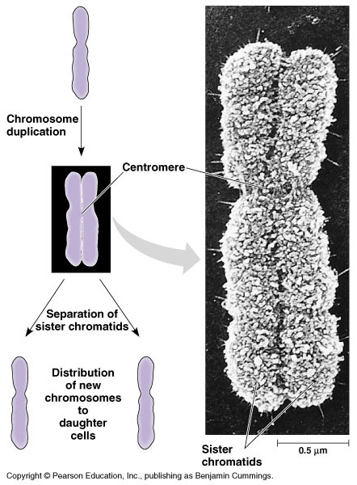
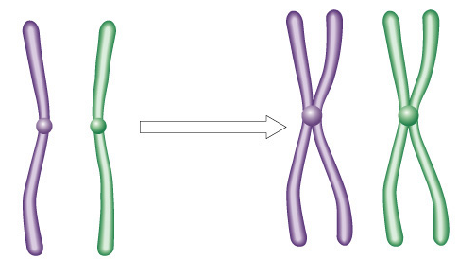
Mitotic Chromosome
Duplicated chromosome
  2 sister chromatids
  narrow at centromeres
  contain identical
  copies of original DNA
homologous
chromosomes
homologous
chromosomes
single-stranded
sister chromatids
homologous = “same information”
double-stranded
Notes:
Centromeres are segments of DNA which have long series of tandem repeats = 100,000s of bases long. The sequence of the repeated bases is quite variable. It has proven difficult to sequence.

Slide 13
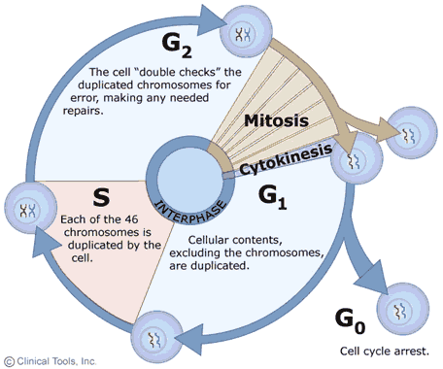
Cell Cycle
G₁- The cell grows and increases in size
S- Synthesis- copying of DNA
G₂- Cell prepares to divide, it does not increase in size
M- Mitosis/Nuclear Division of chromosomes
C- Cytokinesis- Division of the cytoplasm

Slide 14
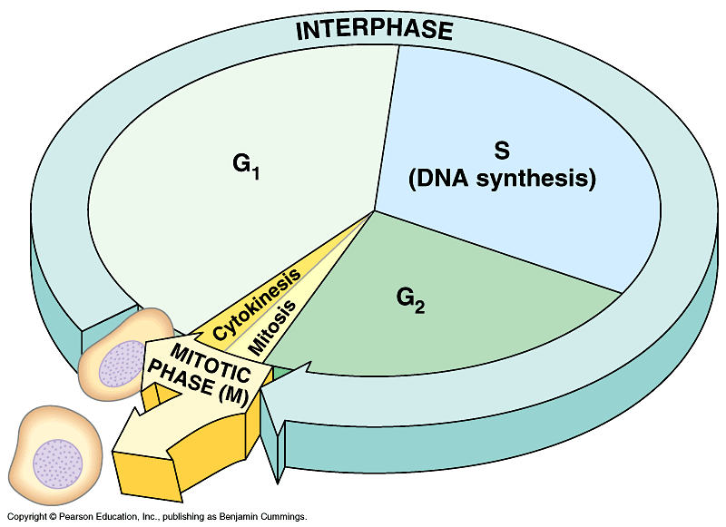
Interphase
90% of cell life cycle
  cell doing its “everyday job”
    produce RNA, synthesize proteins/enzymes
  prepares for duplication if triggered
I’m working here!
Time to divide
& multiply!

Slide 15
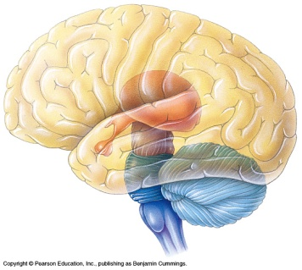
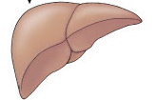
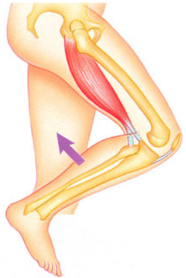
Cell cycle
Cell has a “life cycle”
cell is formed from
a mitotic division
cell grows & matures
to divide again
cell grows & matures
to never divide again
G₁, S, G₂, M
liver cells
G₁→G₀
epithelial cells,
blood cells,
stem cells
brain / nerve cells
muscle cells

Slide 16

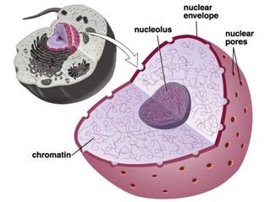
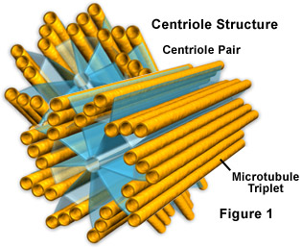
Mitosis
Events of mitosis:
  Prophase
  Metaphase
  Anaphase
  Telophase
  Words to know: centrioles, spindle fibers, nuclear envelope

Slide 17
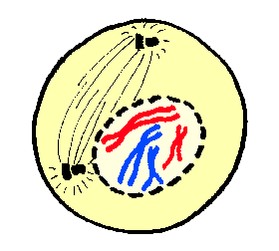
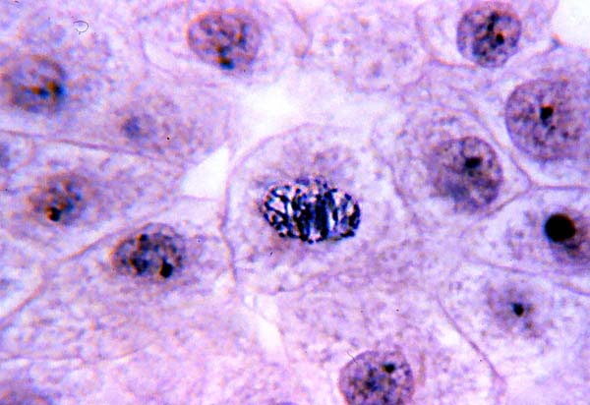
Phases of Mitosis
Prophase
Chromatin condenses (packs) to form chromosomes
Centrioles move to opposite poles (ends of the cell) and spindle fibers begin to form between them and stretch the length of the cell
Nuclear envelope begins to breakdown and disappear
Nucleolus disappears

Slide 18
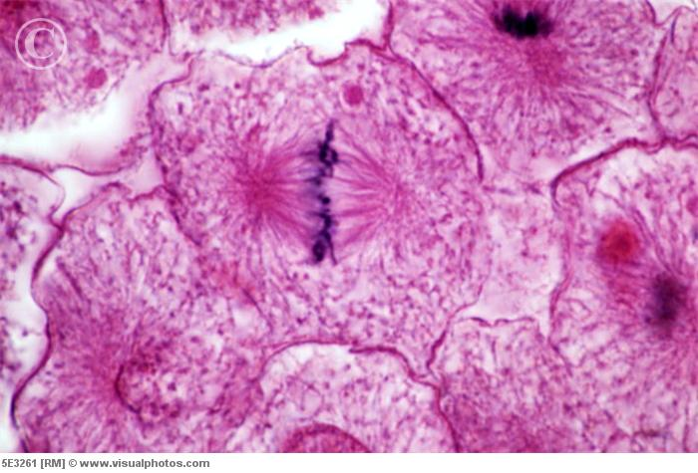
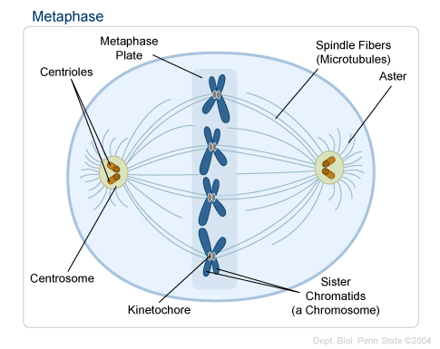
Phases of Mitosis
Metaphase
Spindle fibers connect to each chromosome at the centromere/kinetochore
The spindle fibers move the chromosomes to the center (middle) of the cell
All chromosomes line the center of the cell.
46 for humans

Slide 19
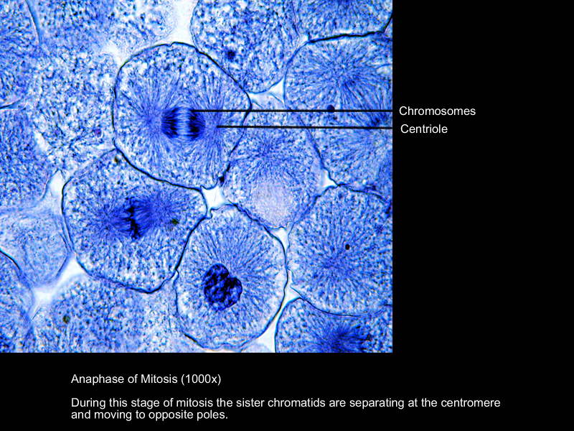
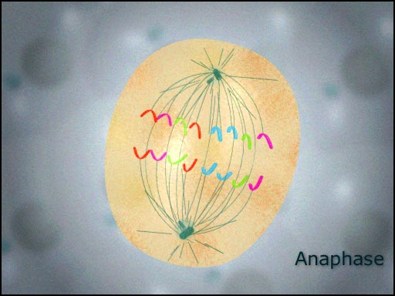
Phases of Mitosis
Anaphase
The sister chromatids separate into individual chromosomes and move apart
Away, Away, Away

Slide 20
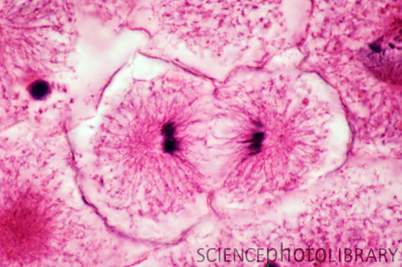
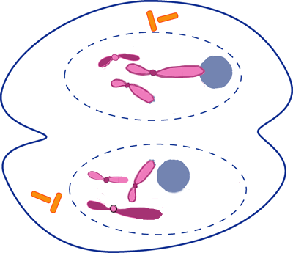
Phases of Mitosis
Telophase
Chromosomes gather at opposite ends of the cell
Chromosomes unpack (uncoil)
TWO new nuclear envelopes reform
Spindle fibers break down
Nucleolus reappears

Slide 21
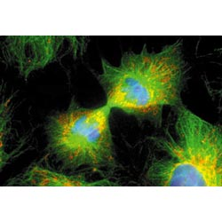
Cytokinesis
Cytoplasm pinches in half.
Each new daughter cell has a set of chromosomes, cytoplasm and organelles

Slide 22
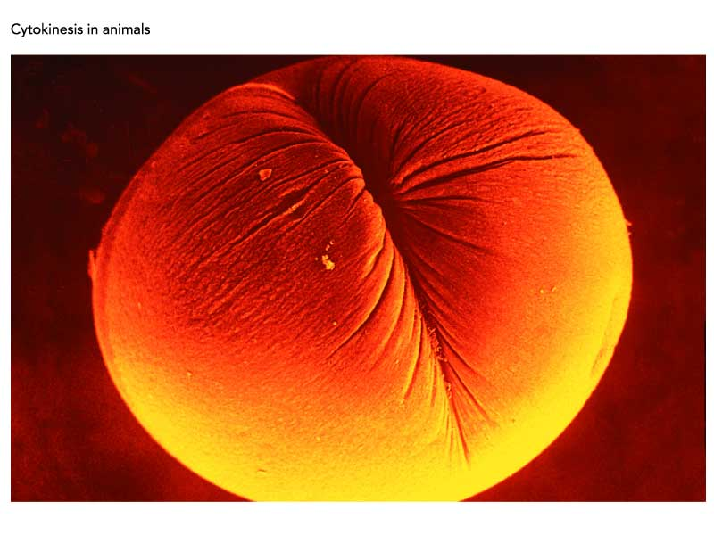
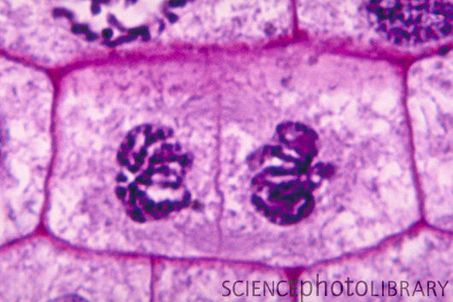
Cytokinesis
Animal Cell
Plant Cell
Cleavage furrow
Cell plate

Slide 23
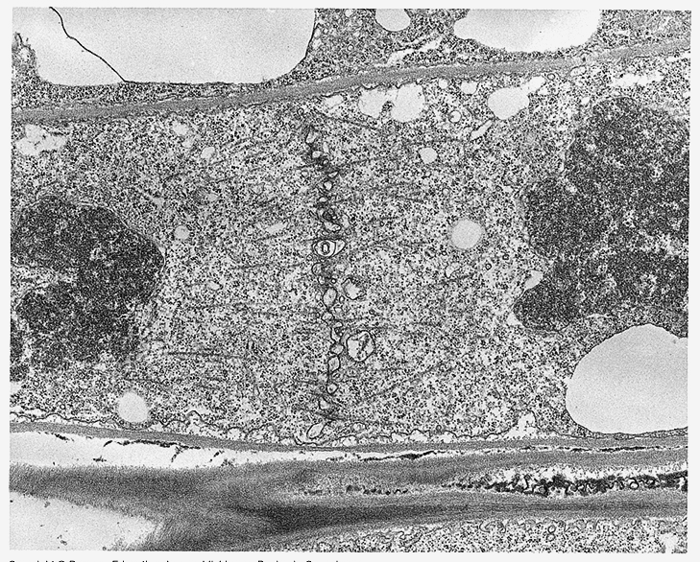
Cytokinesis in plant cell

Slide 24
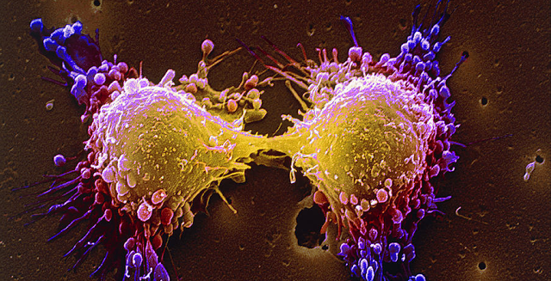
Products of Mitosis
2 Identical Diploid Cells
Somatic Cells (Body Cells)
Daughter Cells

Slide 25
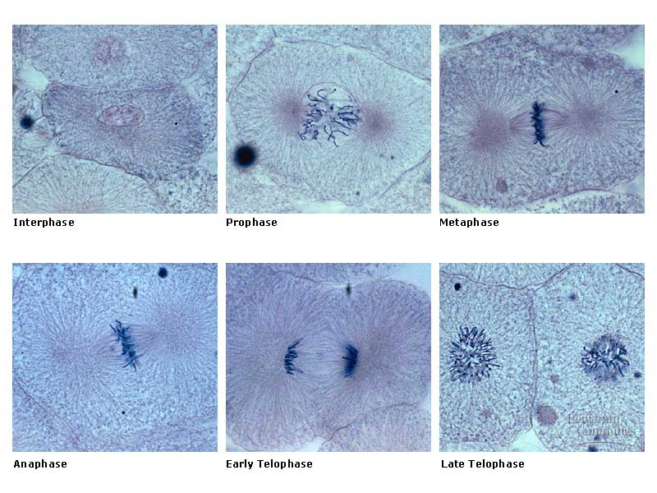
Mitosis in whitefish blastula

Slide 26
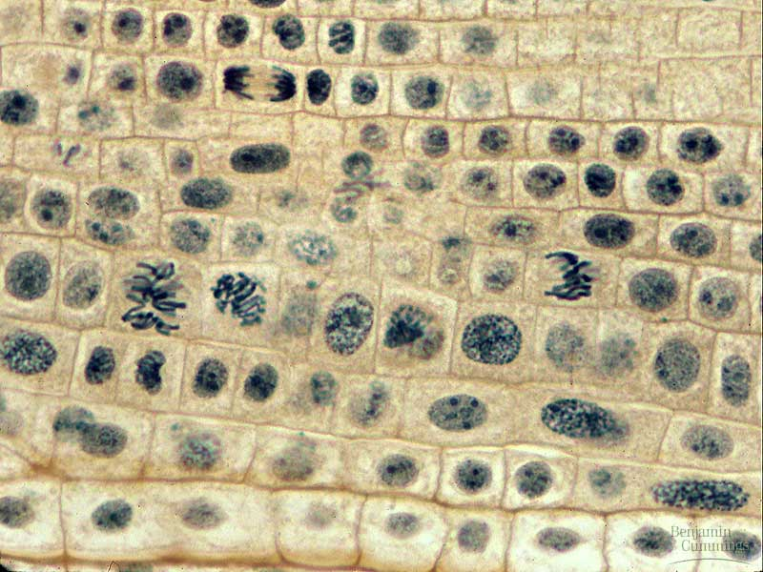
onion root tip

Slide 27
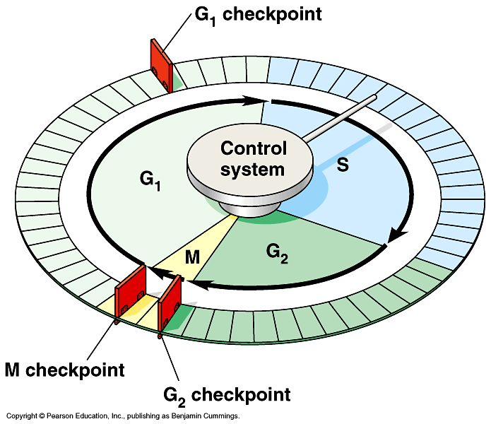
Checkpoint control system
Checkpoints
  cell cycle controlled by STOP & GO chemical signals at critical points
  signals indicate if key cellular
  processes have been
  completed correctly

Slide 28
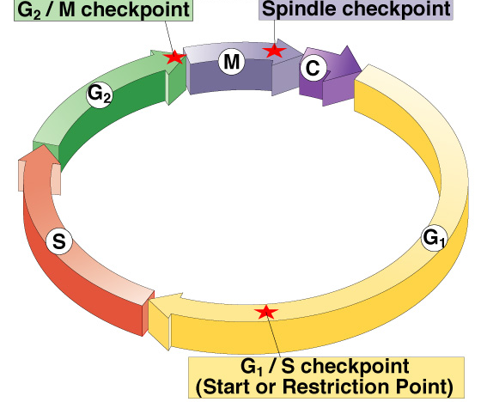
Checkpoint control system
3 major checkpoints:
  G/S
    can DNA synthesis begin?
  G₂/M
    has DNA synthesis been completed correctly?
    commitment to mitosis
  spindle checkpoint
    are all chromosomes attached to spindle?
    can sister chromatids separate correctly?

Slide 29
G₁/S checkpoint
G₁/S checkpoint is most critical
  primary decision point
    “restriction point”
  if cell receives “GO” signal, it divides
    internal signals: cell growth (size), cell nutrition
    external signals: “growth factors”
  if cell does not receive
  signal, it exits cycle &
  switches to G₀ phase
    non-dividing, working state

Slide 30
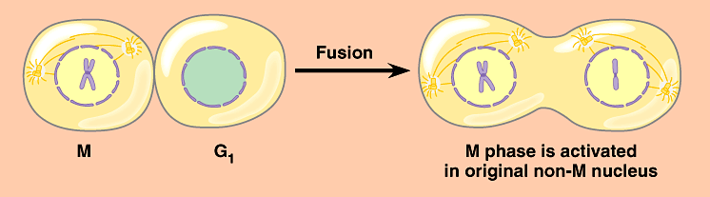
Activation of cell division
How do cells know when to divide?
  cell communication signals
    chemical signals in cytoplasm give cue
    signals usually mean proteins
      activators
      inhibitors
experimental evidence: Can you explain this?

Slide 31
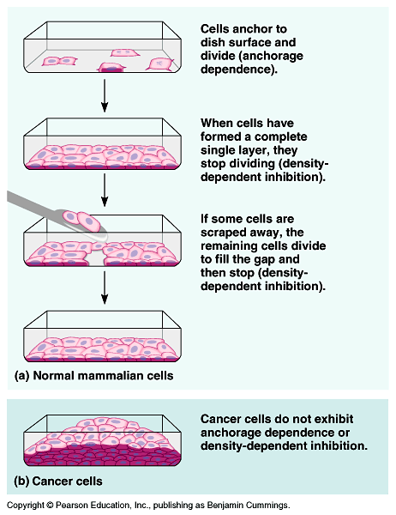
External signals
Growth factors
  coordination between cells
  protein signals released by body cells that stimulate other cells to divide
    density-dependent inhibition
      crowded cells stop dividing
      each cell binds a bit of growth factor
        not enough activator left to trigger division in any one cell
    anchorage dependence
      to divide cells must be attached to a substrate
        “touch sensor” receptors

Slide 32
Growth Factors and Cancer
Growth factors can create cancers
  proto-oncogenes
    normally activates cell division
      growth factor genes
      become oncogenes (cancer-causing) when mutated
    if switched “ON” can cause cancer
    example: RAS (activates cyclins)
  tumor-suppressor genes
    normally inhibits cell division
    if switched “OFF” can cause cancer
    example: p53

Slide 33
Cancer & Cell Growth
Cancer is essentially a failure
of cell division control
  unrestrained, uncontrolled cell growth
What control is lost?
  lose checkpoint stops
  gene p53 plays a key role in G₁/S restriction point
    p53 protein halts cell division if it detects damaged DNA
      options:
        stimulates repair enzymes to fix DNA
        forces cell into G₀ resting stage
        keeps cell in G₁ arrest
        causes apoptosis of damaged cell
    ALL cancers have to shut down p53 activity
p53 is the
Cell Cycle
Enforcer
p53 discovered at Stony Brook by Dr. Arnold Levine

Slide 34
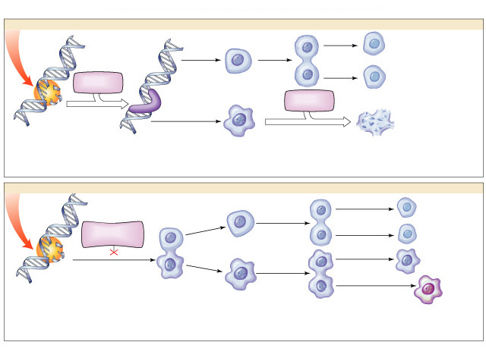
p53 — master regulator gene
NORMAL p53
p53 allows cells
with repaired
DNA to divide.
p53
protein
DNA repair enzyme
p53
protein
Step 1
Step 2
Step 3
DNA damage is caused
by heat, radiation, or
chemicals.
Cell division stops, and
p53 triggers enzymes to
repair damaged region.
p53 triggers the destruction
of cells damaged beyond repair.
ABNORMAL p53
abnormal
p53 protein
cancer
cell
Step 1
Step 2
DNA damage is
caused by heat,
radiation, or
chemicals.
The p53 protein fails to stop
cell division and repair DNA.
Cell divides without repair to
damaged DNA.
Step 3
Damaged cells continue to divide.
If other damage accumulates, the
cell can turn cancerous.

Slide 35
Development of Cancer
Cancer develops only after a cell experiences ~6 key mutations (“hits”)
  unlimited growth
    turn on growth promoter genes
  ignore checkpoints
    turn off tumor suppressor genes (p53)
  escape apoptosis
    turn off suicide genes
  immortality = unlimited divisions
    turn on chromosome maintenance genes
  promotes blood vessel growth
    turn on blood vessel growth genes
  overcome anchor & density dependence
    turn off touch-sensor gene
It’s like an
out-of-control
car with many
systems failing!

Slide 36
What causes these “hits”?
Mutations in cells can be triggered by
  UV radiation
  chemical exposure
  radiation exposure
  heat
  cigarette smoke
  pollution
  age
  genetics

Slide 37
Tumors
Mass of abnormal cells
  Benign tumor
    abnormal cells remain at original site as a lump
      p53 has halted cell divisions
    most do not cause serious problems &
    can be removed by surgery
  Malignant tumor
    cells leave original site
      lose attachment to nearby cells
      carried by blood & lymph system to other tissues
      start more tumors = metastasis
    impair functions of organs throughout body

Slide 38
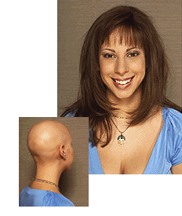
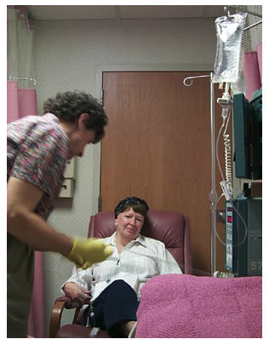
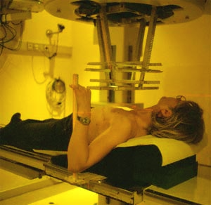
Traditional treatments for cancers
Treatments target rapidly dividing cells
  high-energy radiation
    kills rapidly dividing cells
  chemotherapy
    stop DNA replication
    stop mitosis & cytokinesis
    stop blood vessel growth

Slide 39
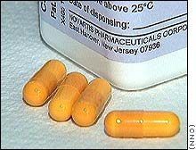
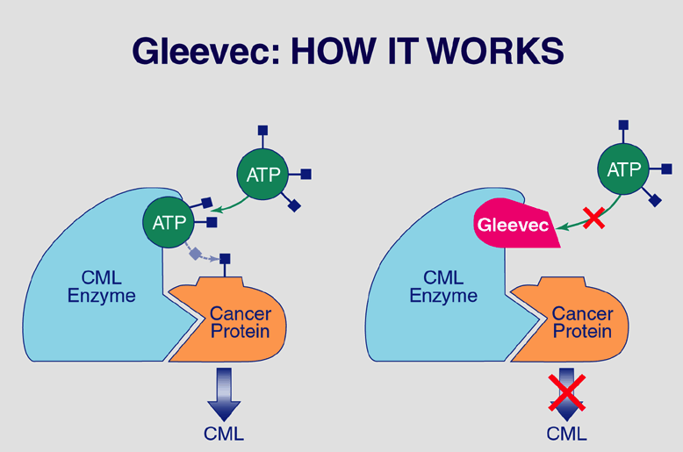
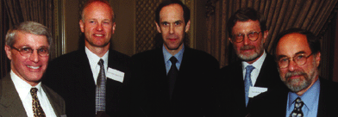
New “miracle drugs”
Drugs targeting proteins (enzymes) found only in cancer cells
  Gleevec
    treatment for adult leukemia (CML)
    & stomach cancer (GIST)
    1st successful drug targeting only cancer cells
without
Gleevec
with
Gleevec
Novartes
Notes:
Proof of Principle: you can treat cancer by targeting cancer-specific proteins.
GIST = gastrointestinal stromal tumors, which affect as many as 5,000 people in the United States
CML = chronic myelogenous leukemia, adult leukemia, which affect as many as 8,000 people in the United States
Fastest FDA approval — 2.5 months

