Slide 1
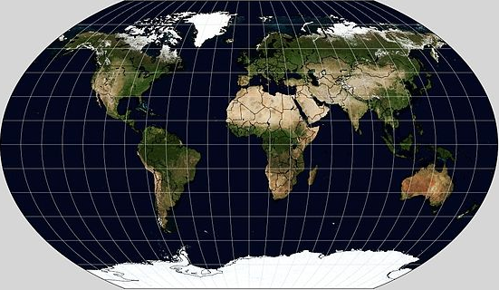
Biogeochemical Cycles

Slide 2
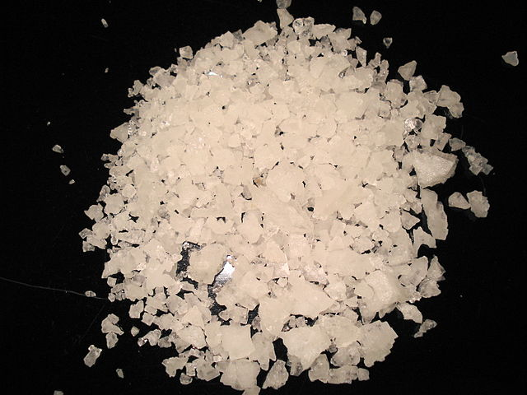
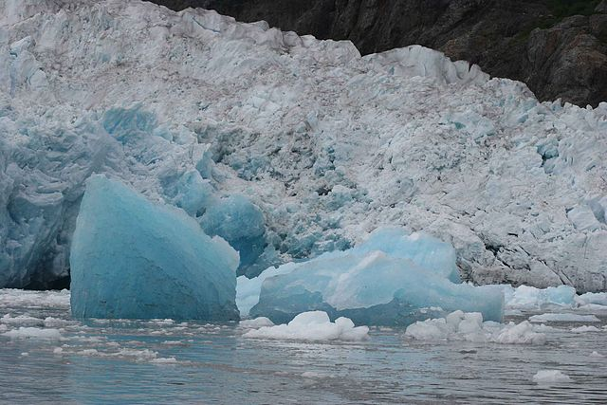
Hydrologic Cycle
aka: Water cycle
Defined: Movement of water through the atmosphere
75% of the earth’s surface is covered by water
  Most water undrinkable (salty & frozen)

Slide 3
Hydrologic Cycle
Water rises in two ways:
  1) Evaporation: heat from the sun changes water from liquid to gas
  2) Transpiration: evaporation of water from the leaves of plants
H₂O
H₂O

Slide 4
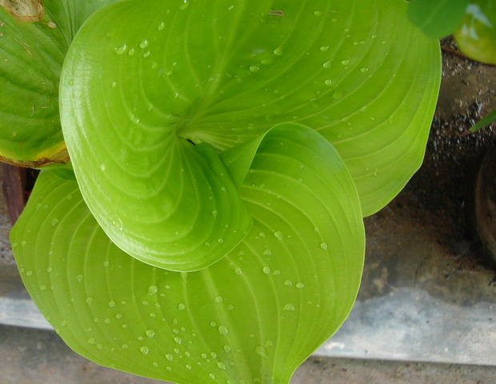
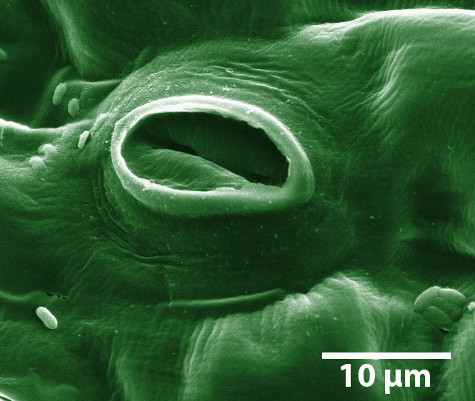
Hydrologic Cycle
Water rises in two ways:
  1) Evaporation: heat from the sun changes water from liquid to gas
  2) Transpiration: evaporation of water from the leaves of plants
    Stomata: microscopic pores on underside of leaves
H
H
O

Slide 5
Hydrologic Cycle
H₂O
H₂O
H₂O
H₂O
H₂O
H₂O
H₂O
H₂O
H₂O
H₂O
H₂O
H₂O
Water rises in two ways:
  1) Evaporation: heat from the sun changes water from liquid to gas
  2) Transpiration: evaporation of water from the leaves of plants
    Stomata: microscopic pores on underside of leaves
H₂O
H₂O

Slide 6
Hydrologic Cycle
H₂O
H₂O
H₂O
H₂O
H₂O
H₂O
H₂O
H₂O
H₂O
H₂O
H₂O
H₂O
Condensation: changing of water vapor to liquid water
  Cause: cool temperatures
Moisture in the air condensed when it came into contact with the cold bottle

Slide 7
Hydrologic Cycle
H₂O
H₂O
H₂O
H₂O
H₂O
H₂O
H₂O
H₂O
H₂O
H₂O
H₂O
H₂O
Condensation: changing of water vapor to liquid water
  Cause: cool temperatures
  Clouds are the effects of condensation

Slide 8
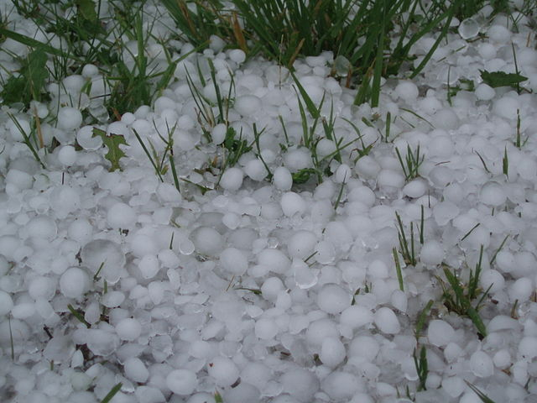
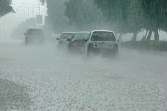
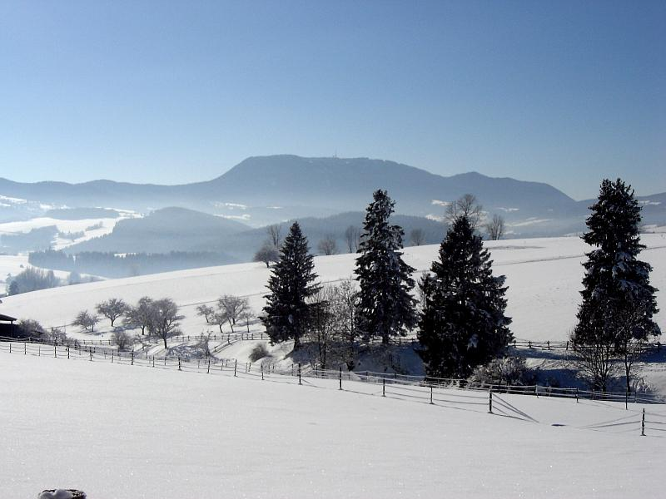
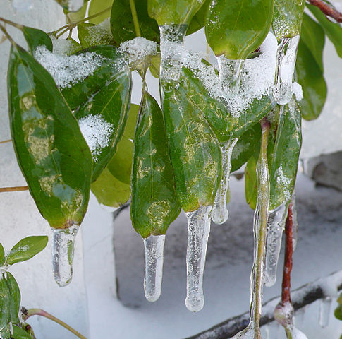
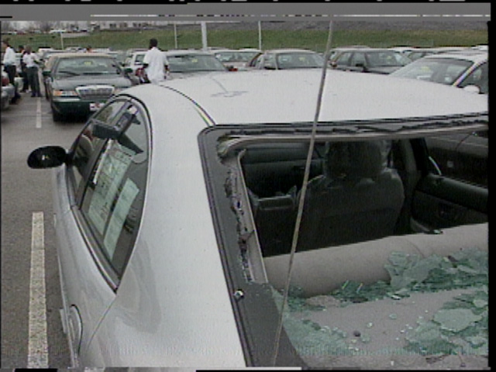

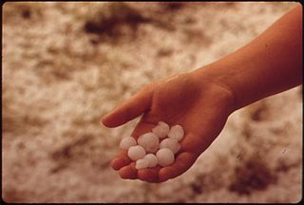
Hydrologic Cycle
H₂O
H₂O
H₂O
Precipitation: Falling of water back to the surface of the Earth
  Rain
  Snow
  Sleet
  Hail

Slide 9
Hydrologic Cycle
H₂O
H₂O
H₂O
On the ground:
1) Runoff: water runs downhill into rivers, lakes, oceans…
2) Infiltration: water soaks into soil and collects as groundwater
H₂O
H₂O
H₂O
H₂O
H₂O
H₂O
H₂O

Slide 10
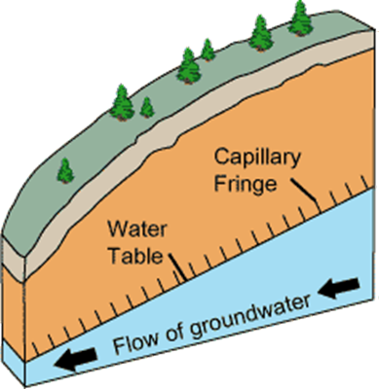
Hydrologic Cycle
On the ground:
1) Runoff: water runs downhill into rivers, lakes, oceans…
2) Infiltration: water soaks into soil and collects as groundwater
well
Groundwater is “recharged” by infiltration

Slide 11
Hydrologic Cycle
condensation
precipitation
transpiration
infiltration
runoff
evaporation

Slide 12


Oxygen Cycle
Autotrophs:
  Photosynthesis requires the intake in CO₂
  Produces O₂ waste
Heterotrophs:
  Cellular respiration requires the intake in O₂
  Produces CO₂ waste
O2
O2
CO2
CO2

Slide 13
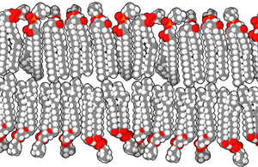
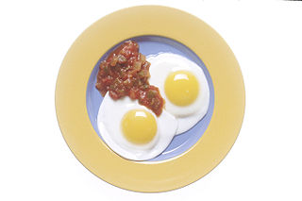
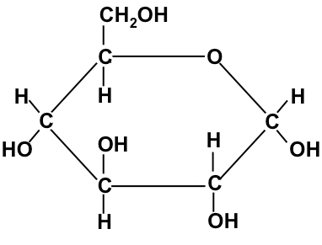
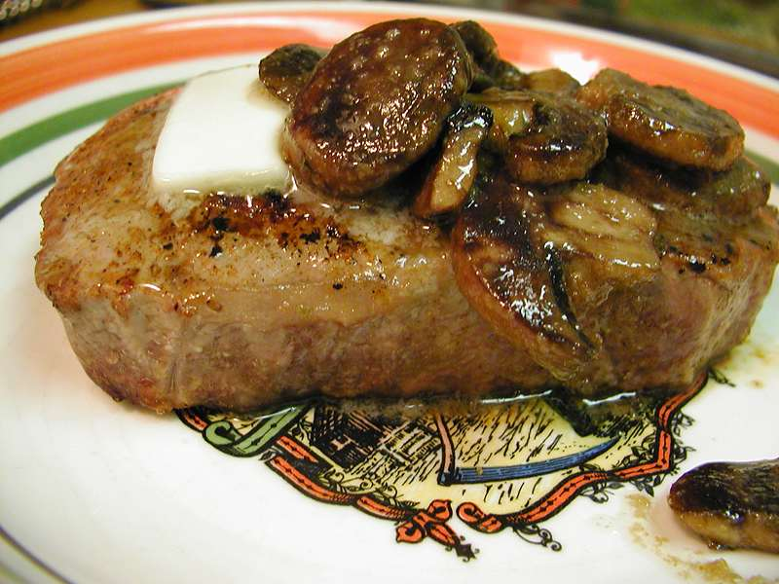
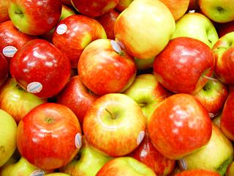
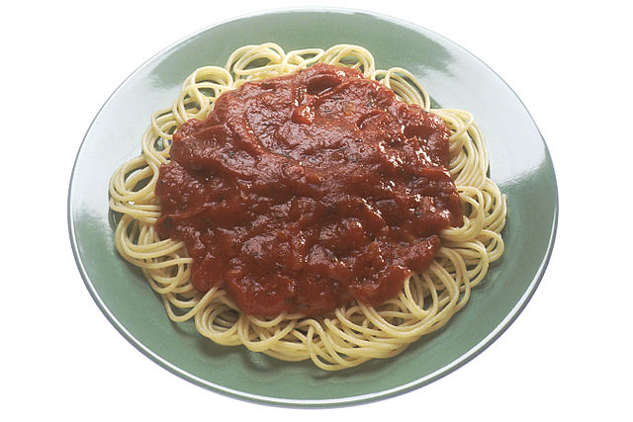
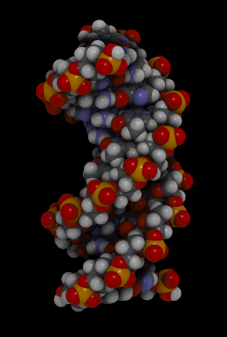
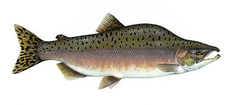
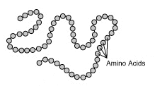
Carbon Cycle
Carbon (C) is the basis of organic molecules
  Proteins
  Carbohydrates
  Lipids
  Nucleic acids

Slide 14
Carbon Cycle
CO₂
CO₂
CO₂
CO₂
CO₂
Plants and Producers
  Absorb CO₂ during photosynthesis
  Produce glucose (C₆H₁₂O₆) via photosynthesis
glucose

Slide 15
Carbon Cycle
CO₂
CO₂
CO₂
CO₂
CO₂
Animals
  Glucose moves up the food chain
  CO₂ released into atmosphere
CO₂
glucose
CO₂
glucose

Slide 16
Carbon Cycle
CO₂
CO₂
CO₂
CO₂
CO₂
Decomposers
  Obtain glucose by feeding on the dead
  CO₂ released into atmosphere
CO₂
glucose
CO₂
CO₂
glucose
glucose
glucose
glucose

Slide 17
Carbon Cycle
CO₂
CO₂
CO₂
CO₂
CO₂
Human contribution
  Excess CO₂ is being released from the burning of fossil fuels (coal, oil, natural gas)
  Cycle is out of balance
CO₂
CO₂
CO₂
CO₂
CO₂
CO₂
CO₂
CO₂
CO₂
CO₂
CO₂
glucose
CO₂
CO₂
glucose
glucose
glucose
glucose

Slide 18
Carbon Cycle
CO₂
CO₂
CO₂
CO₂
CO₂
CO₂
CO₂
CO₂
CO₂
CO₂
CO₂
CO₂
CO₂
CO₂
CO₂
CO₂
glucose
CO₂
CO₂
glucose
glucose
glucose
glucose

Slide 19
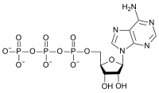
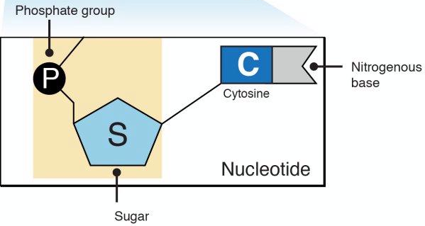
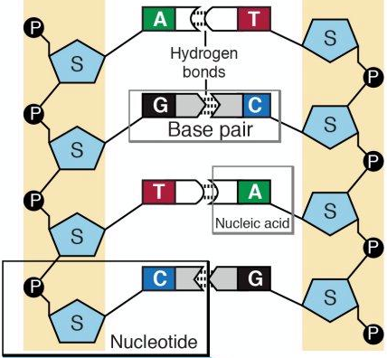

Phosphorus (P) Cycle
Problem: No phosphorus in atmosphere
Phosphorus needed to make:
  ATP
  DNA
  lipids

Slide 20
Phosphorus (P) Cycle
Phosphorus released from the weathering of rocks
Producers absorb phosphorus through their roots
2
1
p
p

Slide 21
Phosphorus (P) Cycle
Phosphorus moves up the food chain as animals eat producers
Decomposers obtain phosphorus as they feed on dead remains
    Phosphorus released in waste
2
p
p
1
p
p
p
p
3
p
p
4

Slide 22
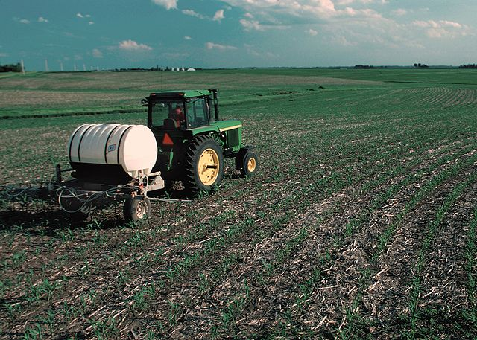
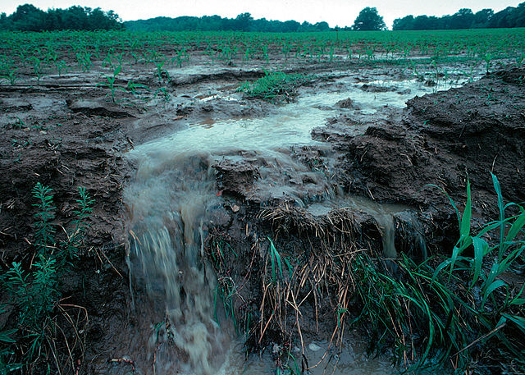
Phosphorus (P) Cycle
Human Contribution
  Fertilizers (contain phosphorus) added to help grow crops
  Problem:
    Phosphorus runs off with rain

Slide 23
Phosphorus (P) Cycle
Human Contribution
  Fertilizers (contain phosphorus) added to help grow crops
  Problem:
    Phosphorus runs off with rain
p
p
p
p
p
p
p
p
p
p

Slide 24
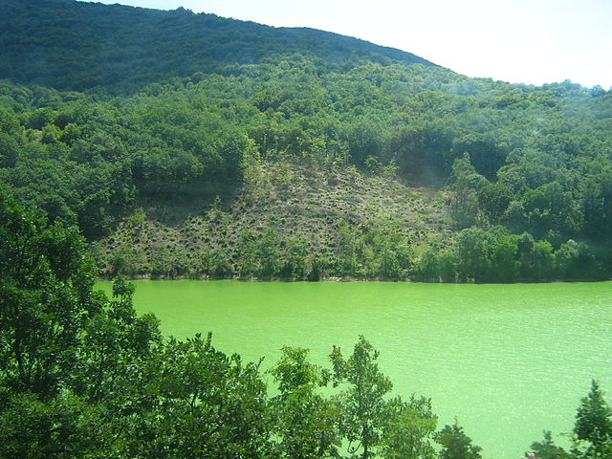
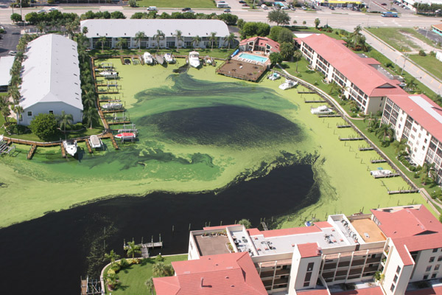
Phosphorus (P) Cycle
Human Contribution
  Fertilizers (contain phosphorus) added to help grow crops
  Problem:
    Phosphorus runs off with rain
    Algal blooms = extreme growth of algae
    Eutrophication = dead zone due to lack of O2 and change in pH
p
p
p
p
p
p

Slide 25
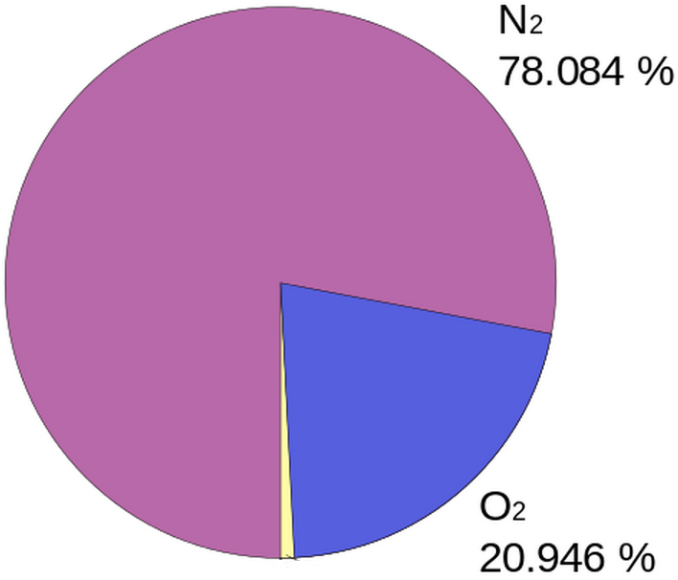
Nitrogen Cycle
Problem: Nitrogen in atmosphere (N₂) is unusable
  N₂ bonds very stable
Nitrogen needed to build DNA
N
N

Slide 26
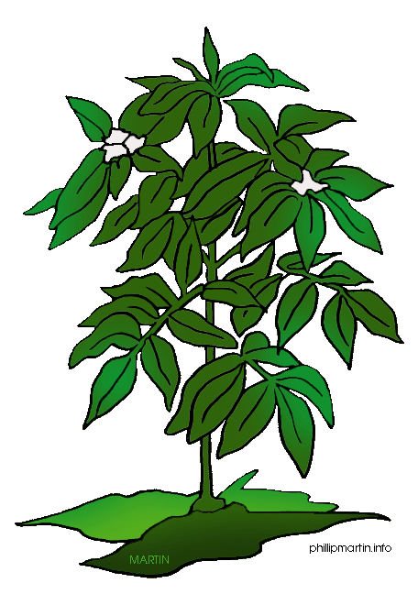




Nitrogen Cycle
Step 1: Soil Bacteria convert N2 into usable nitrates
Step 2: Bacteria absorb nitrates… release N waste into air
N2
Step 3: Producers absorb nitrates through their roots
Step 4: Consumers ingest N through the food chain
Step 5: Decomposers obtain N from the dead… return nitrates to soil
N
3
4
N
N2
2
N
5
Nitrates
Nitrates
Nitrates
Nitrates
1
Nitrogen fixation
Nitrates

Slide 27
The Role of Lightning
O
O
O
O
O
O
O
N
N
O
O
N
O
O
N
O
O
N
N
N
O
N
O
N
O
O
N
N
N
N
N
O
O
N
O
N
N
O
N
O
O
O
N
N
O
O
O
N
O
O
N
N
O
N
O
O
N
O
O
O
N
N
N
O
N
O
O
N
N
O
O
N
O
O
O
O
O
N
N
O
O
O
N
N
O
Energy from lightning breaks apart N₂ into N… and O₂ into O
Nitrogen oxides form
Nitrogen oxides react with rain water to form Nitrates (NO₃)
O

Slide 28
Practice Quiz
Name and define the 6 stages of the water cycle.
How is oxygen released into the atmosphere?
In which cellular process is oxygen removed and used from the atmosphere?
Which organic molecule is created by photosynthesis?
In which cellular process is carbon dioxide released into the atmosphere?
How are humans disrupting the carbon cycle?
What happens during nitrogen fixation?
How do plants obtain nitrogen?
Which objects release phosphorus over time?
How are humans disrupting the phosphorus cycle?

