Slide 1
Organic Macromolecules
A macromolecule is a larger molecule (polymer) built by putting together smaller single units (monomers).
Always contain Carbon, so commonly called Carbon Compounds

Slide 2
4 Types of Organic Molecules
Carbohydrates
Lipids
Proteins
Nucleic Acids

Slide 3
Monomer - Monosaccharides (Mono = 1)
CARBOHYDRATES
Are major sources of energy for cells
Ex. Glucose – cellular respiration
Most common monosaccharides: glucose, fructose, galactose
Notes:
Glucose: *made during photosynthesis *main source of energy for plants and animals
Fructose: *found naturally in fruits *is the sweetest of monosaccarides
Galactose: *found in milk *is usually in association with glucose or fructose

Slide 4
Disaccharide
Disaccharide – two monosaccharides bonded together.
table sugar (sucrose) is made up of glucose and fructose bonded together
milk sugar (lactose) is made up of glucose and galactose

Slide 5
Polysaccharide
Polysaccharide – more than two monosaccharide bonded together.
STARCH - made by plants, broken down by plants and animals
CELLULOSE - made by plants
GLYCOGEN - made and stored by animals only.
*Glycogen is stored in the liver and the muscles and provides the body with a readily available source of energy if blood glucose levels decrease.
Notes:
Potatoes are an example of a starch

Slide 6
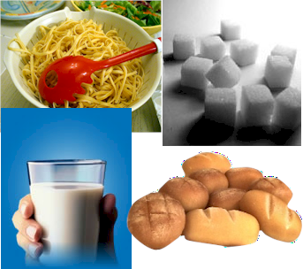
Carbohydrates - FUNCTION
Main source of immediate energy for living things
Plants and some animals use carbohydrates for structural purposes
Sugar or Starch

Slide 7
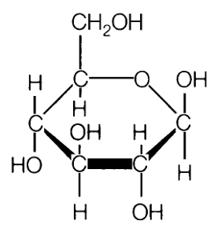
ELEMENTS that make up CARBOHYDRATES
Made up of elements C, H, and O (carbon, hydrogen, and oxygen)
Ratio 1:2:1

Slide 8
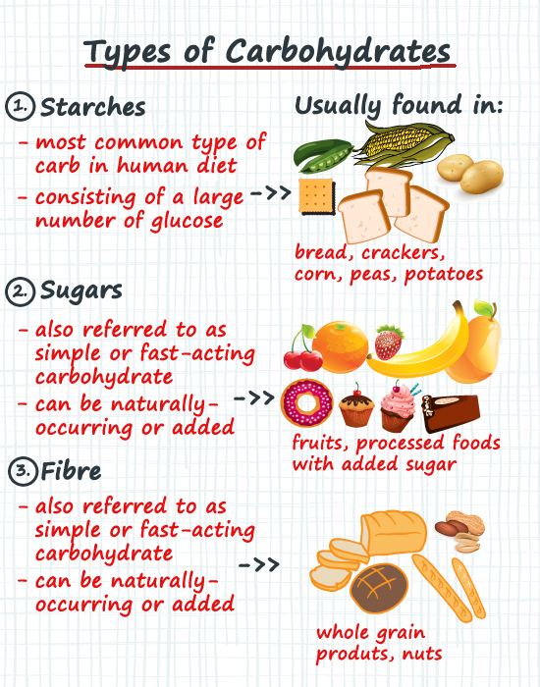

Slide 9
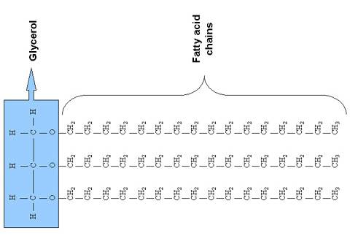
Lipid - MONOMER
Lipid monomers are made up of 3 fatty acids and a glycerol (Triglycerides)

Slide 10
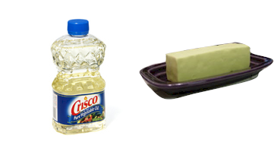
Lipids (fats and oils) - FUNCTION
Used to store energy
Some lipids are important parts of biological membranes and waterproof coverings & insulation.

Slide 11
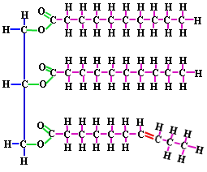
Lipids – ELEMENTS
Contains C, H, and O.
Many more H then O or C.

Slide 12
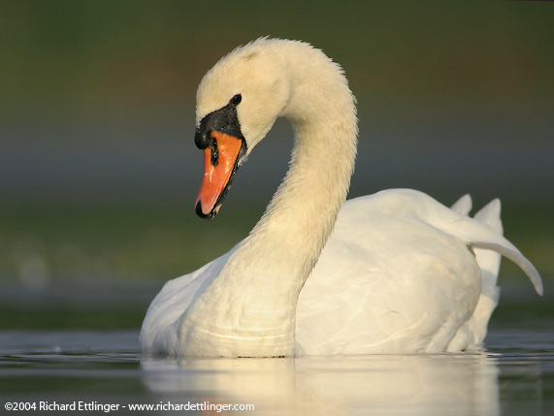
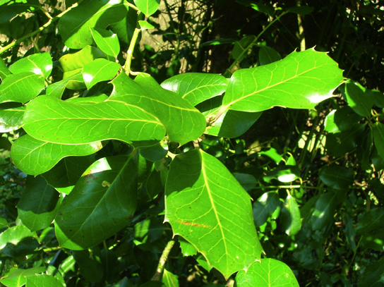
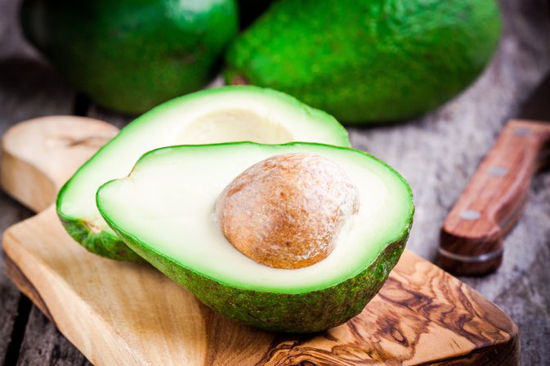
Saturated fat
(solid at room temp)
Unsaturated fat
(liquid at room temp)
Fats, Waxes, Oils, Steroids
Wax covers the feathers of some aquatic birds and the leaf surfaces of some plants, where its hydrophobic (water-repelling) properties prevent water from sticking to, or soaking into, the surface. This is why water beads up on the leaves of many plants, and why birds don’t get soaked through when it rains.

Slide 13
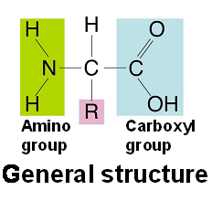
Amino Acid are linked together by peptide bonds (Monomer for Protein)
Contain an amino end (NH₂ and a carboxyl end (COOH)
20 different amino acids are commonly found in proteins

Slide 14
Proteins
Contain ELEMENTS - C, H, O, N, and some have S.
Control the rate of reactions. (enzymes are proteins)
Used to form bones and muscles
Transport substances into or out of cells or help to fight disease
FUNCTION:

Slide 15
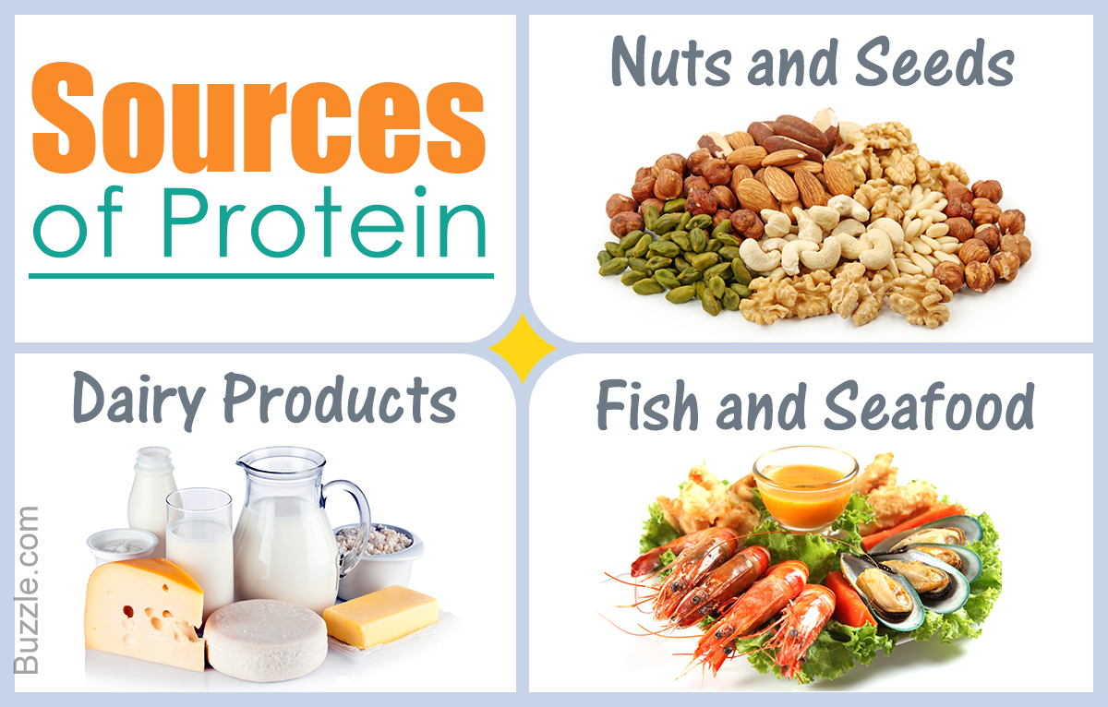
Protein SOURCES
1) MEAT
2) BEANS
3) NUTS
4) EGGS

Slide 16
Nucleic Acids
Monomer is the nucleotide
Consist of 3 parts
5-carbon sugar
A phosphate group
Nitrogenous base

Slide 17
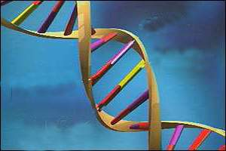
Nucleic Acids
DNA
Contains the elements C, H, O, N, and P
FUNCTION:
Store and transmit hereditary or genetic information

Slide 18
NUCLEIC ACID - EXAMPLES
RNA- ribonucleic acid
DNA- deoxyribonucleic acid

Slide 19
Carbon Macromolecules
Compounds
include
Carbohydrates
Lipids
Nucleic acids
Proteins
that consist of
that consist of
that consist of
that consist of
Sugars and
starches
Fats and oils
Nucleotides
Amino Acids
which contain
which contain
which contain
which contain
Carbon,
hydrogen,
oxygen
Carbon,
hydrogen,
oxygen
Carbon,hydrogen,
oxygen, nitrogen,
phosphorus
Carbon,
hydrogen,oxygen,
nitrogen,

